Slide 1
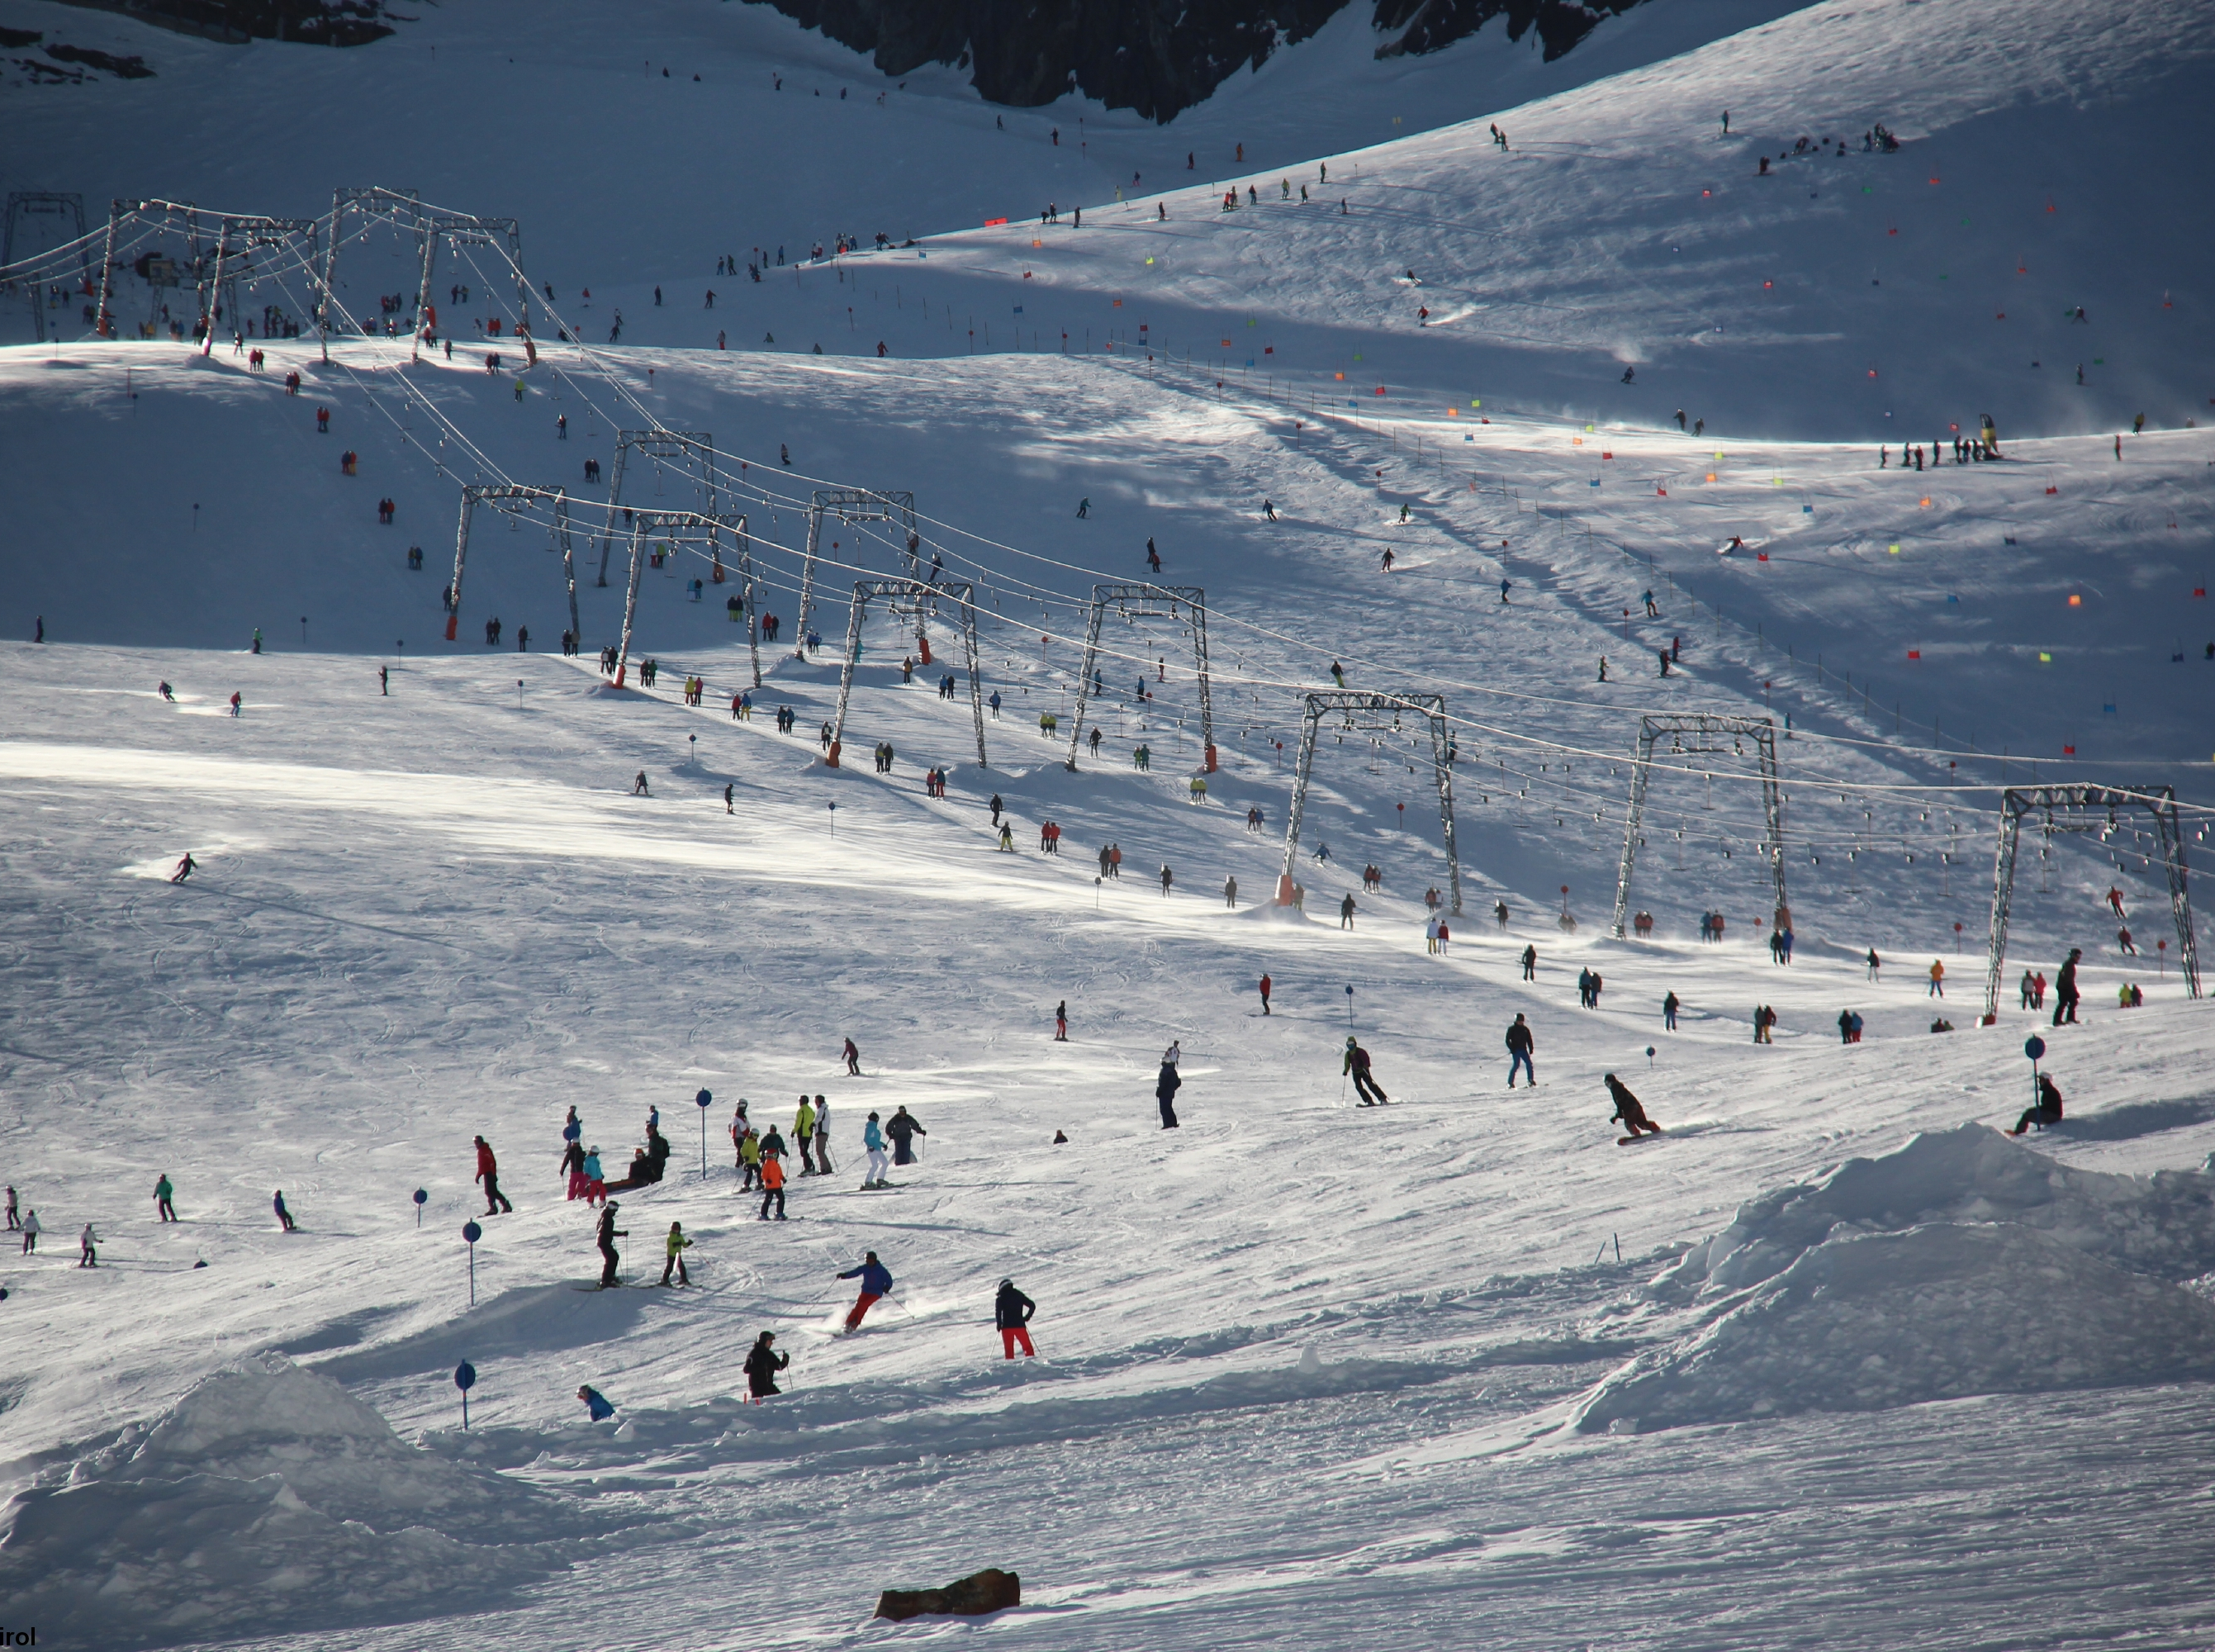


Emergency on the ski slope
© snow institute / LWD Tirol
Notes:
Even on a regular day skiing on marked pistes, accidents can happen. Whether you or your group are involved in an emergency, or you come across an accident, you should be prepared for such an event. The goal is to carry out the most important rescue measures correctly.
This topic is especially suitable for hands-on practice. Scenario training (role-playing) is extremely valuable to help you respond confidently and competently in a real emergency.

Slide 2

01 10 for 10
02 Initial assessment
03 Securing the accident site
04 Emergency call
05 First aid measures
06 Ski patrol
07 Conclusion

Slide 3
01 10 for 10
02 Initial assessment
03 Securing the accident site
04 Emergency call
05 First aid measures
06 Ski patrol
07 Conclusion

Slide 4
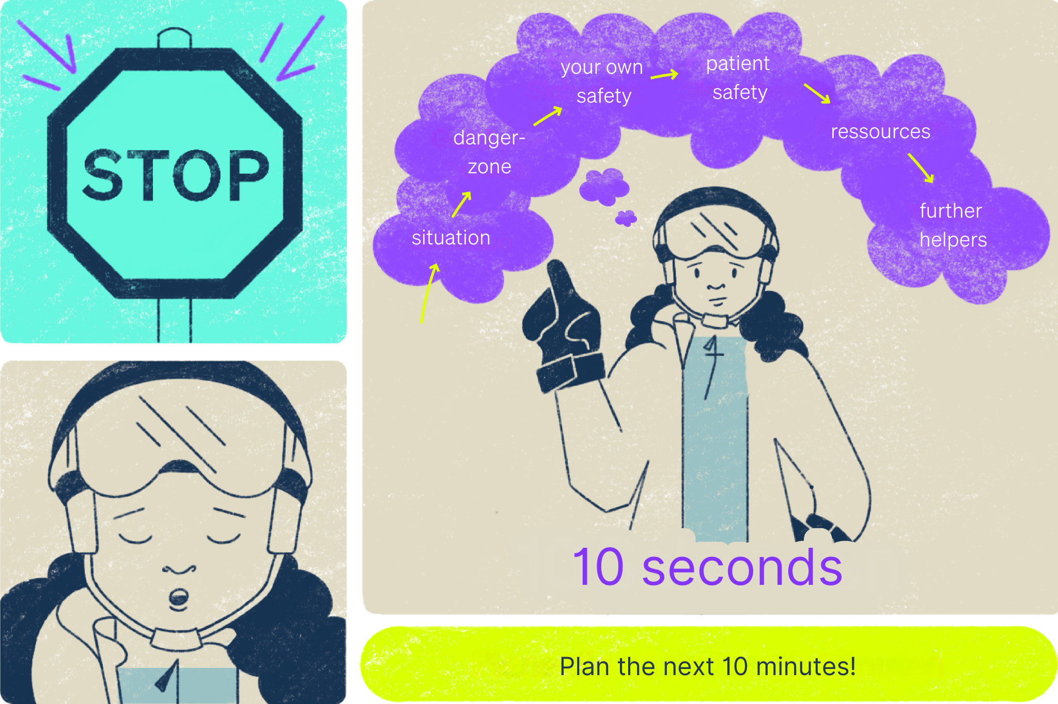
10 for 10
© snow institute
Notes:
First and foremost, it is important to stay calm and pay attention to your own safety. In an emergency, it’s easy to become overwhelmed and lose focus. Naturally, you will be nervous, so it’s crucial to regain your composure as quickly as possible in order to assess the situation. Taking a deep breath, as the saying goes, helps you to collect yourself. Then, you can work through the necessary steps one by one.
Always start with a “10 for 10.” “10 seconds for 10 minutes” means taking 10 seconds before each action to make a plan for the next 10 minutes. These 10 seconds are well spent and help save valuable time later by allowing you to understand the situation, check your resources, and decide on a course of action.

Slide 5
What would you do if your friend got injured on the slopes?

Slide 6
01 10 for 10
02 Initial assessment
03 Securing the accident site
04 Emergency call
05 First aid measures
06 Ski patrol
07 Conclusion

Slide 7
Initial assessment
Assess the situation
Identifying danger zones
Your own safety and patient safety
Further helpers and emergency call
© snow institute

Slide 8
Initial assessment
Assess the situation
What happened?
For example: A skier is lying on a ski path, has lost both skis and is complaining of pain.

Slide 9
Initial assessment
Identifying danger zones
Are there any potential dangers for the helper or the accident victim?
For example: other skiers/snowboarders, alpine hazards (off-piste)?

Slide 10
Initial assessment
Your own safety and patient safety
What about safety for the helpers and the patient?
For example: Can skiers descending the slope see the accident site and avoid it or not?

Slide 11
Initial assessment
Further helpers and emergency call
Can the helper handle the situation alone or with the group?
Should the emergency call be made immediately, or is there another priority?

Slide 12
01 10 for 10
02 Initial assessment
03 Securing the accident site
04 Emergency call
05 First aid measures
06 Ski patrol
07 Conclusion

Slide 13
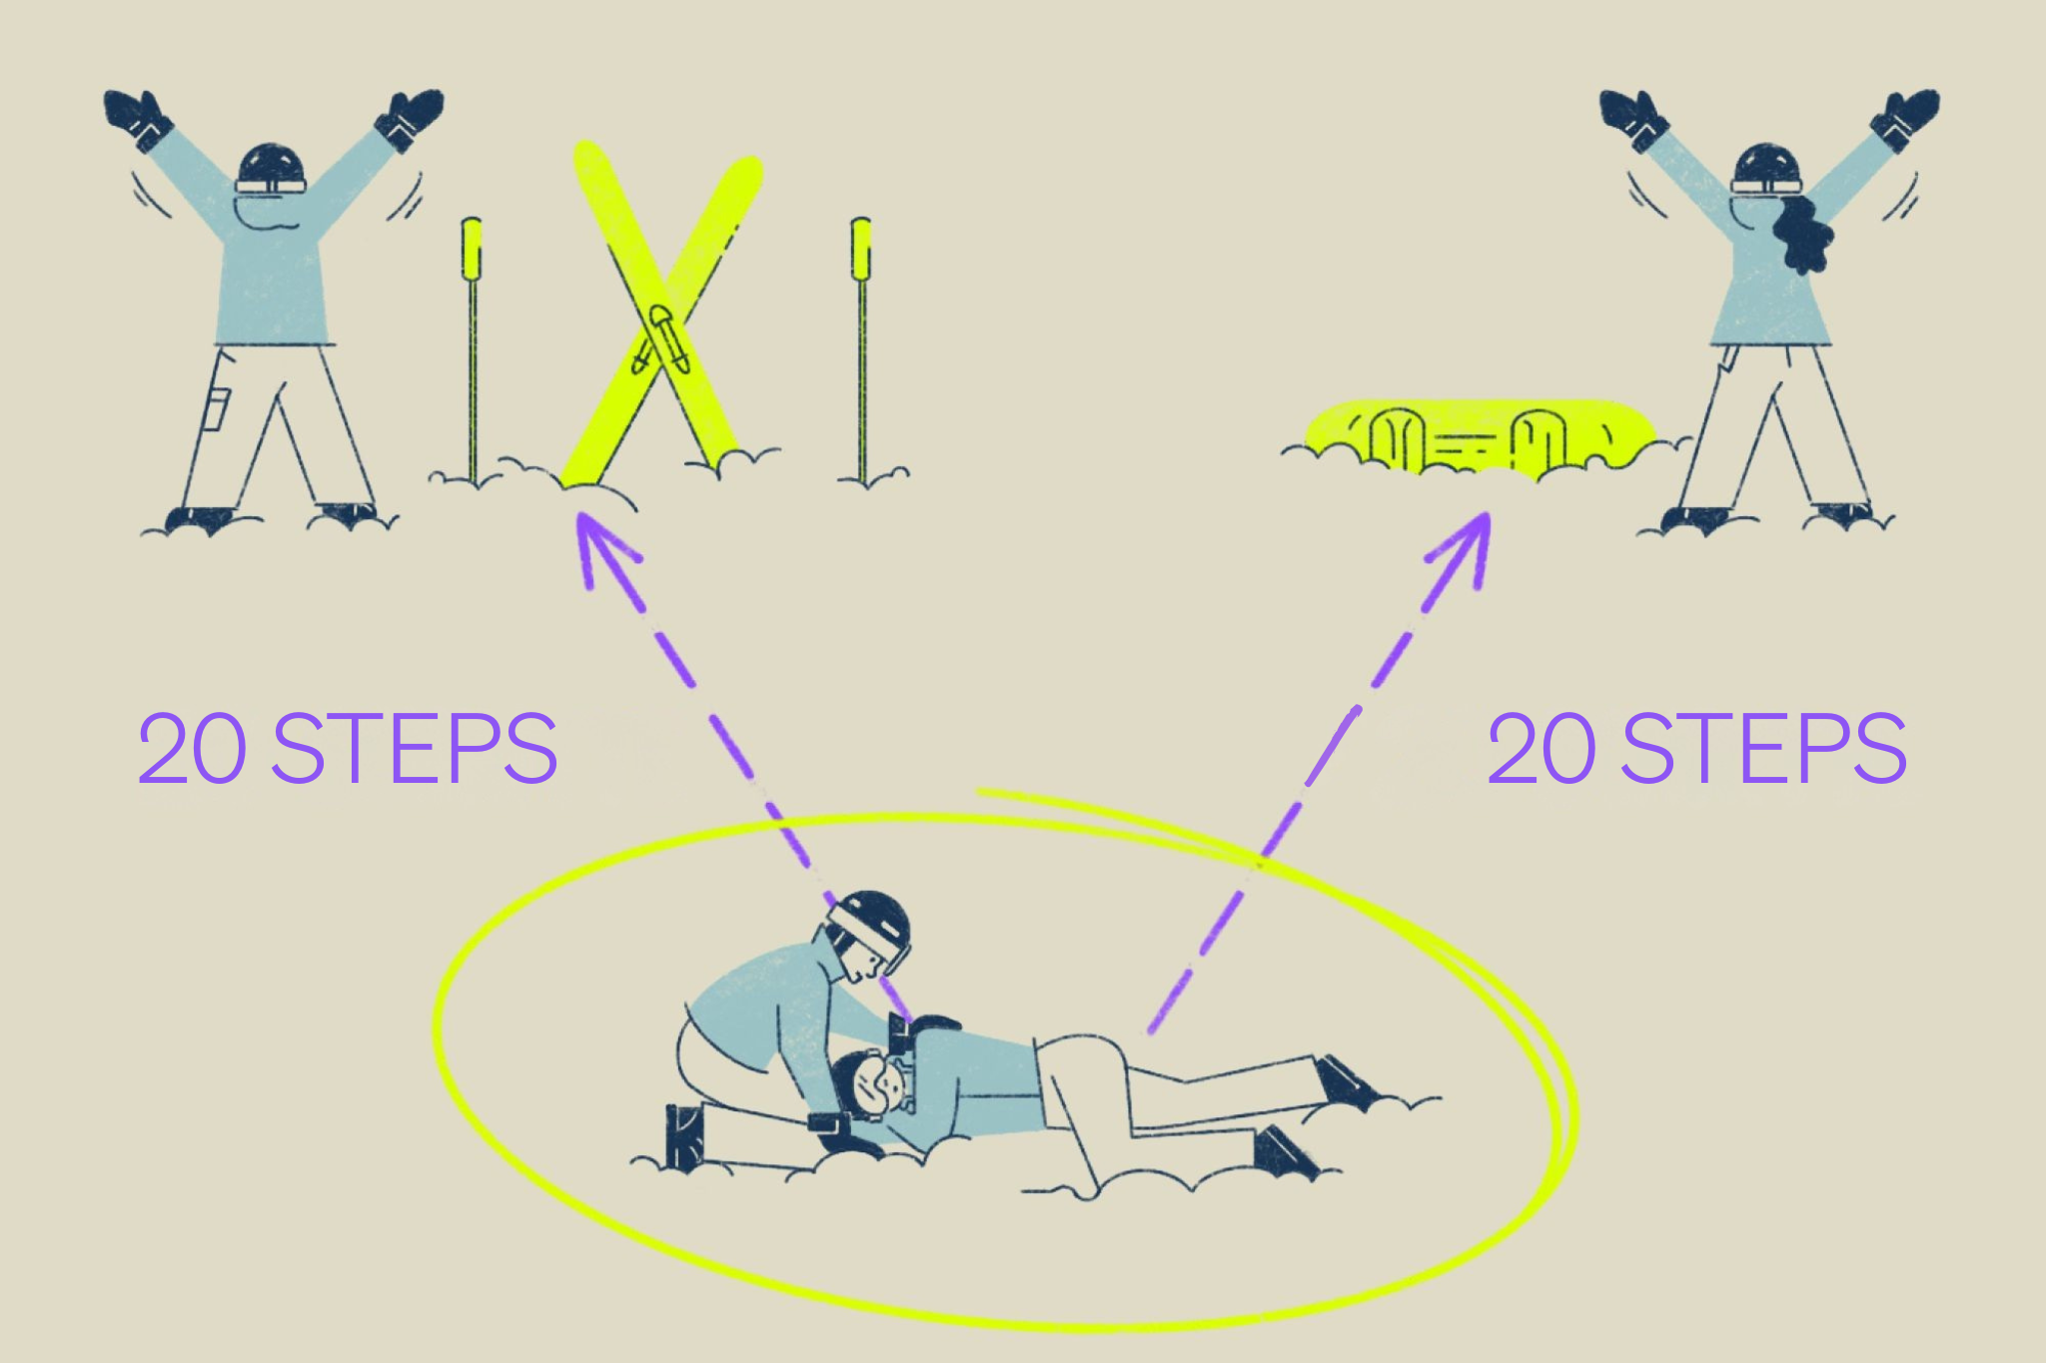
Securing the accident site
© snow institute
Notes:
After the initial assessment, the next step is to secure the accident site. As described, this can already be done while another person is calling emergency services.
If there is a danger, for example from other skiers, the accident site should be immediately secured by placing a ski cross about twenty steps uphill from the potential hazard. This internationally recognized marker for an accident site on a piste is made by planting skis crossed in the snow, signaling to all descending skiers that an accident has occurred. Alternatively, a snowboard can be placed across the slope with the binding facing down for securing the area.
Ideally, a helper – preferably wearing highly visible clothing – should stay by the barrier to warn other skiers. This person can also coordinate requests for additional help from others. For example, medical personnel are often present on the slopes and can offer assistance.

Slide 14
01 10 for 10
02 Initial assessment
03 Securing the accident site
04 Emergency call
05 First aid measures
06 Ski patrol
07 Conclusion

Slide 15
Who knows the emergency numbers?

Slide 16
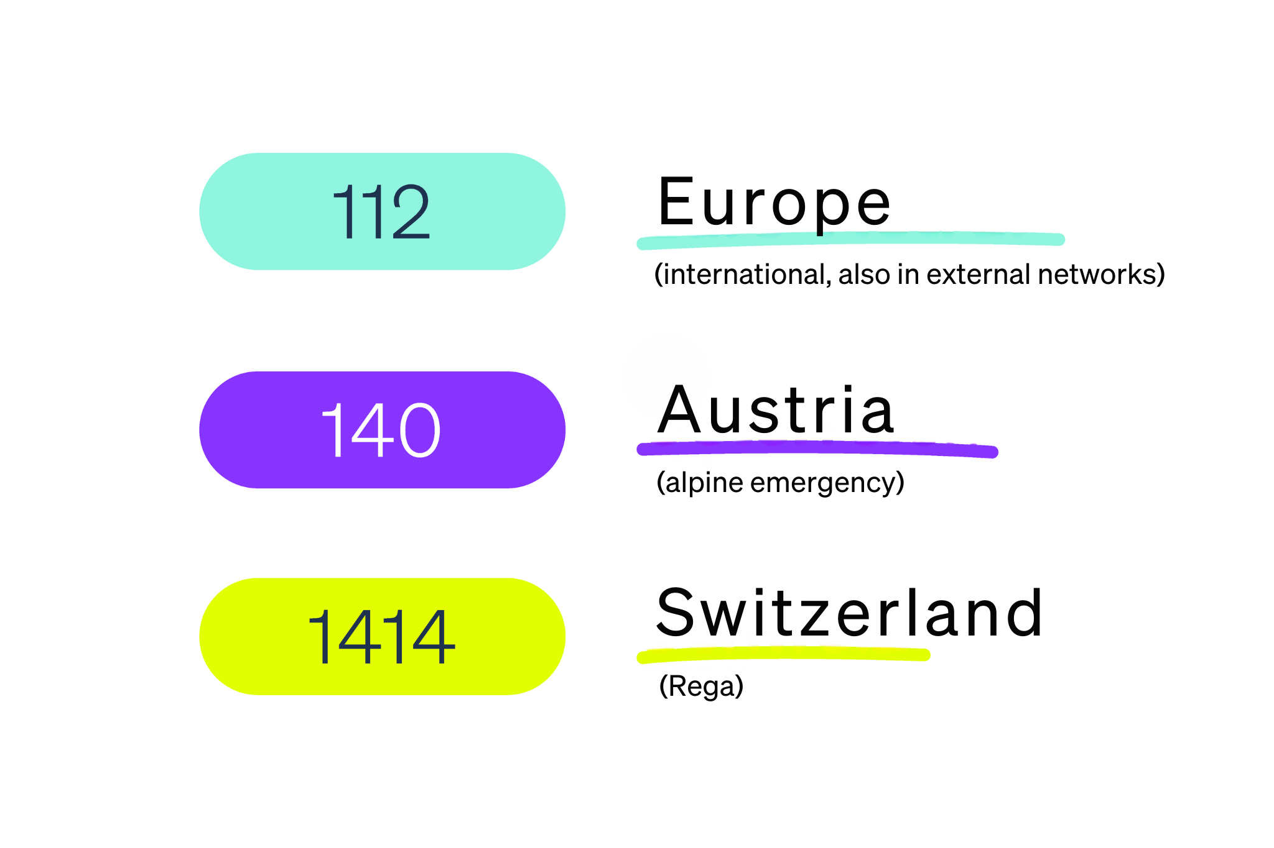
Emergency call
Timing depends on the situation
Questions from the control centre
Where is the accident site?
What happend?
© snow institute
Notes:
The timing of the emergency call varies depending on the situation. It can be made right after the initial assessment or later, once the severity of the injury or other factors become clear. Ideally, you have the local emergency numbers saved, or even better, a regional emergency app installed on your smartphone.
# Where is the accident location? For example: Nordkette ski area, Zweier run at the traverse path just below the base station of the triple chairlift.
# What happened? For example: A roughly 30-year-old female skier is lying on the slope after a fall, complaining of knee pain and unable to stand up.
When you make the call, the dispatcher follows a protocol and guides you through a series of questions. If something is unclear, they will ask additional relevant questions. The person at the emergency center remains your contact and can also provide guidance for further first aid measures.

Slide 17
Emergency call
No network coverage
Attract attention (calls for help, whistle)
Change of location
Get help (e.g. nearest lift station)
© snow institute

Slide 18
01 10 for 10
02 Initial assessment
03 Securing the accident site
04 Emergency call
05 First aid measures
06 Ski patrol
07 Conclusion

Slide 19
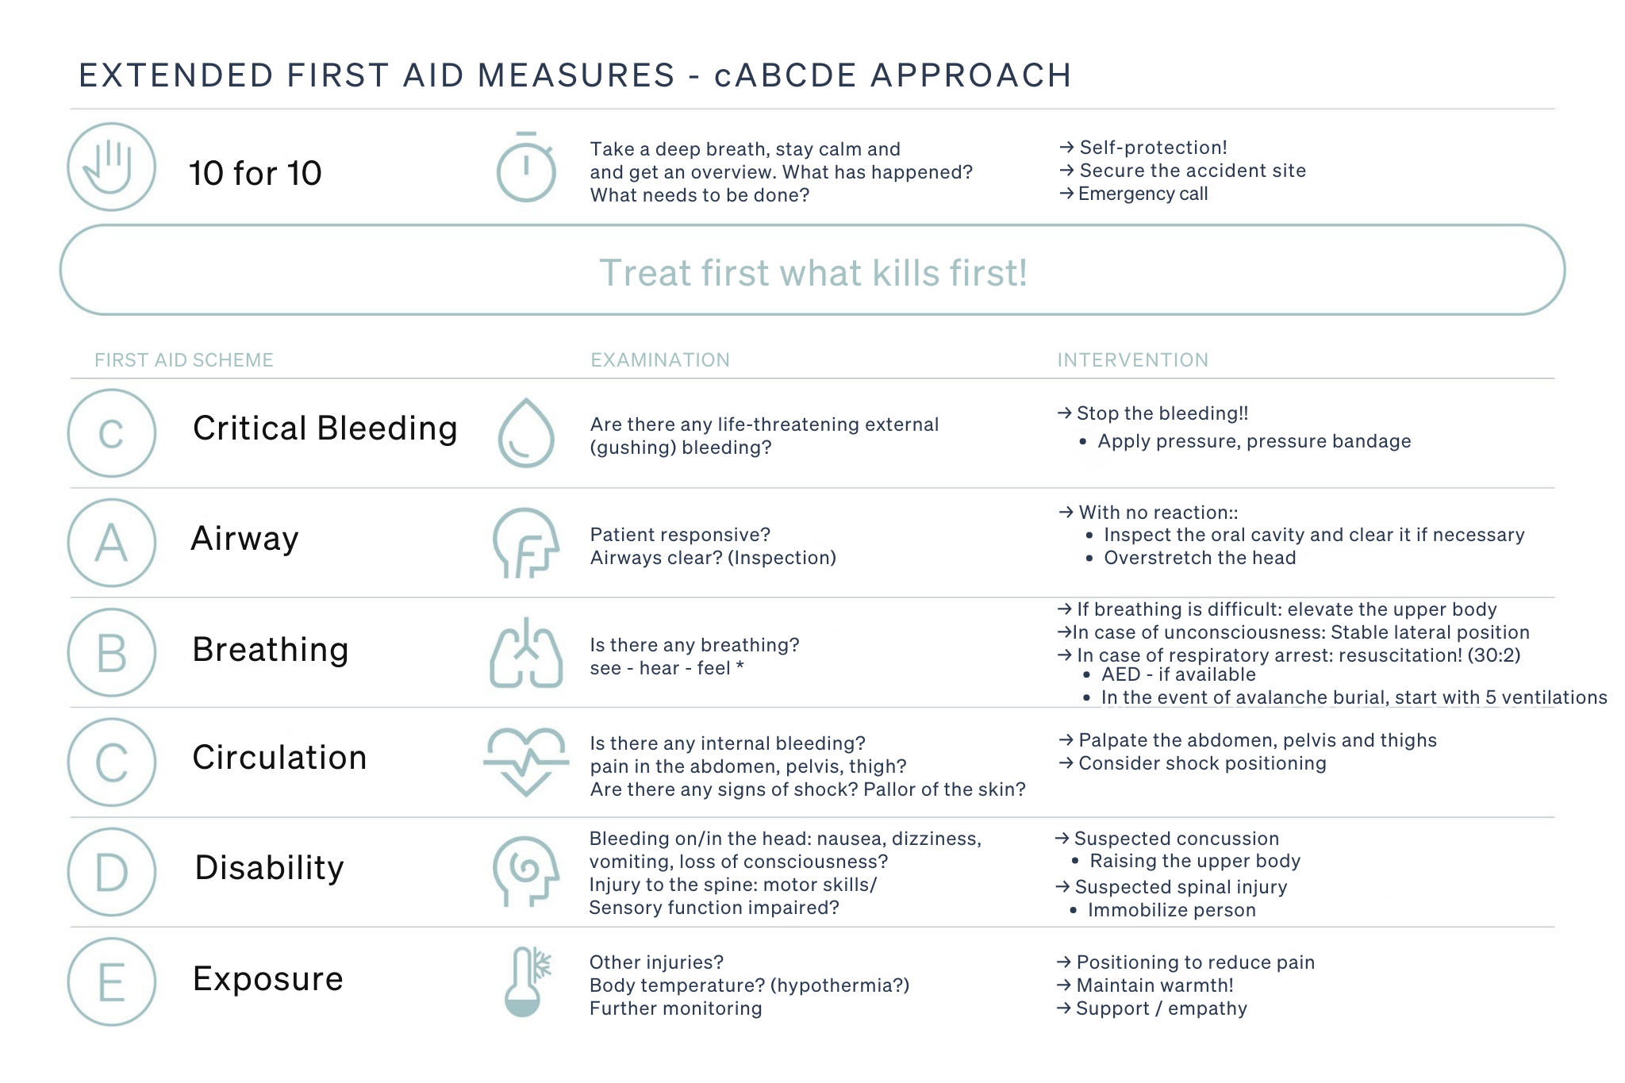
First aid measures : cABCDE-Scheme
Priority principle
Approach
Is there life-threatening bleeding?
Are the vital functions present?
Do a body check
Pain-reducing positioning
© snow institute

Slide 20
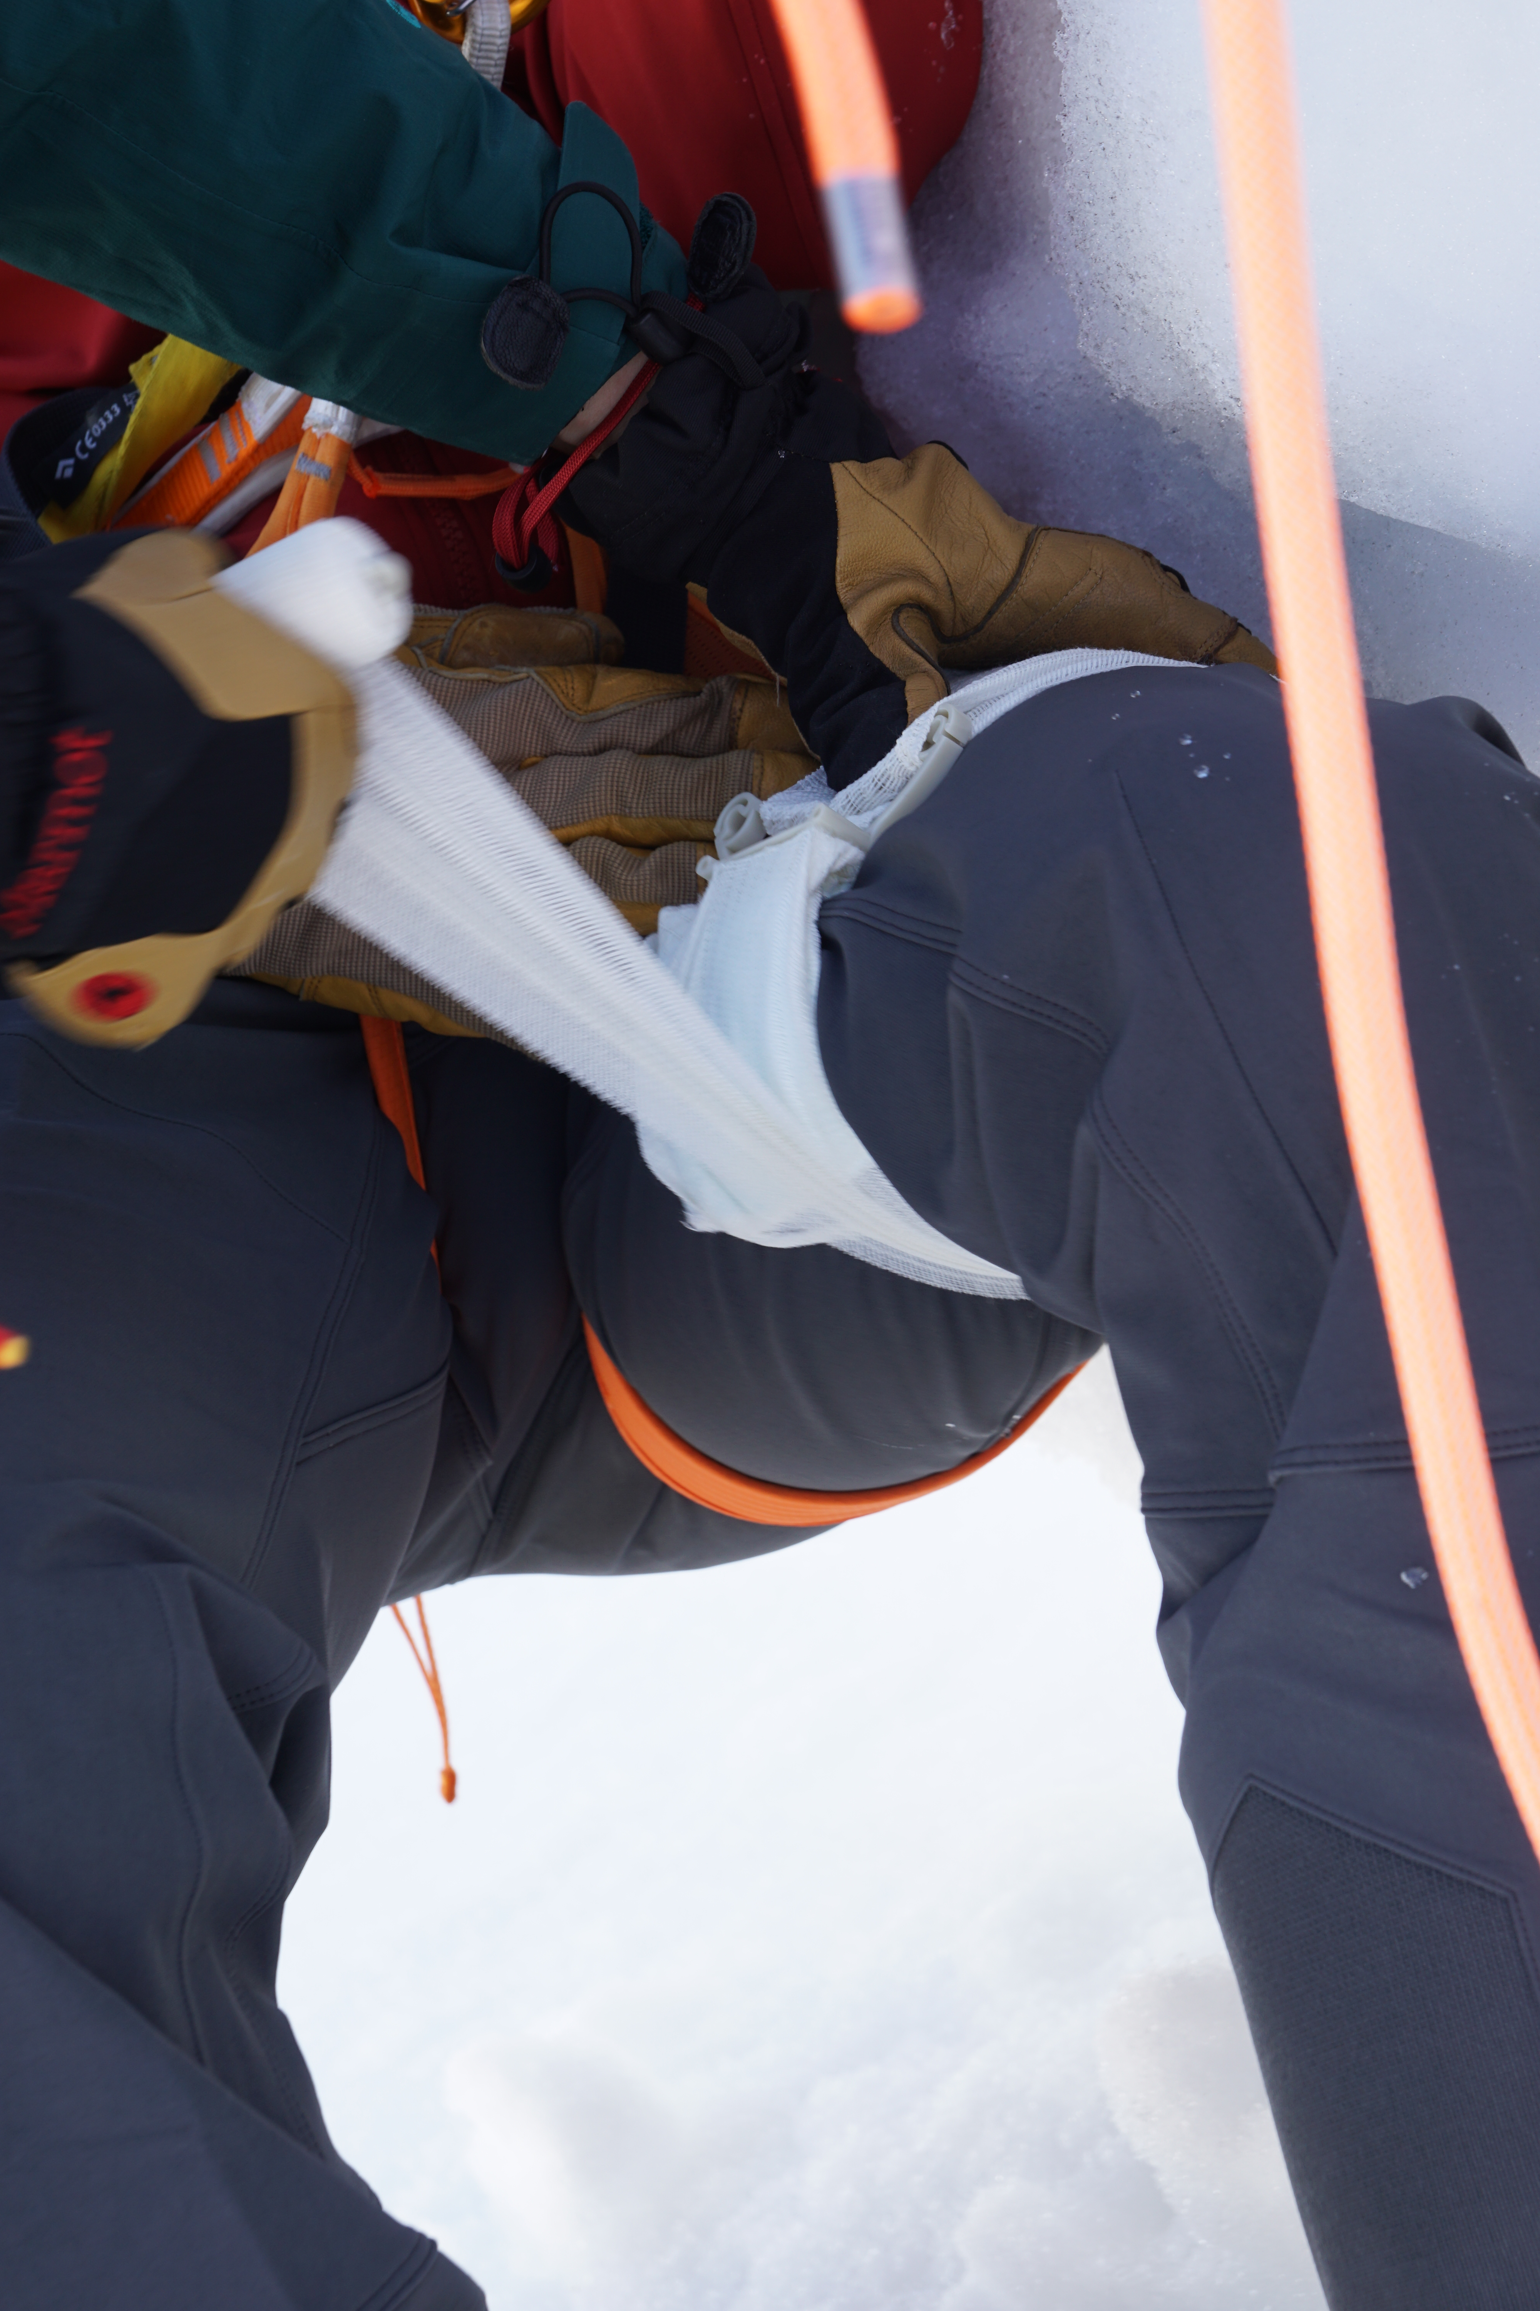
First aid measures
Life-threatening bleeding
Extremely heavy, gushing external bleeding
Apply pressure immediately and/or apply a pressure bandage
© snow institute / argonaut.pro
Notes:
Cuts from ski or snowboard edges are a recurring issue in this context.

Slide 21
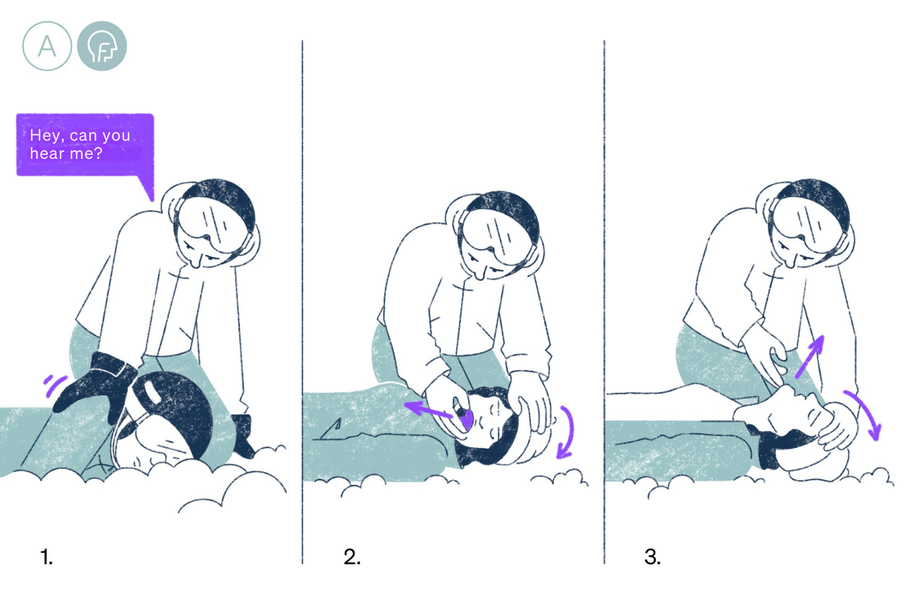
First aid measures
Approach
If possible, approach the injured person from the front.
Touch them gently
‘What happened?’
© snow institute
Notes:
The question ‘What happened?’ provides you with information about whether the person
-is responsive
-is oriented
-has pain
Measures: no response -> inspect the oral cavity and clear it if necessary

Slide 22
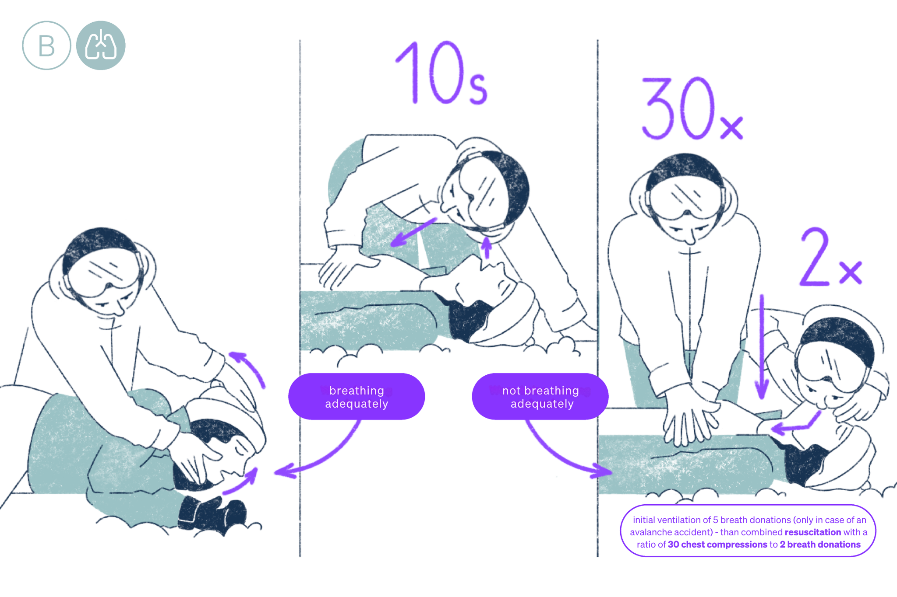
First aid measures
Check of vital functions
„see – hear – feel“
Airways clear?
Breathing present?
© snow institute
Notes:
Is the person breathing? (Check by seeing, hearing and feeling)
Actions: YES – recovery position; NO – resuscitation

Slide 23
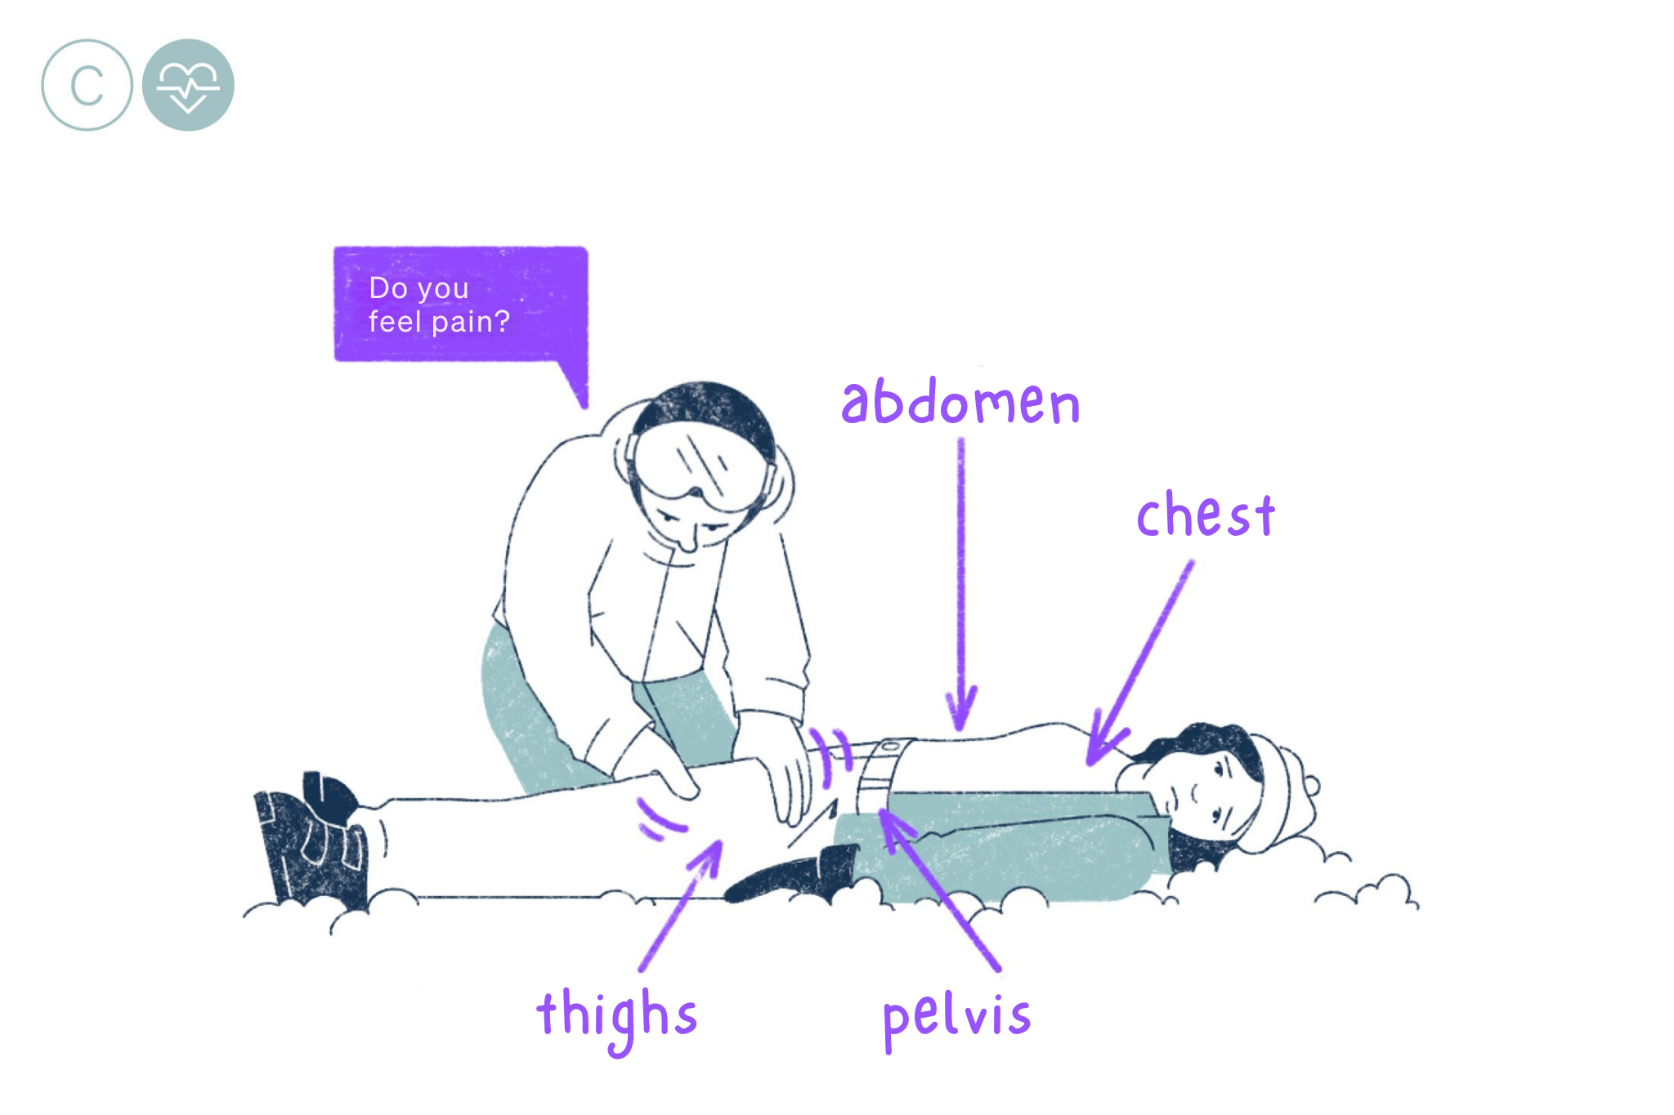
First aid measures
Bodycheck
Check patient for injuries
Palpation of abdomen, pelvis, legs
© snow institute
Notes:
Is there any internal bleeding? Pain in the legs, abdomen or arms? Signs of shock (e.g. pale skin)?
Measures: Palpate and apply shock bandage if necessary.

Slide 24
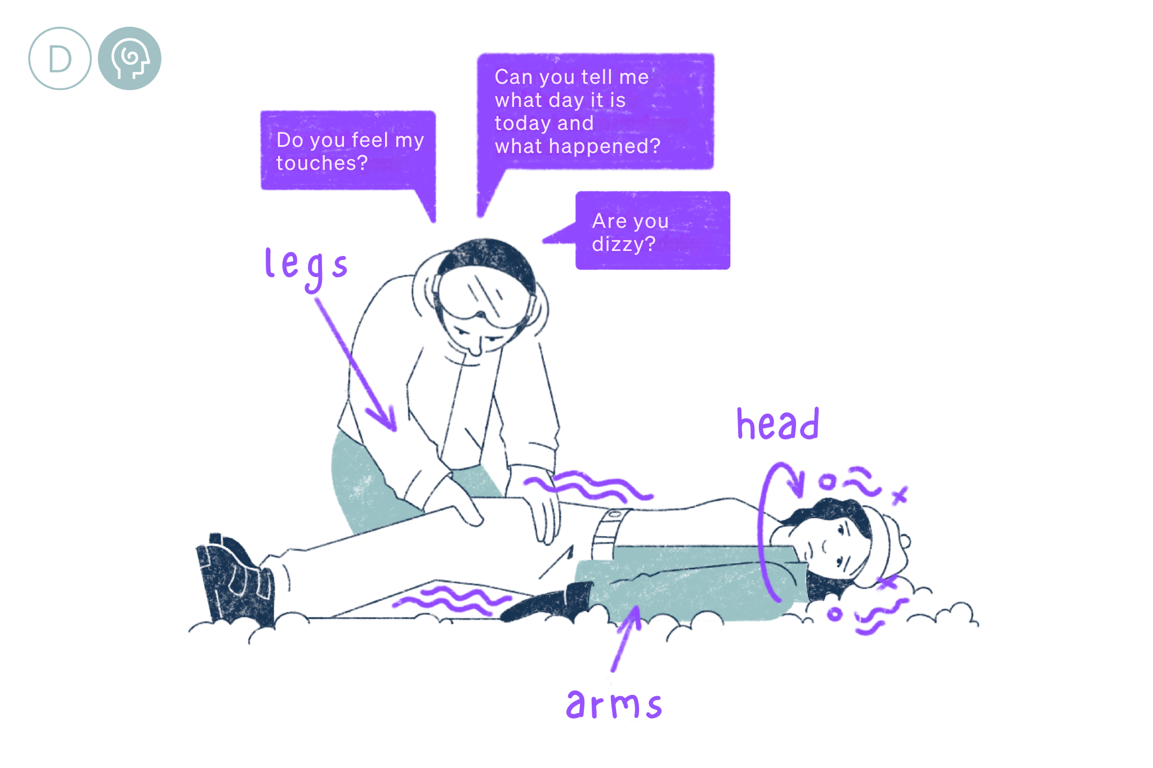
First aid measures
Head/spinal injuries
Nausea, dizziness, impaired consciousness
Motor/sensory problems
Adjust positioning
© snow institute
Notes:
Is the person complaining of nausea, dizziness or impaired consciousness? Are their motor skills or sensory functions impaired?
Measures: as a first aider, you can only position the person accordingly if you suspect this to be the case. Head injury -> upper body raised; spinal injury -> immobilise

Slide 25
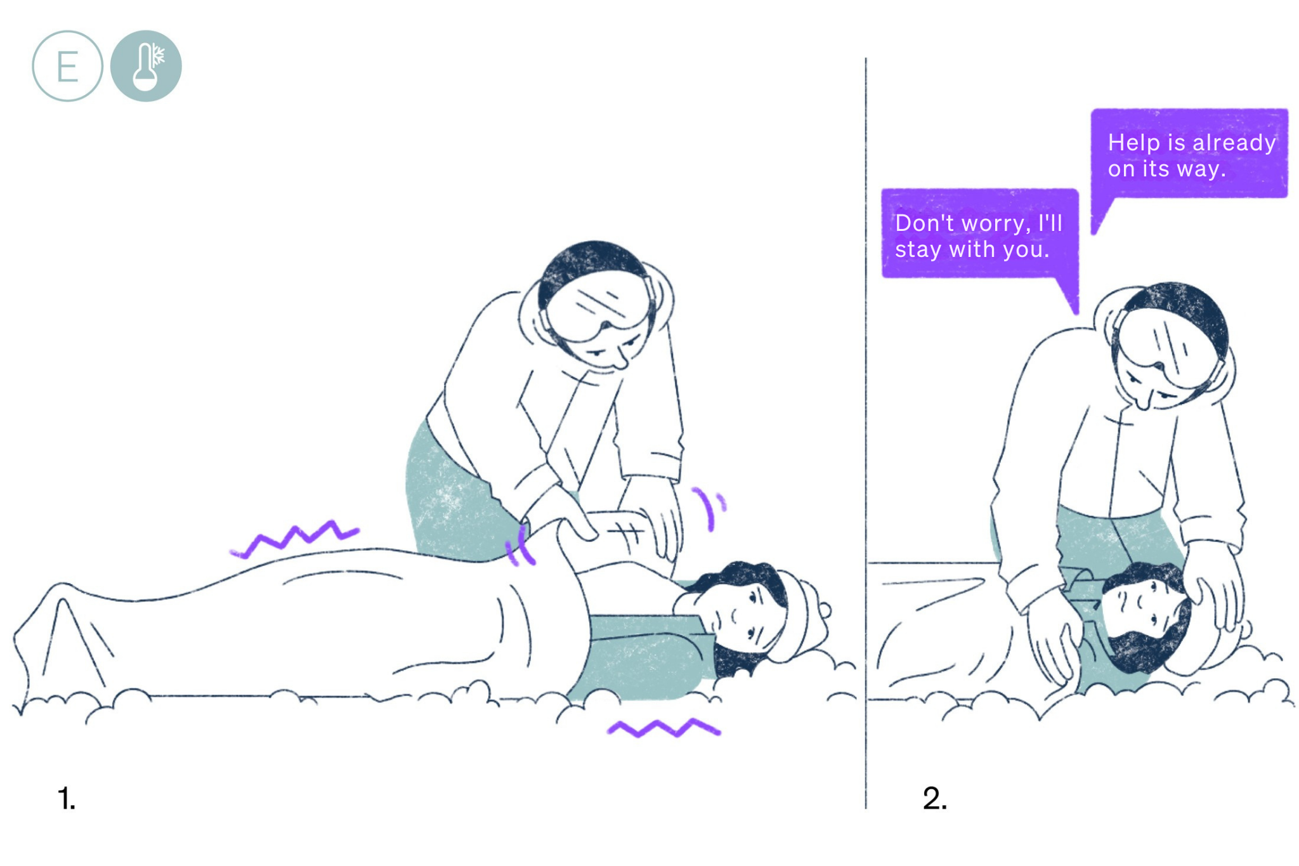
First aid measures
Adjust positioning
Painless position
Thermal management
Blankets (down jacket)
Putting on a cap
Show empathy
Be there!
© snow institute
Notes:
Other injuries present? Risk of hypothermia? Actions: Monitor the person, treat any additional injuries if necessary, manage warmth, and show empathy.
Maintaining warmth: Since we can usually expect rescue personnel to arrive quickly on the slope, maintaining warmth is not as critical. Still, you can cover the injured person to improve their comfort, put on a hat, and put on gloves.

Slide 26
01 10 for 10
02 Initial assessment
03 Securing the accident site
04 Emergency call
05 First aid measures
06 Ski patrol
07 Conclusion

Slide 27
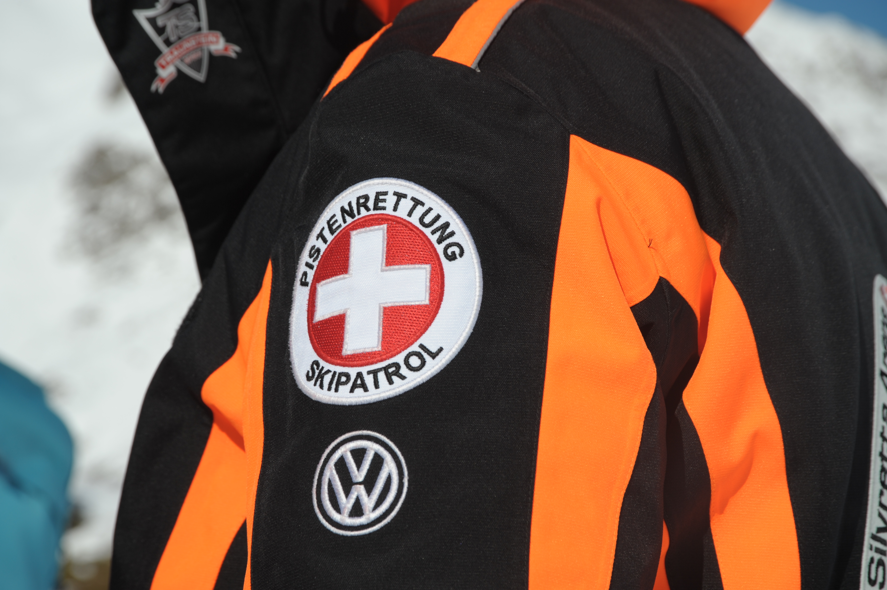
Support the ski patroler
Share information
Remain on site
Help if necessary (following the instructions of the emergency services)
© snow institute/argonaut.pro
Notes:
When the ski patrol arrives, you should draw their attention to yourself and assist them as best you can. The ski patrol will ask for all the information they need about the accident. A brief description of what happened and the situation is usually sufficient. Stay at the scene as a first responder, but do not get in the way of the rescue team – if they need your assistance, they will give you instructions.

Slide 28
01 10 for 10
02 Initial assessment
03 Securing the accident site
04 Emergency call
05 First aid measures
06 Ski patrol
07 Conclusion

Slide 29
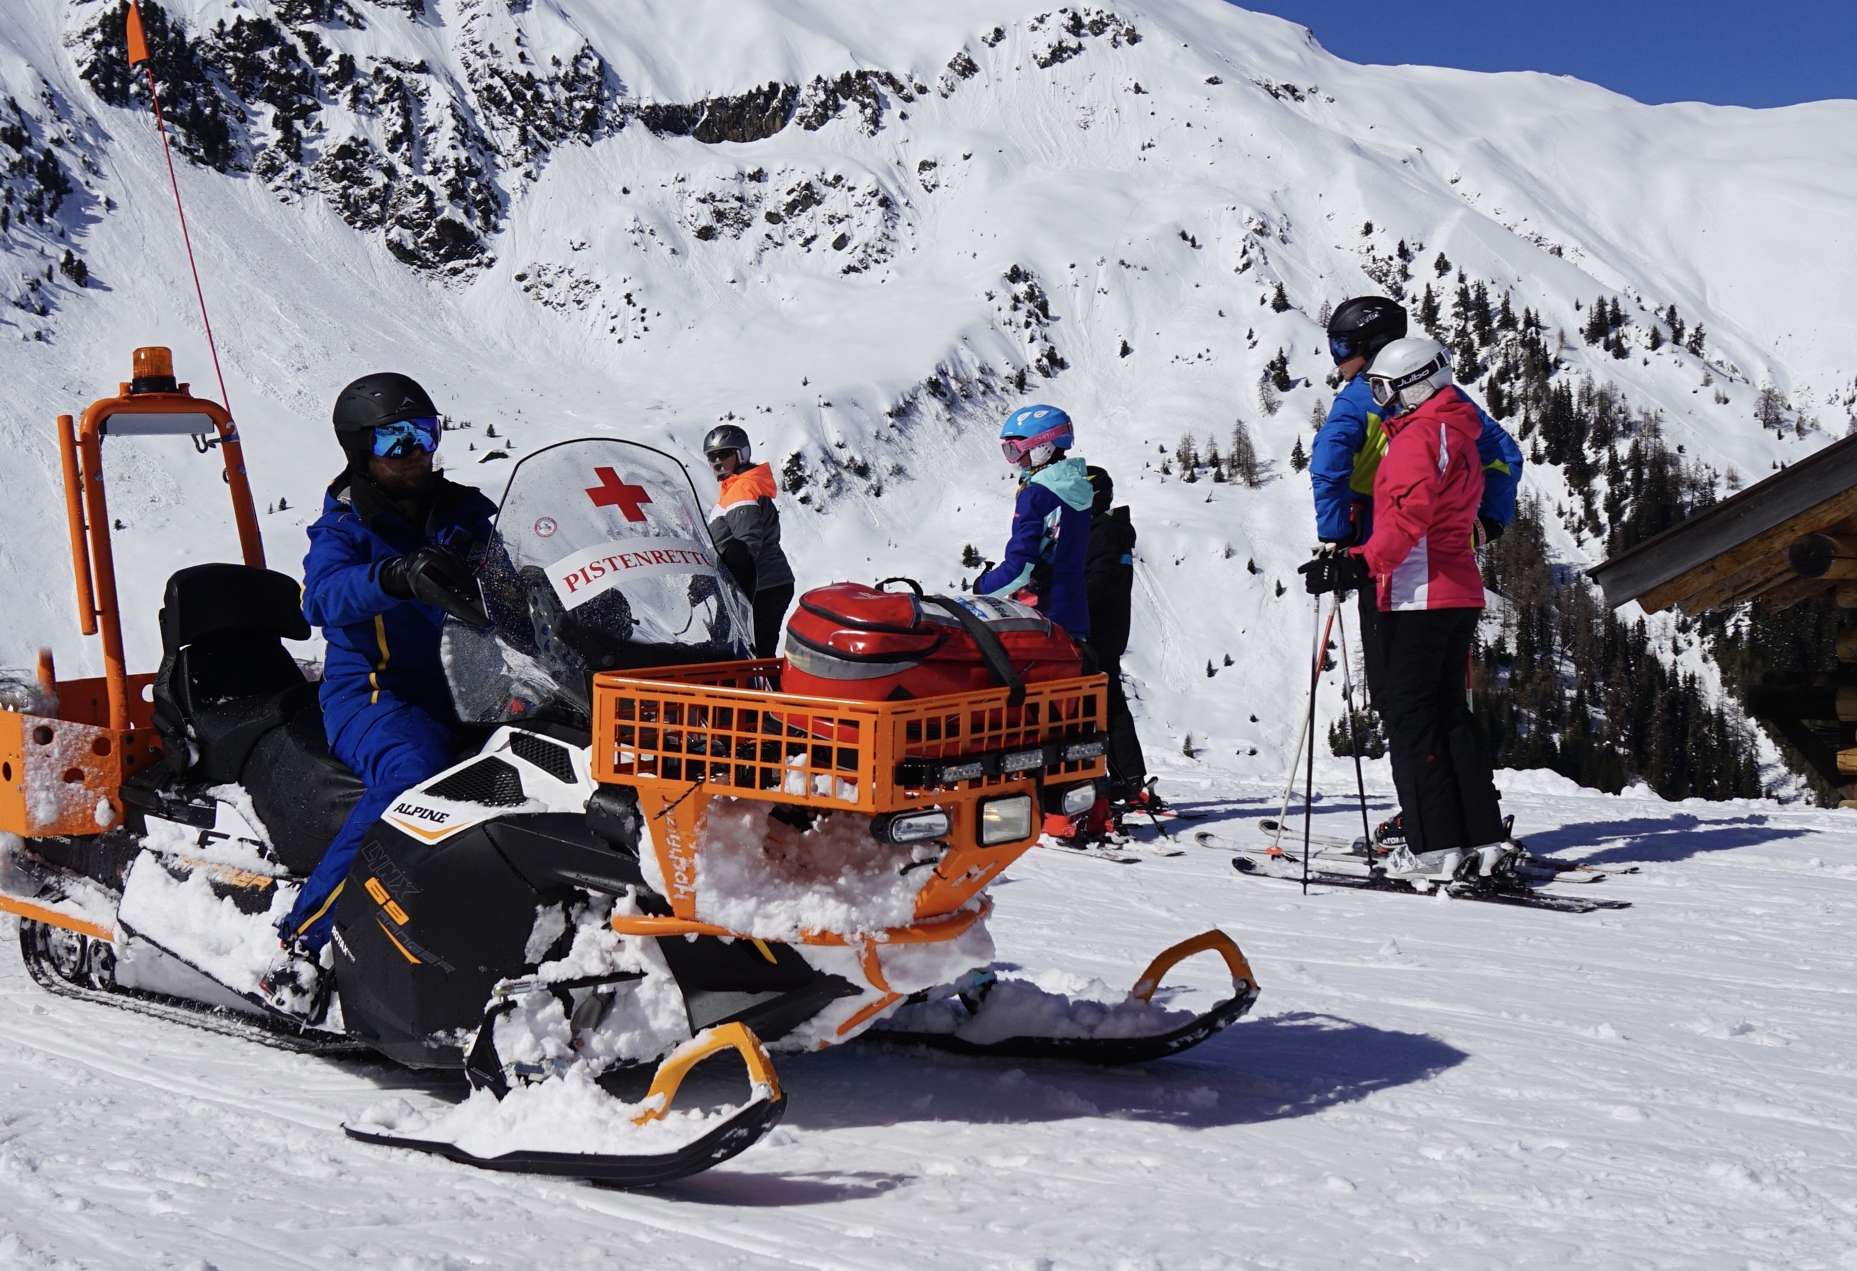
Conclusion
Everyone should and can help in an emergency!
Self-protection before protecting others!
Emergency call!
Practice helps you to react confidently and competently in an emergency!
© snow institute/argonaut.pro

Slide 30
Have fun on the slopes! ☺

