Slide 1
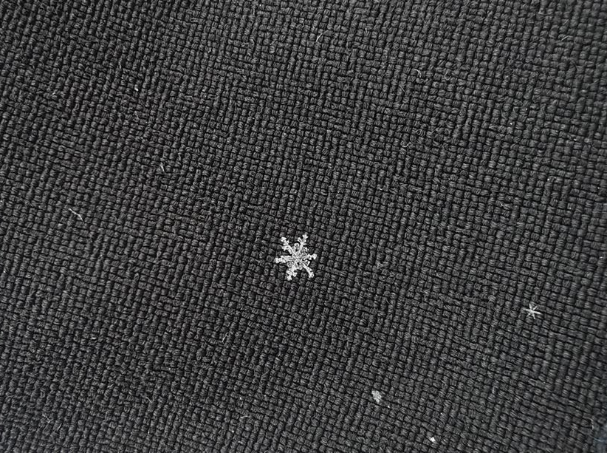


Physical properties of snow Part 2
© snow institute / LWD Tirol

Slide 2
01 Why is snow cold?
02 How heavy is snow?
03 Thermal conductivity of air, ice and water
04 The snow metamorphosis

Slide 3
01 Why is snow cold?
02 How heavy is snow?
03 Thermal conductivity of air, ice and water
04 The snow metamorphosis

Slide 4
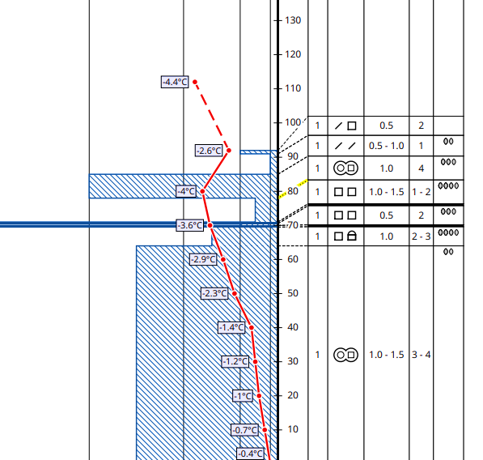
Why is snow cold?
Temperature of snow
under 0 °C
Snow temperature is lower than our body temperature
Actually, snow is a hot material.
© snow institute / LWD Tirol
Notes:
*The red line is the snow temperature, measured every 10 cm. At the very bottom, it is always close to 0°C – snow cannot be above 0°C, here we see areas ranging from -0.4°C to a maximum of -3.6°C. The air temperature – the top of the red line – was -4.4°C on this day.
For us humans, snow is cold because its temperature is below our body temperature. When snow falls on our skin, it draws heat from our bodies, making us feel cold. Even though snow feels cold to us humans, snow itself is actually quite hot here on Earth. To understand this, we need to understand the concept of homologous temperature.

Slide 5
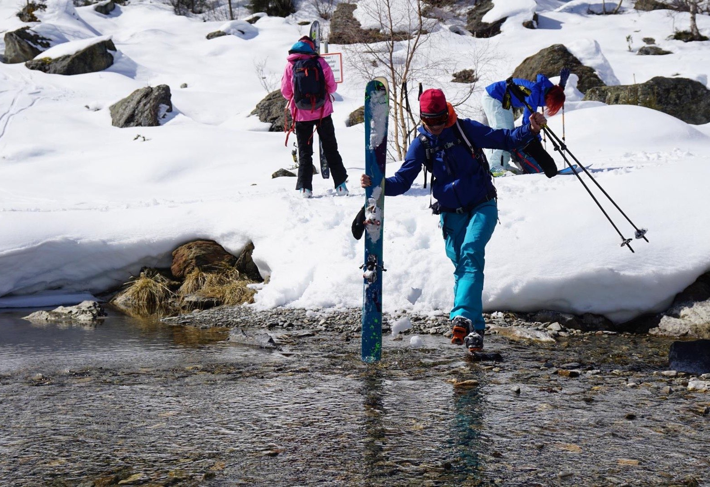
Why is snow cold?
Temperature of snow
The melting point of snow is 0°C
Snow temperature: ~ -20°C to -5°C
Comparison: Melting point of aluminium: ~ 660°C → very far from its own temperature
© snow institute / argonaut.pro
Notes:
To understand this, we need to know the concept of homologous temperature. It describes the temperature at which a material, in this case snow or ice, melts. The homologous temperature of snow is 0°C. Since snow in our latitudes rarely gets colder than -30°C, its temperature is always quite close to its homologous temperature, i.e. always very close to its melting point, which feels very hot to the material snow itself. If we take the homologous temperature as a reference, we can even refer to snow as a hot material.
Snow therefore has high thermal activity. What seems strange at first glance becomes logical when this phenomenon is compared with other materials that we humans perceive as hot anyway. Let's compare snow with a metal: aluminium, for example, has a melting point of approx. 660 °C. Normally, aluminium is therefore very far from its melting point compared to snow. Snow, on the other hand, is permanently very close to melting, which causes water molecules to constantly detach themselves from the ice grains and transition into the gaseous phase, sublimating into water vapour.

Slide 6
01 Why is snow cold?
02 How heavy is snow?
03 Thermal conductivity of air, ice and water
04 The snow metamorphosis

Slide 7
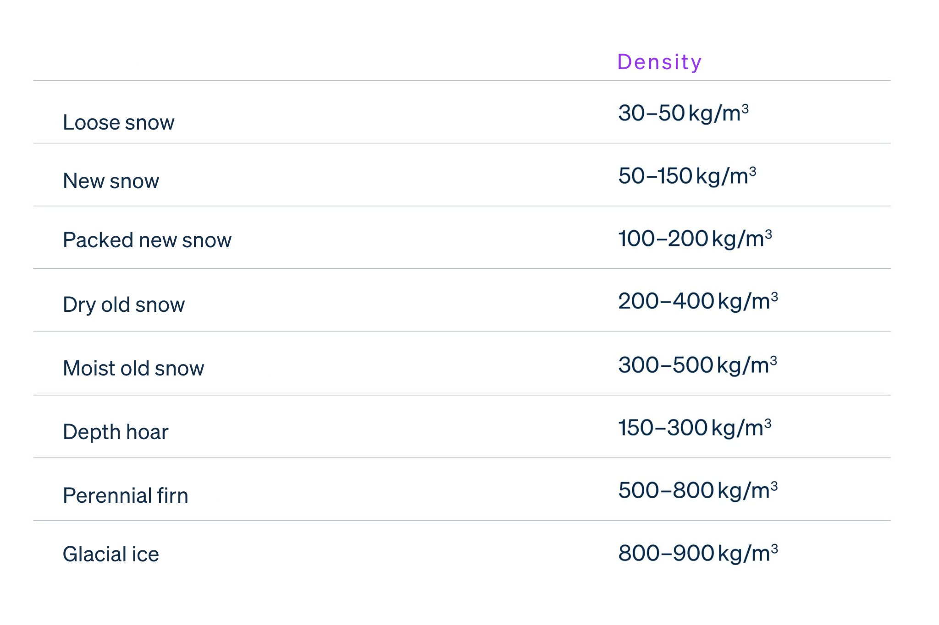
How heavy is snow?
Density or porosity
It can be really different!
Specified in kilograms per area (=density)
Depending on the amount of water and air in the snow
© snow institute
Notes:
The weight of snow can vary greatly. For this reason, snow is not measured or specified in units of mass (such as kilograms), but always in relation to a reference volume (such as cubic meters). In this context, we no longer refer to the weight of snow, but to its density.
The density of a material is defined as its mass per unit of volume.
In general, snow has a lower density than water, which means that a given volume of snow has less mass than the same volume of water.

Slide 8
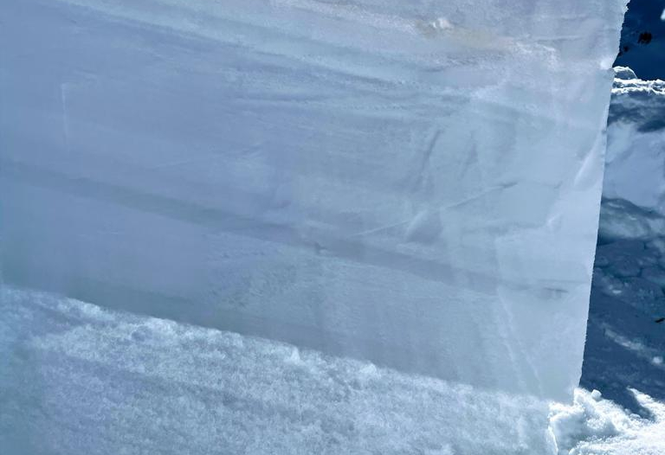
How heavy is snow?
Density or porosity
Dry snow (little water, lots of air): low density – light
Wet snow (lots of water, little air): high density – heavy
© snow institute / LWD Tirol
Notes:
This concept can also be used to describe the density of dry snow (i.e. snow consisting solely of ice) and wet snow. In this context, ‘dry’ means that the snow consists solely of ice crystals, while ‘wet’ snow consists of a mixture of ice crystals and water. Due to its structure and whether it is dry or wet, snow can have widely varying density values (see table). The maximum density value of snow is when it appears as pure ice, which weighs 917 kg/m³.

Slide 9
01 Why is snow cold?
02 How heavy is snow?
03 Thermal conductivity of air, ice and water
04 The snow metamorphosis

Slide 10
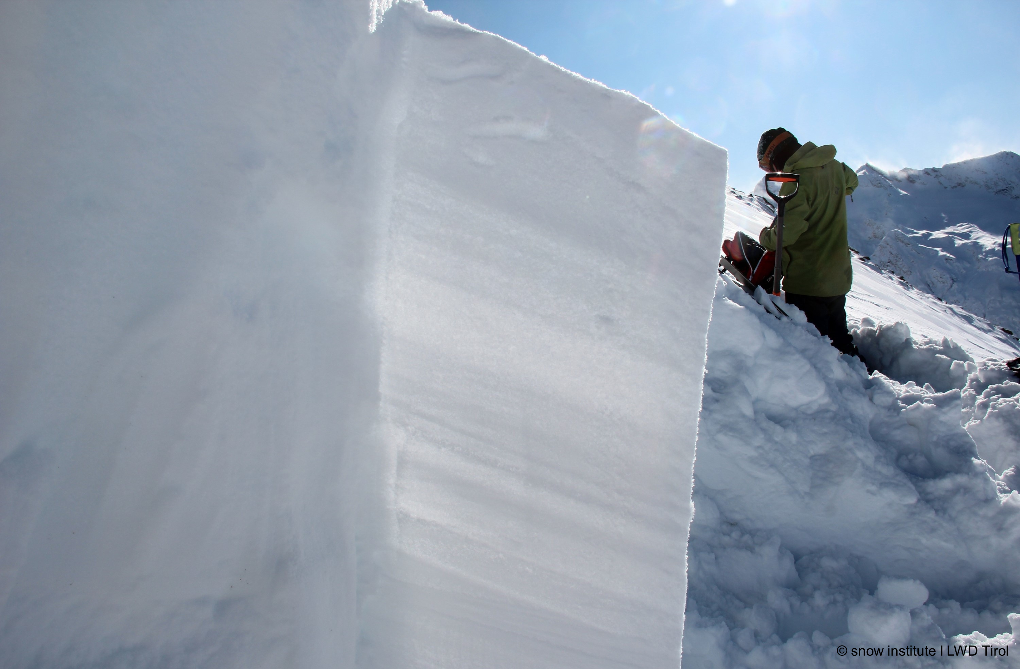
Thermal conductivity of air, ice and water
Air, ice and water: poor heat conductors.
This means that snow is also a poor heat conductor.
Consequence: porous snow (high air content, low ice content) has a strong insulating effect.
© snow institute / LWD Tirol
Notes:
Why is this important/interesting? An insulating layer of snow (i.e. a porous layer of snow) within the snowpack has a negative effect on snow metamorphosis.

Slide 11
01 Why is snow cold?
02 How heavy is snow?
03 Thermal conductivity of air, ice and water
04 The snow metamorphosis

Slide 12

The snow metamorphosis
Metamorphosis = transformation
Change in snow crystals within the snowpack or on the snow surface
Can have a negative or positive effect on the stability of the snowpack.
© snow institute / LWD Tirol
Notes:
The snow cover is highly susceptible to transformation, as snow changes from the moment it falls to the ground and remains there. How quickly and extensively this transformation occurs depends on the temperature, the density of the snow (= porosity) and the weight of the snow layers above it.

Slide 13
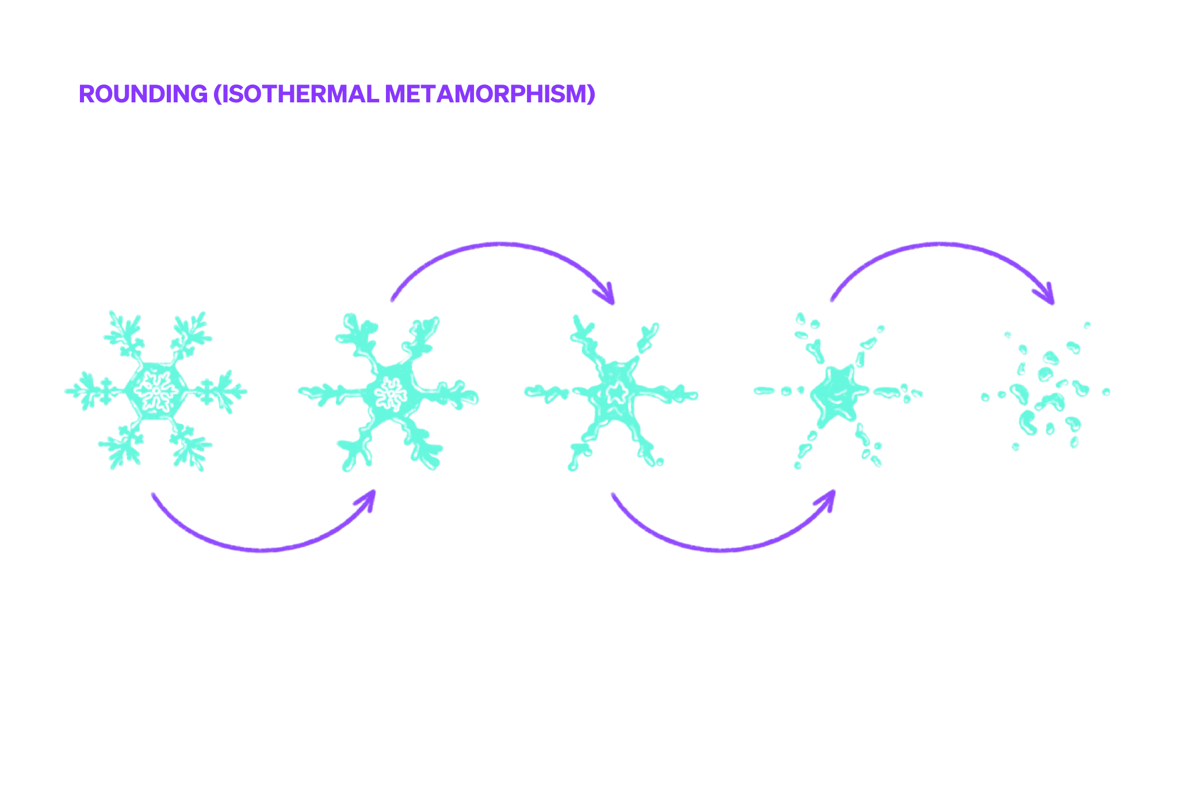
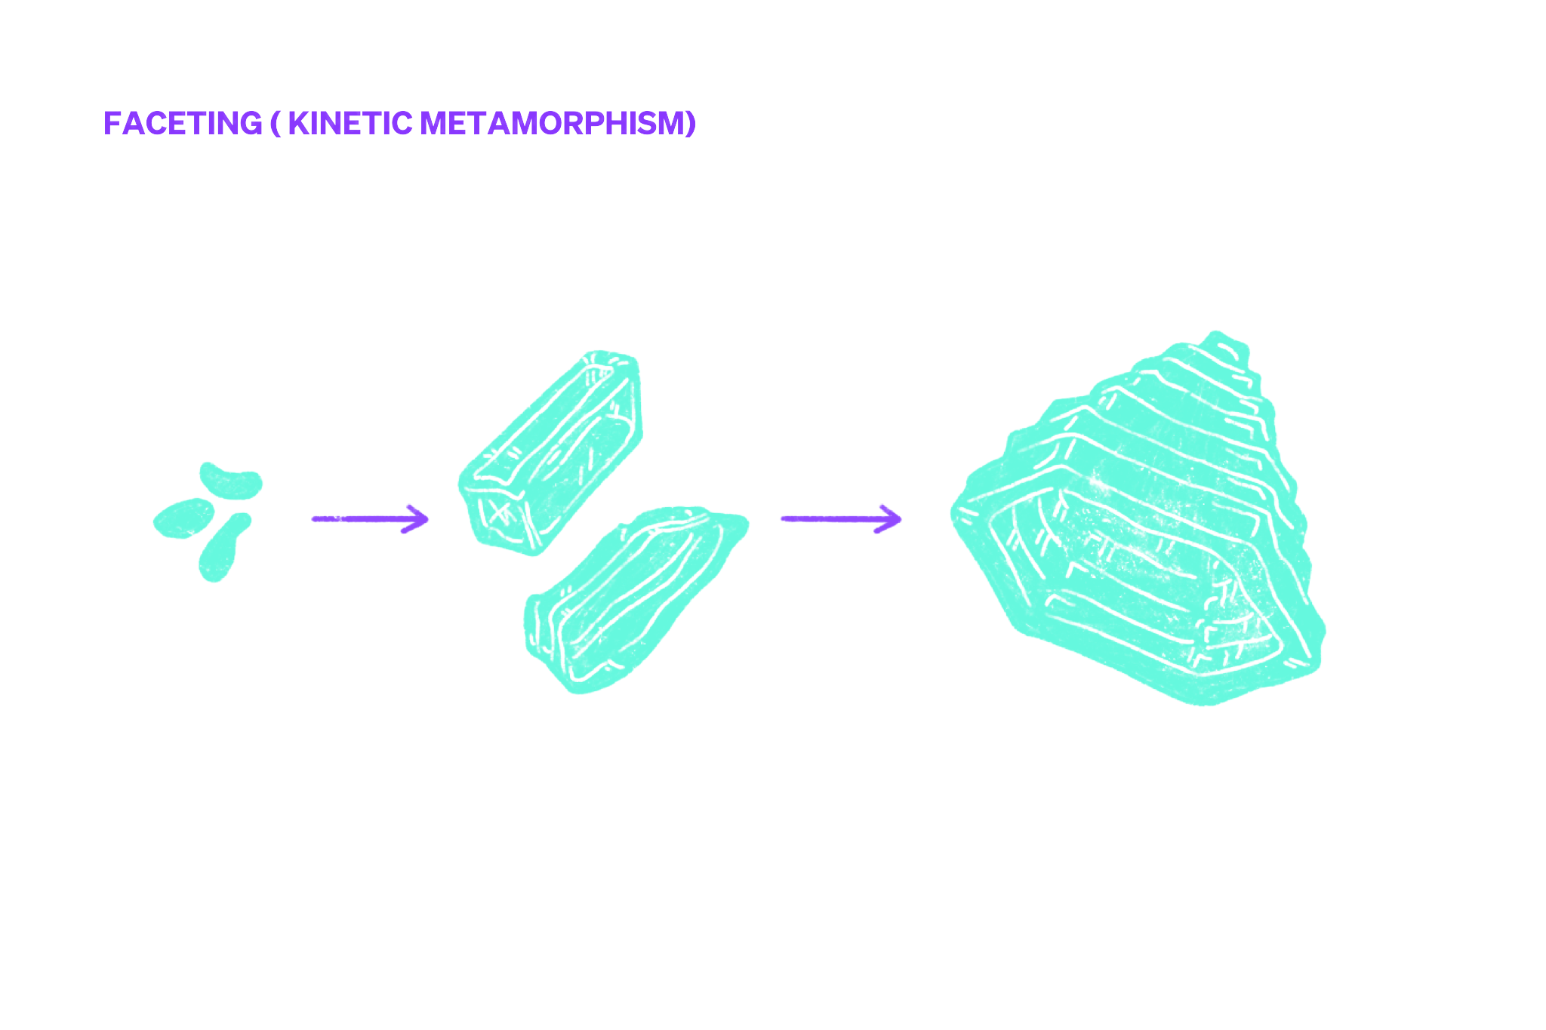
The snow metamorphosis
3 Types of transformation
Rounding
Faceting
Melt freeze metamorphism
© Lisa Manneh / snow institute
Notes:
How quickly and extensively this transformation occurs depends on the temperature, the density of the snow (= porosity) and the weight of the snow layers above it. If, for example, there are large temperature differences near the snow surface, the snow crystals can change from rather round shapes to angular, edgy shapes within a few hours.
The description of snow transformation, also known as metamorphosis, is a mixture of a morphological description, which refers to the shape of the snow crystals (see table with grain shapes), and a process description. The aim is to describe and characterise the shape and formation of the transformed snow crystal. Three types of transformation can be distinguished:
The destructive transformation describes the processes that transforms a new snow crystal into small round grains via the so-called felt (snow). In the constructive transformation, the snow crystal grows. In the melting transformation, water plays the decisive role.

Slide 14
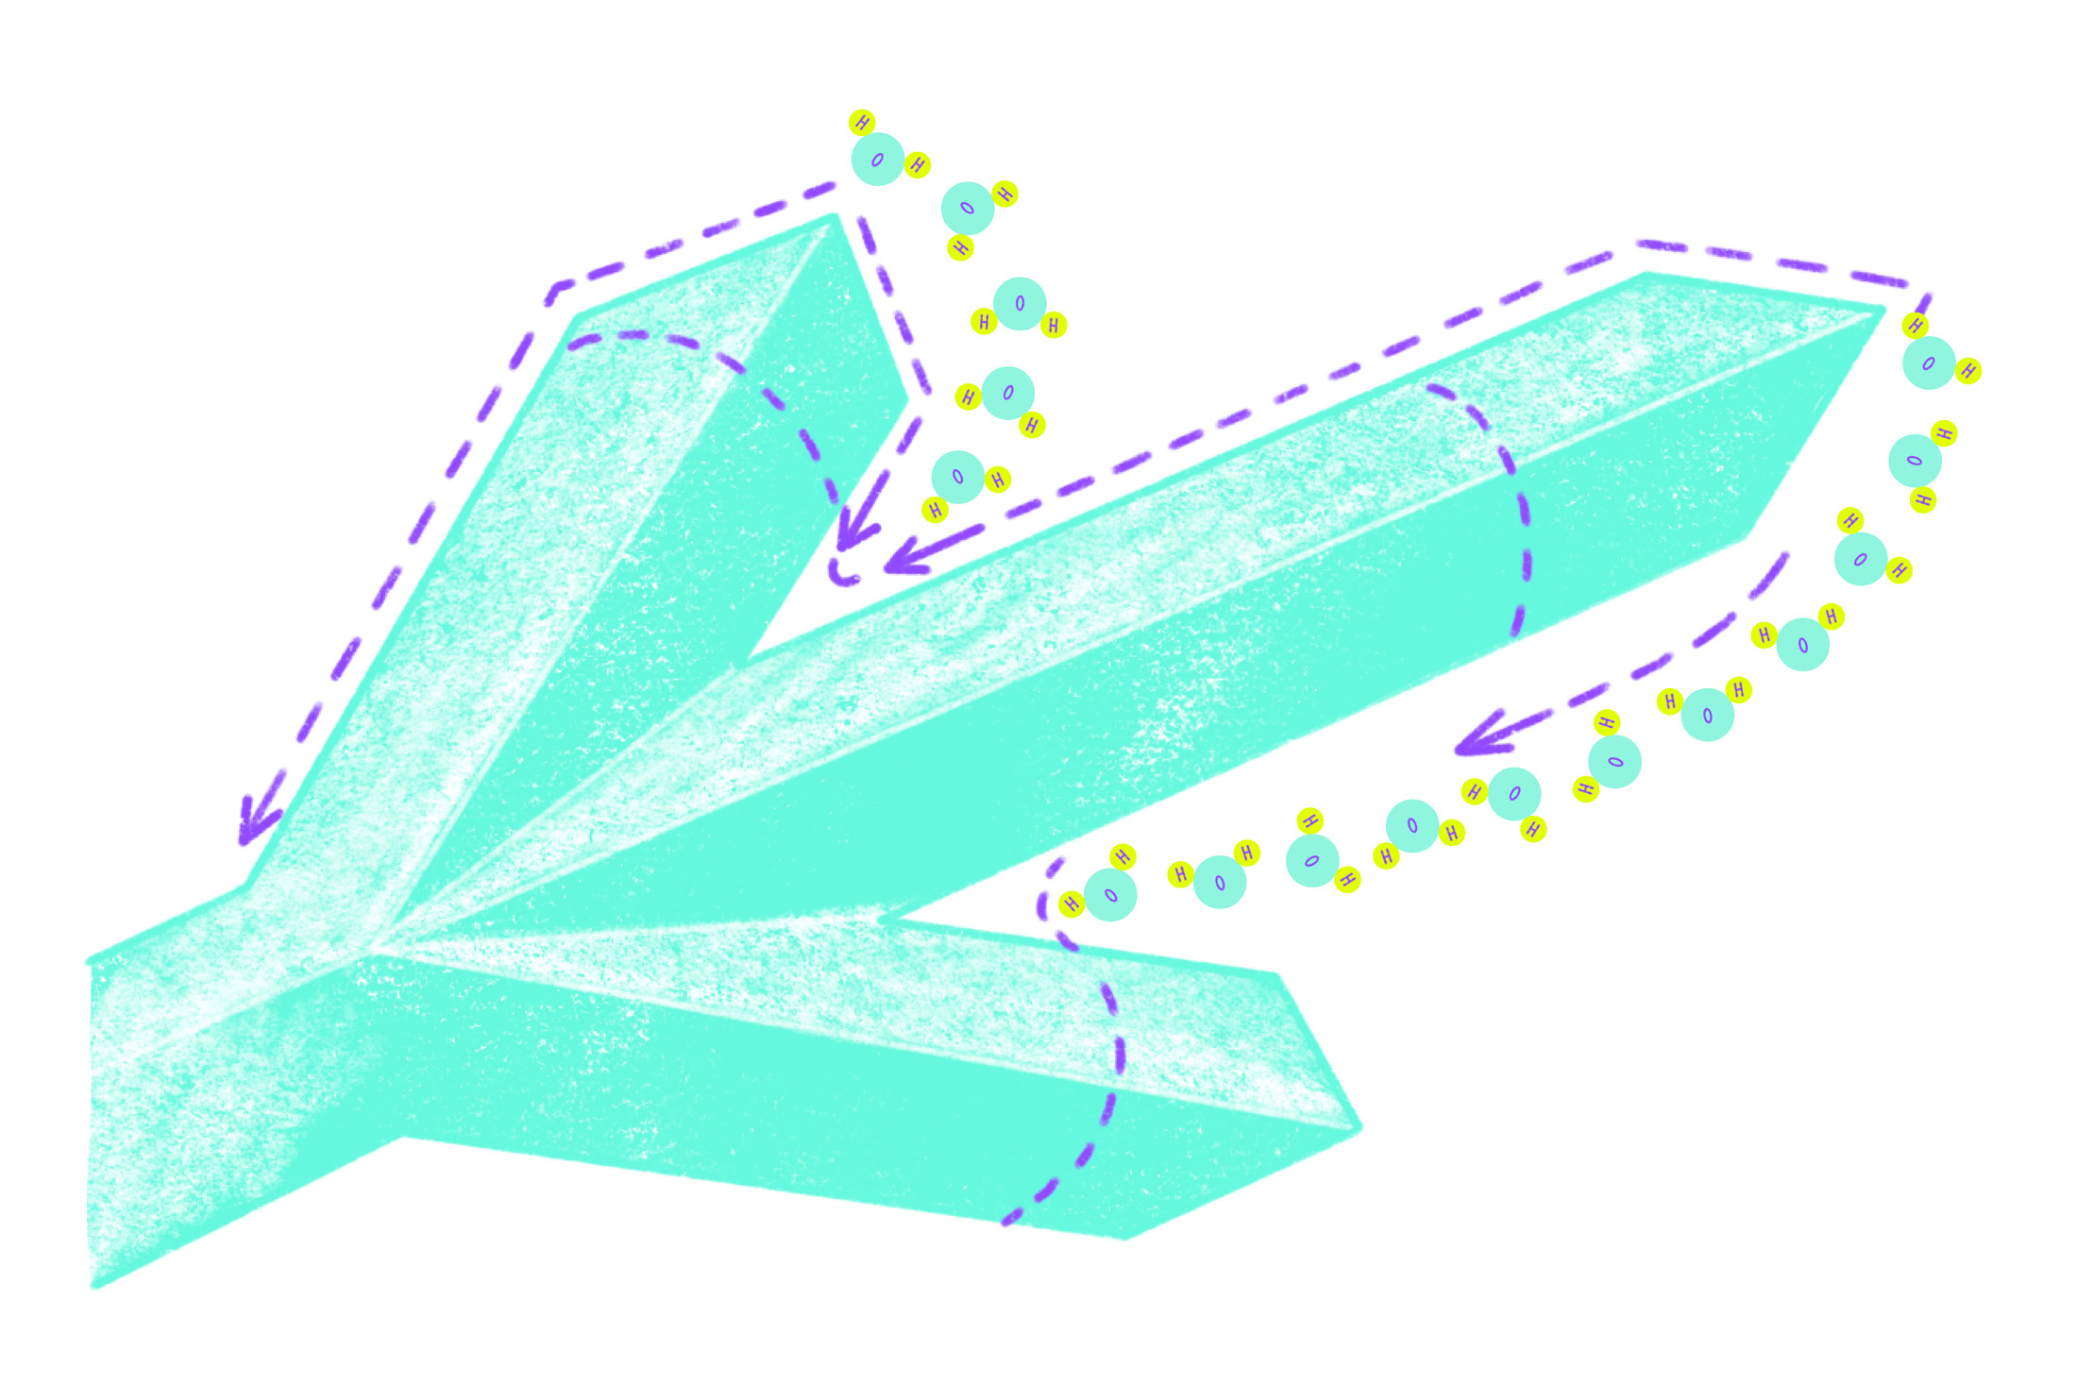
Rounding (isothermal metamorphism)
Uneven distribution of water molecules in fresh snow
Water vapour migrates from the peaks to the indentations
The crystal becomes smaller and rounder.
© snow institute
Notes:
The originally finely branched, relatively large fresh snow crystals transform into small round grains. The reason for this is the uneven distribution of water molecules in the fresh snow star: at the tips, each water molecule has only a few neighbours that can hold it in the ice structure. However, many neighbouring molecules crowd together at the depressions and indentations, which can hold the water molecule in place. Physically speaking, the water vapour pressure is greater over convex shapes (ridges, tips) than over concave shapes (indentations, depressions). Due to this pressure difference, ice sublimates over time at the tips, migrates as water vapour to the concave areas of the fresh snow crystal and is deposited there again as ice.
Behind this process lies nature's universal endeavour to minimise surface energy. The geometric shape with the lowest surface energy is the sphere. Through the degrading transformation, the complex snow crystal increasingly takes on a spherical shape. The accompanying strengthening of the bonds can be summarised under the term sintering. Sintering is therefore a consequence of the degrading metamorphosis.

Slide 15
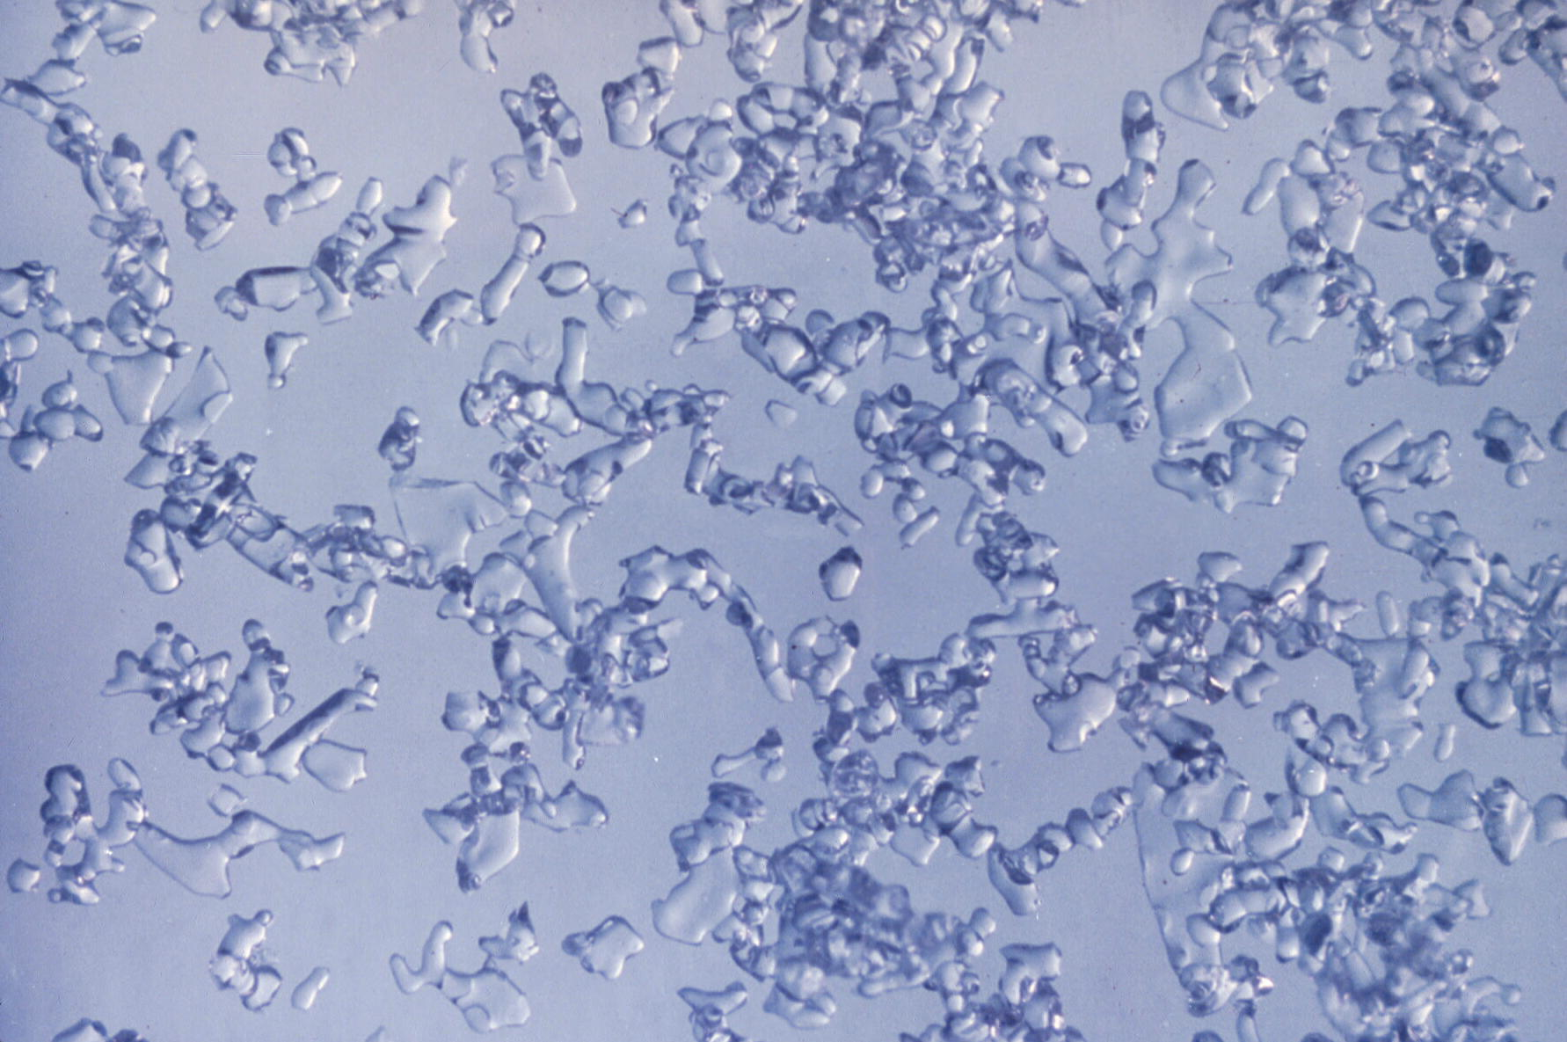
Rounding (isothermal metamorphism)
Density increases
Usually favourable for the stability of the snow cover
© snow institute / LWD Tirol
Notes:
This process begins immediately after a new snow crystal is deposited. As the pore space becomes smaller and the ice grains also become smaller, the volume decreases and the snow cover settles – a process that we can observe with the naked eye after fresh snowfall.

Slide 16
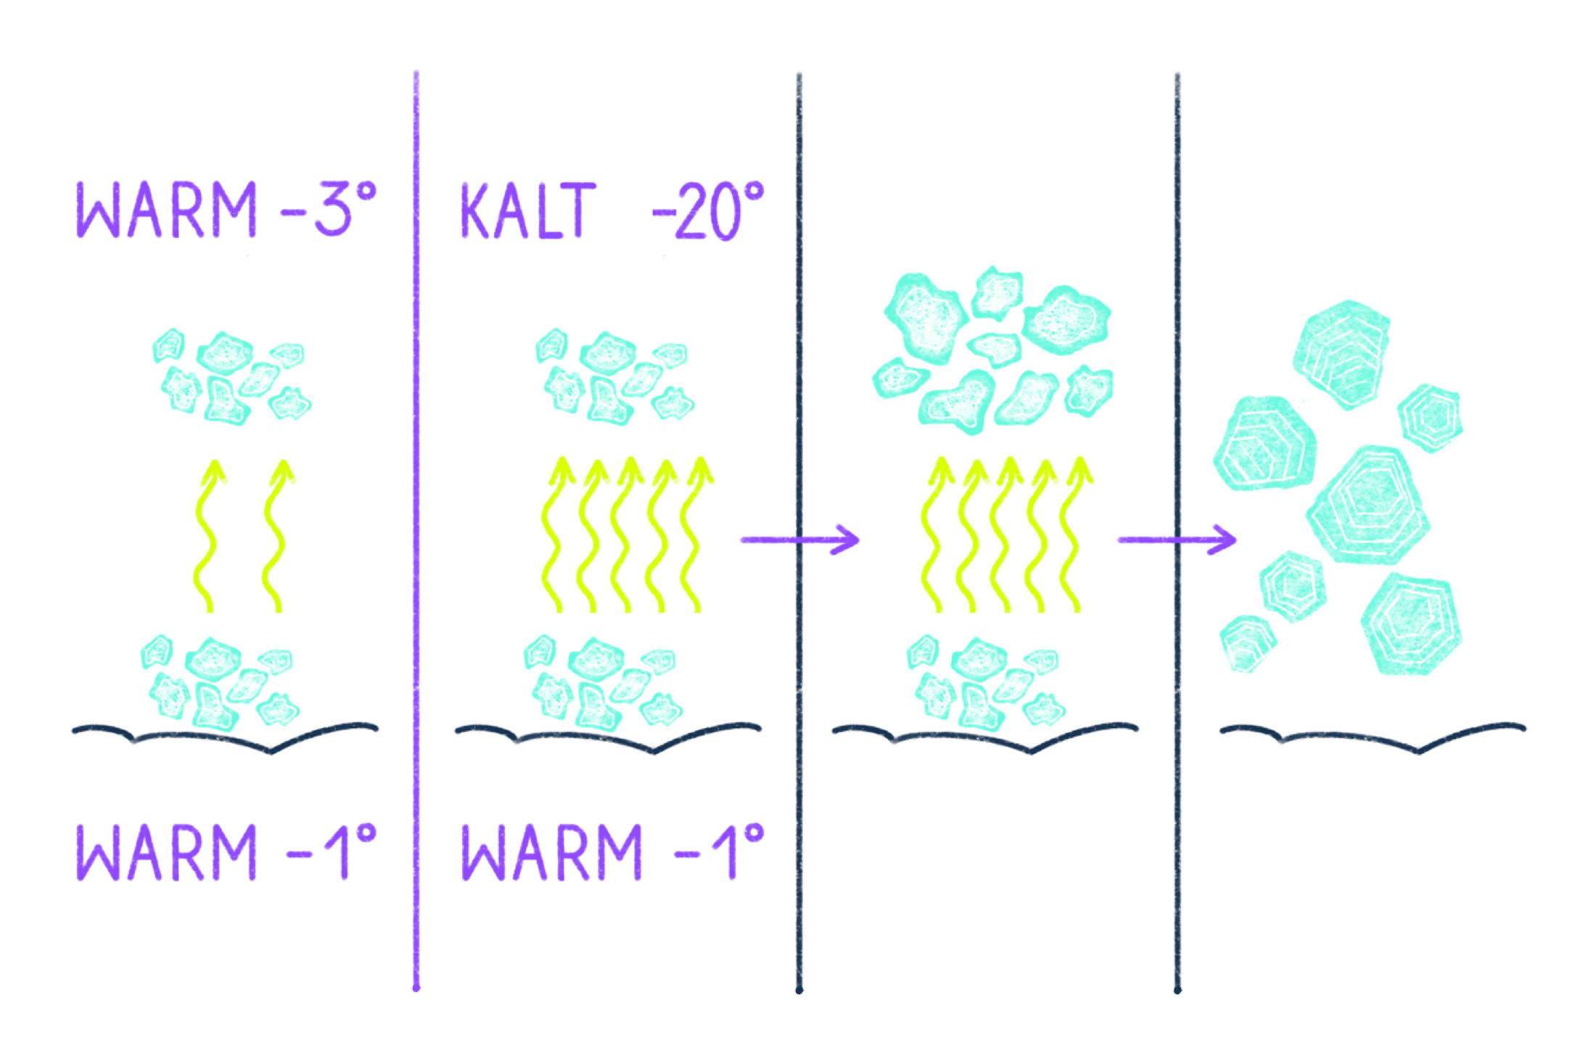
Faceting (kinetic metamorphism)
Water vapour rises from the ground towards the colder layers.
Crystallises on the underside of the colder crystals
The crystal becomes larger and more angular, and the snow layer becomes more porous.
© snow institute
Notes:
During constructive metamorphosis, snow crystals grow. The driving force behind constructive snow metamorphosis is the temperature gradient in the snowpack, with water vapour being the main ingredient. The temperature gradient describes the temperature difference between the snow surface and the ground in relation to the snow depth. The greater the temperature difference, the faster and more intense the constructive metamorphosis.
The warmer pore air at the ground contains more water vapour than the colder layers above it. This causes the water vapour to rise towards the colder layers and freeze again on the underside of the colder crystals (= deposition). The greater the temperature difference, the faster/stronger this process and thus the constructive transformation takes place.
Since the snow cover insulates very well, a constant temperature of close to 0 °C is established in the layers near the ground over the course of the winter. At the snow surface, the snow temperature varies greatly due to energy exchange with the atmosphere and can reach very low temperatures. The greater the temperature difference in the snow cover and the lower the snow depth, the greater the gradient.

Slide 17
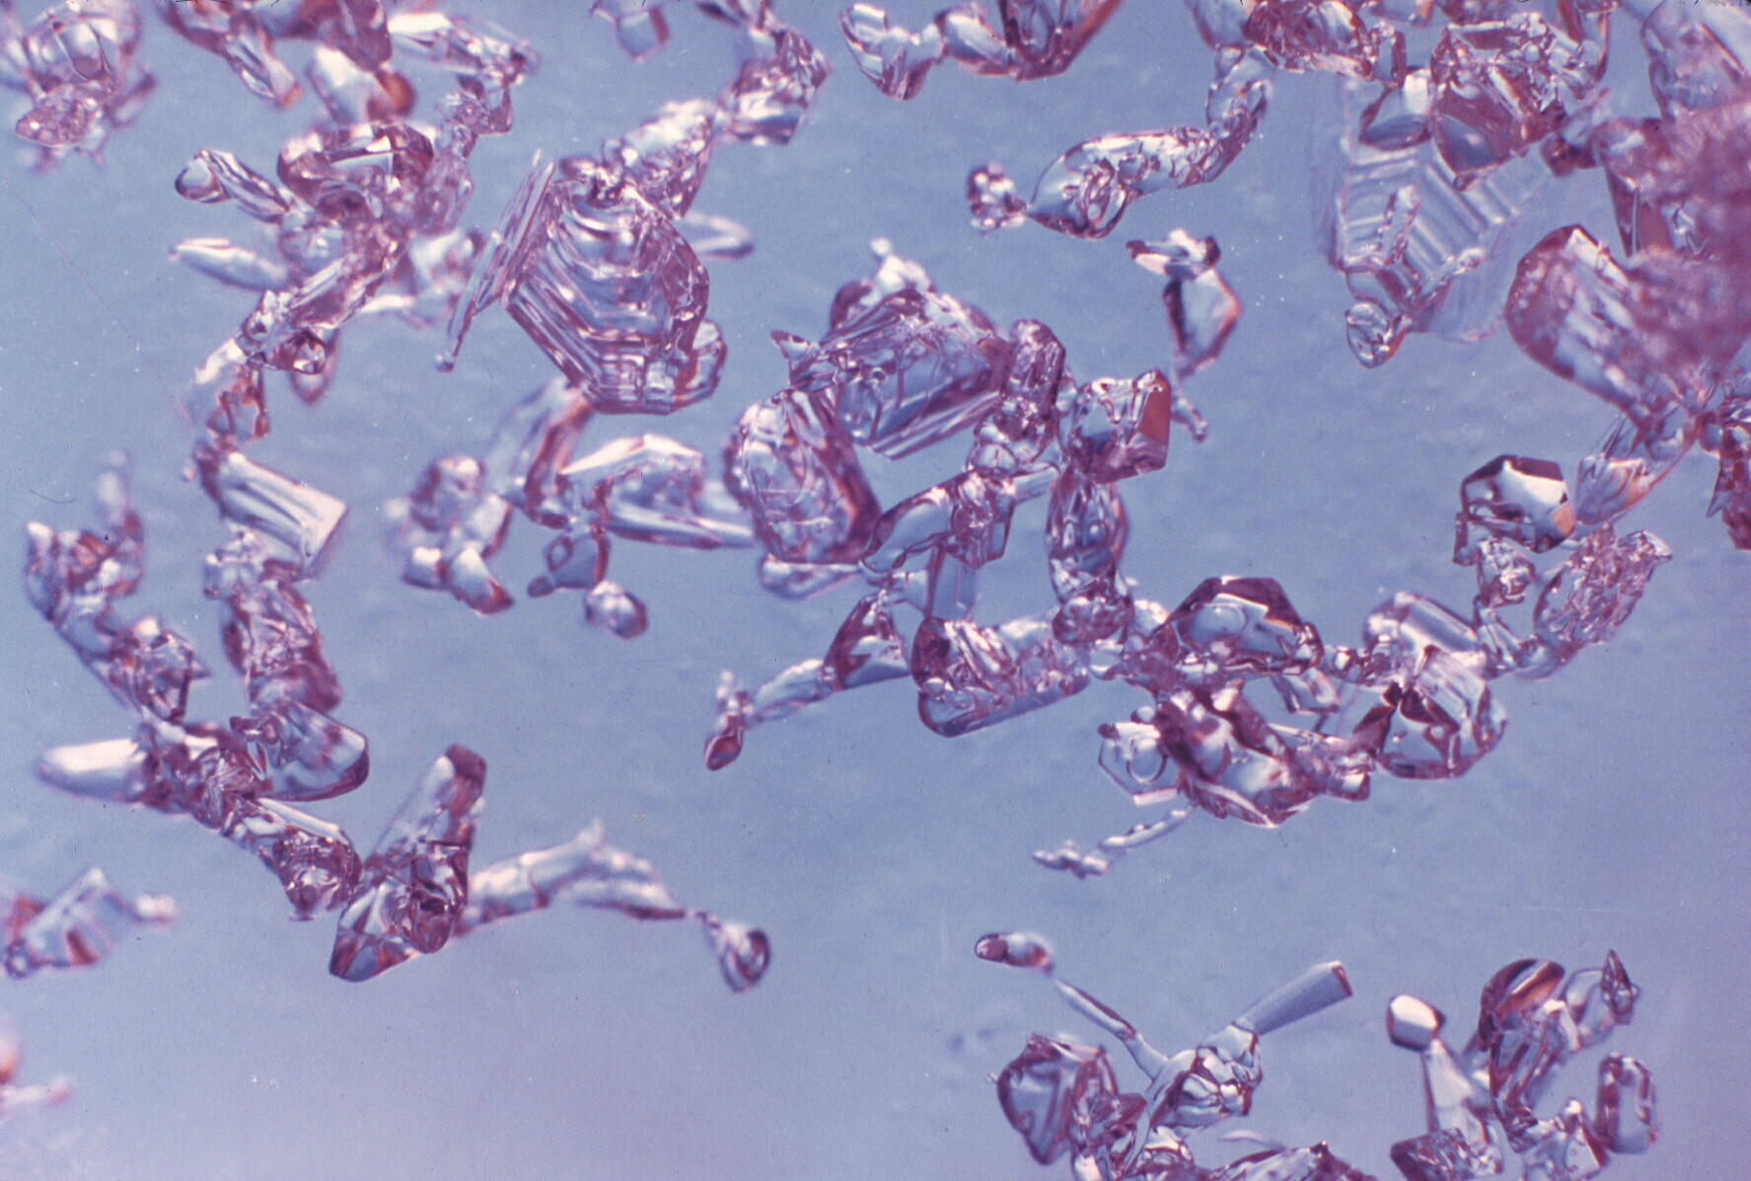
Faceting (kinetic metamorphism)
Density decreases
Few contact points between the crystals
Mostly unstable
© snow institute / LWD Tirol
Notes:
However, constructive transformation does not always reduce the stability of a snowpack. If, for example, the entire snowpack undergoes massive constructive transformation during a prolonged cold spell, there is no longer any bonded snow that could break away as a snow slab. The snowpack then consists only of loose snow crystals with little bonding.

Slide 18
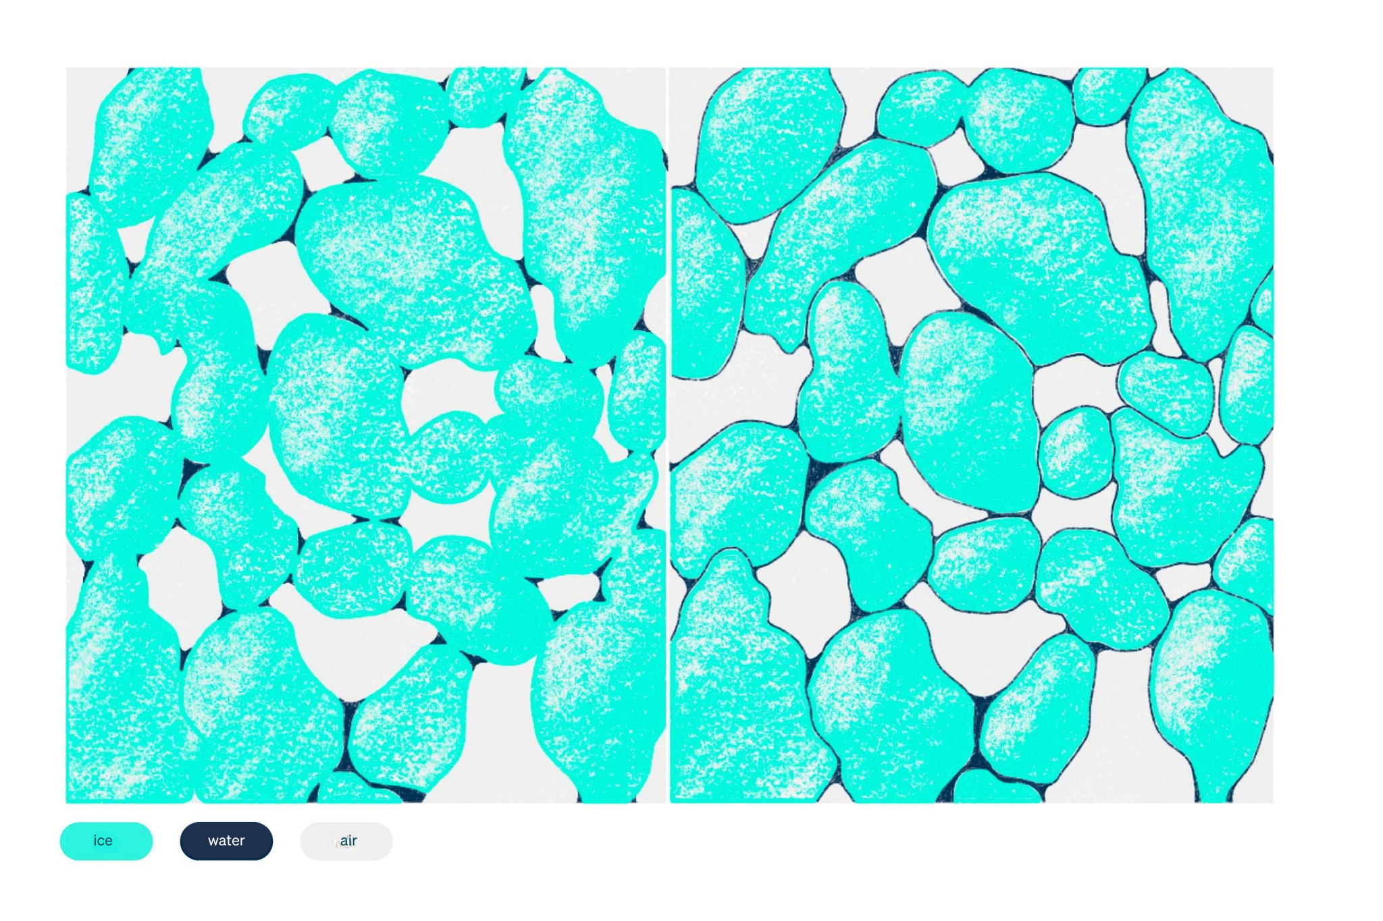
Melt freeze metamorphism
Snow temperature 0°C
The snow crystals begin to melt at their corners and edges and become rounder.
Individual round crystals grow together and become large.
© snow institute
Notes:
As soon as the snow temperature rises to 0 °C, the crystals begin to melt at their corners and edges. They take on a rounded shape and move closer together. Conglomerates (clusters) of several grains can often be seen under a magnifying glass. The individual rounded snow crystals grow rapidly and can reach several millimetres in size within a short time.

Slide 19
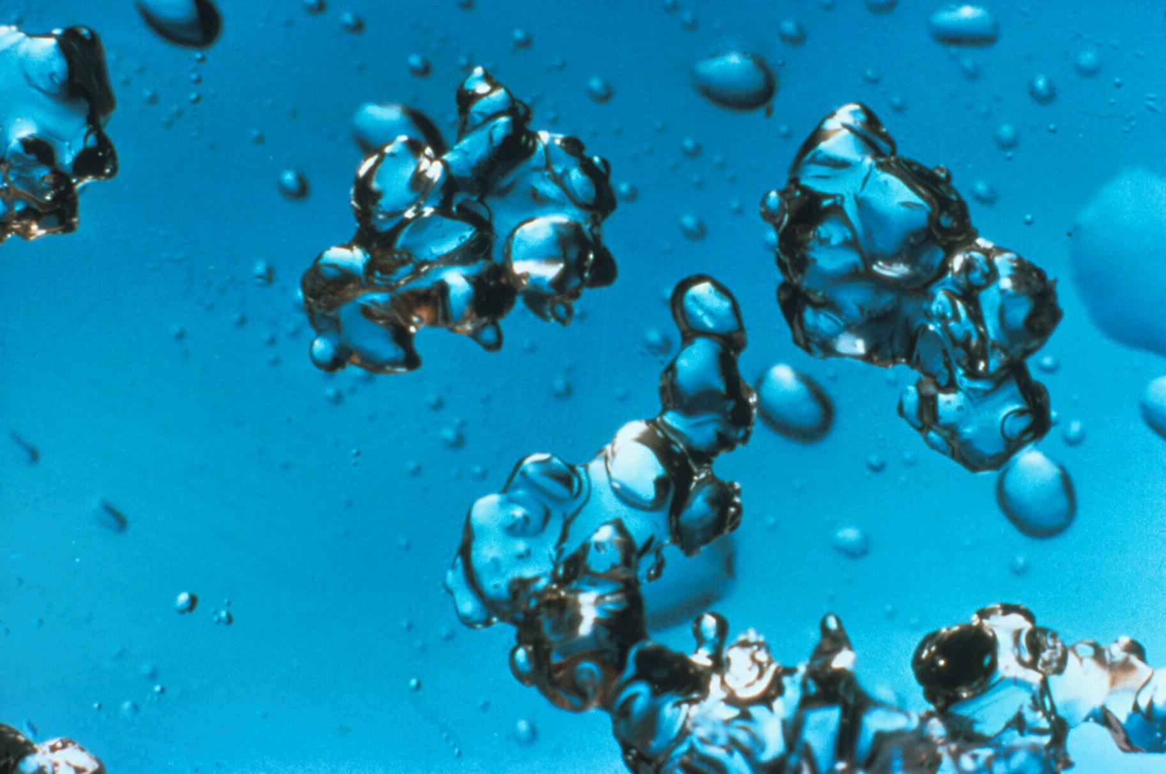
Melt freeze metamorphism
Decrease in stability with increasing water content
Snow crystals completely surrounded by water and separated from each other
© snow institute / LWD Tirol
Notes:
The resulting water initially only occupies the indentations and crystal contacts of the clusters. This nesting of small amounts of water in the pore angles increases the capillary forces between the crystals and increases the strength. As long as the moisture content of the snow and the grain diameter are low, consolidation occurs. The snow sticks together and is perfect for extended snowball fights or building a beautiful snowman.
As melting progresses, the pores increasingly fill with meltwater. The water can no longer be held in the pore angles and flows away under the force of gravity. The snow crystals are now almost completely surrounded by a layer of water and separated from each other. The disappearance of the grain bonds results in a significant loss of strength (slush). Small differences in the amount of water determine whether the wet snow is stable or not. However, changes in the amount of water can happen very quickly.

Slide 20
Experiments: Discover snow
Notes:
DOWNLOAD UNTER: https://www.snow.institute/experiments-discovering-snow/?lang=en

