Slide 1
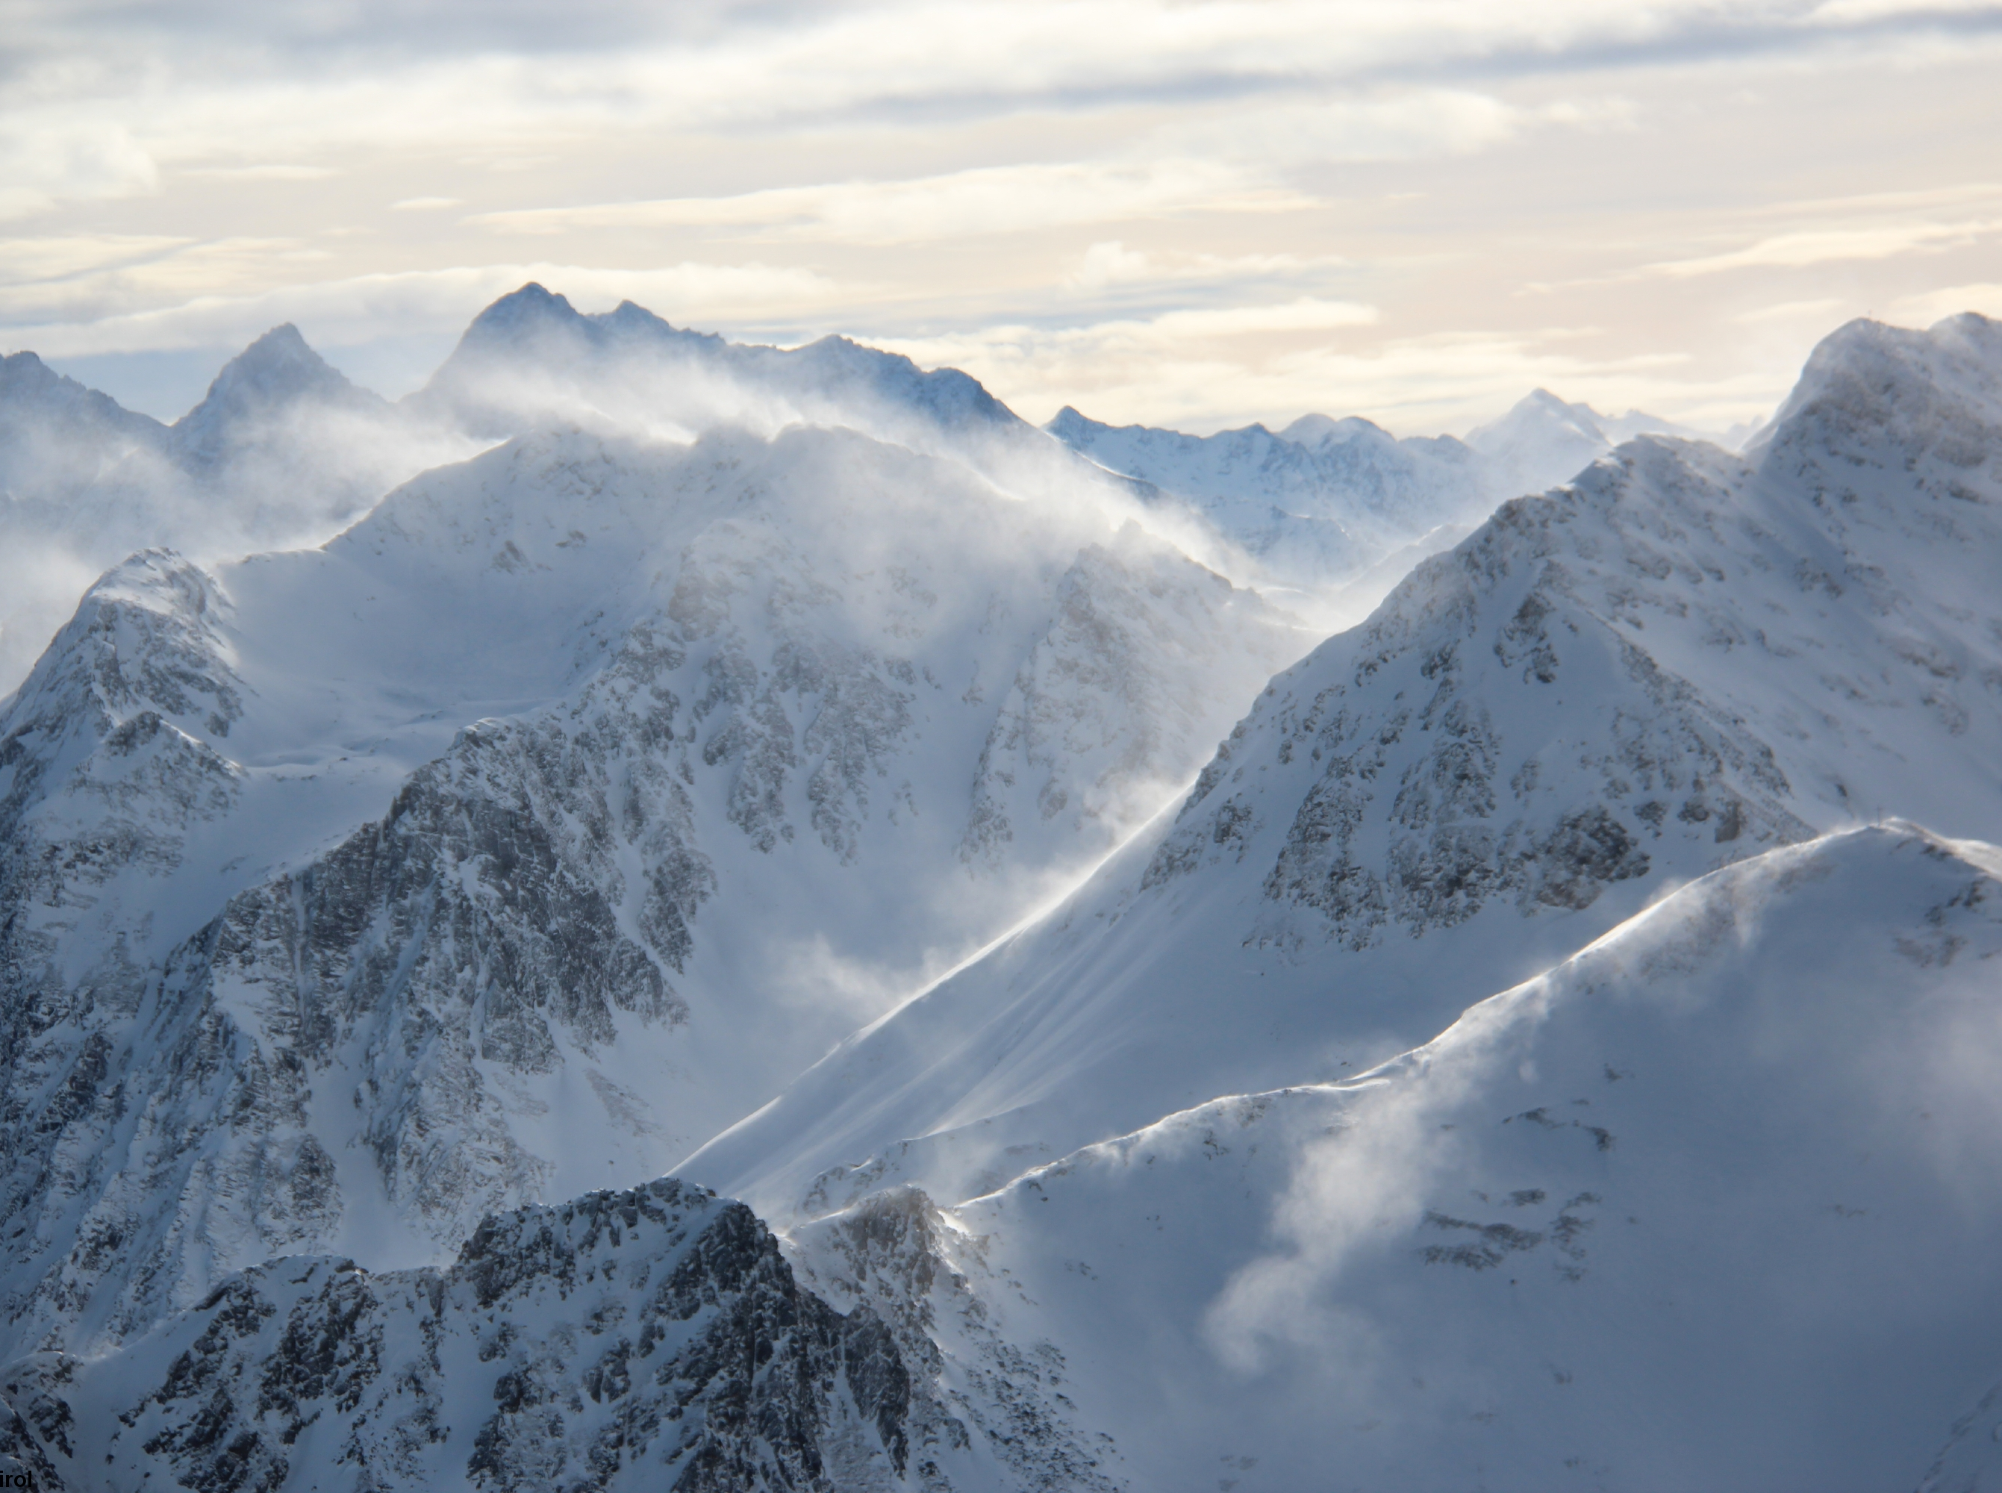


Mountain Weather
© snow institute / LWD Tirol
Notes:
To stay safe in the mountains, solid knowledge of weather conditions and an understanding of the most common terms used in weather forecasts are essential. When planning, before, and during any (alpine) tour — whether in winter or summer — it is important to consider the weather forecast, the actual weather at the start of the tour, and how conditions may change throughout the day.
A basic requirement for this is being able to understand and correctly interpret the weather report.

Slide 2

01 The meaning of ‘weather’
02 Radiation
03 Temperature
04 Air pressure
05 Wind
06 Air humidity
07 Precipitation

Slide 3
01 The meaning of ‘weather’
02 Radiation
03 Temperature
04 Air pressure
05 Wind
06 Air humidity
07 Precipitation

Slide 4
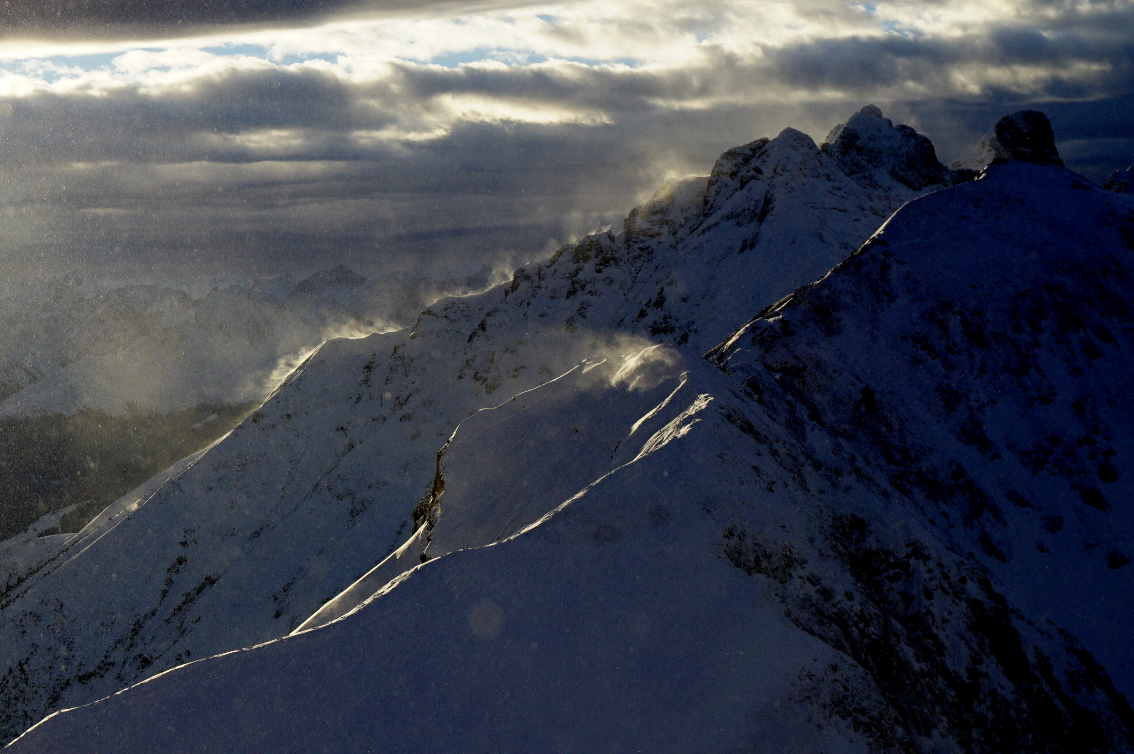
Weather
Current physical state of the lowest layer of the atmosphere (=troposphere)
Important parameters: temperature, humidity, precipitation, wind
Driving force: radiation
© snow institute / argonaut.pro
Notes:
What do we actually mean when we talk about "weather"? The term refers to the current physical state of the lowest layer of the atmosphere at a specific place and time.
Weather is composed of factors such as temperature, humidity, precipitation, and wind, which are used to describe the condition of the atmosphere.
However, before describing these weather parameters, we must first look at the driving force behind weather processes — radiation.

Slide 5
01 The meaning of ‘weather’
02 Radiation
03 Temperature
04 Air pressure
05 Wind
06 Air humidity
07 Precipitation

Slide 6
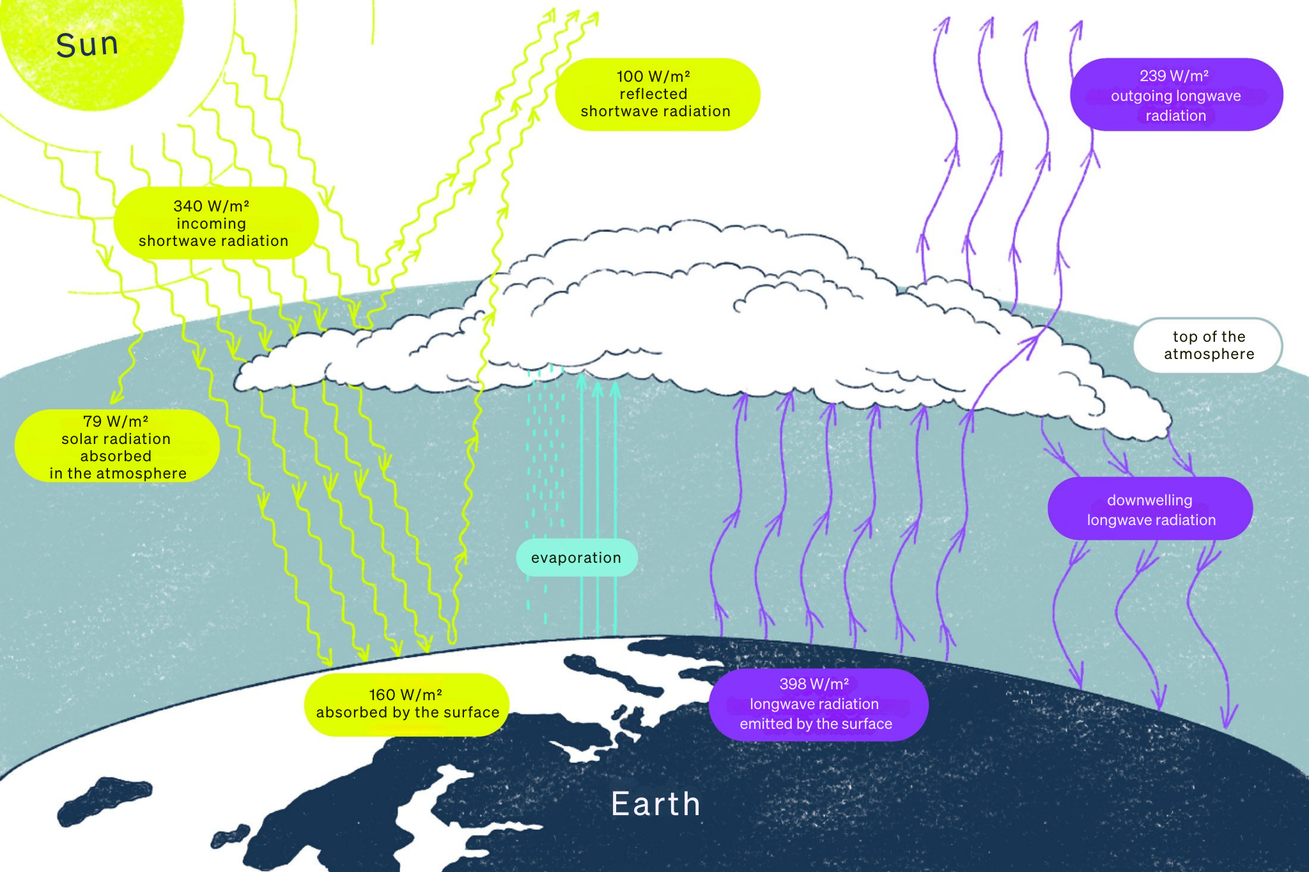
Radiation
Driving force of weather events
Energy source for the Earth: solar radiation
© snow institute
Notes:
Incoming solar radiation is the only significant energy source for the Earth. A large portion of this radiation is reflected back into space by the atmosphere and therefore never reaches the Earth’s surface.

Slide 7
Radiation
3 key processes
Reflection
Dispersion
Absorption
© snow institute
Notes:
The amount of radiation that reaches the Earth’s surface varies due to three main processes [see slides]. Key factors include the filtering effect of the atmosphere, the angle at which the radiation hits the Earth, and the presence of clouds as well as the intensity of air pollution.

Slide 8
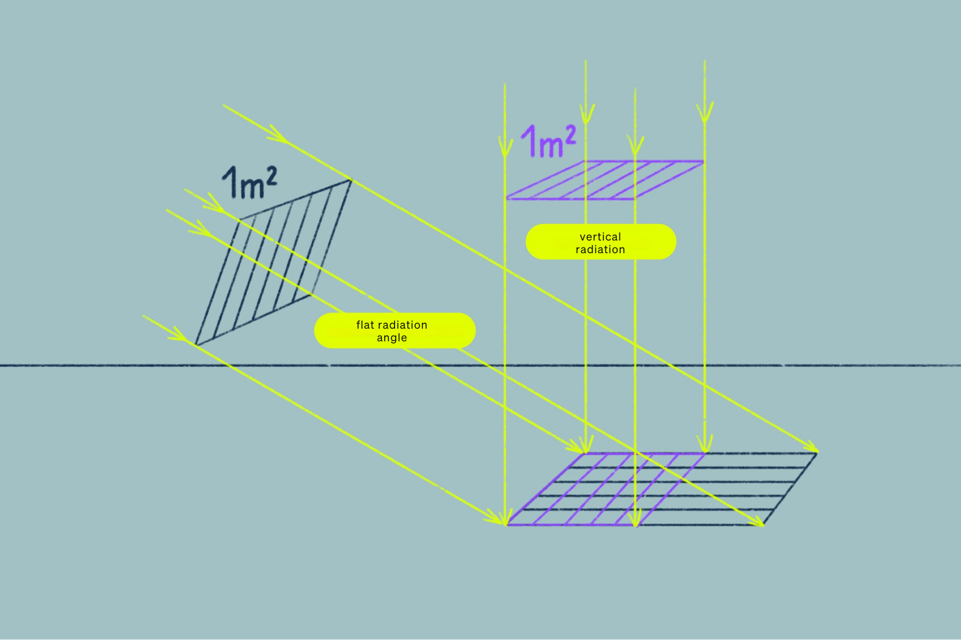
Radiation
Radiation angle
Position of the surface relative to the sun
Causes large temperature differences
© snow institute
Notes:
Surfaces that are positioned perpendicular (at a right angle) to the light source absorb significantly more incoming radiation than those that are tilted at a shallower angle. This is what causes the large temperature differences on Earth — which, in turn, are the driving force behind our weather.

Slide 9
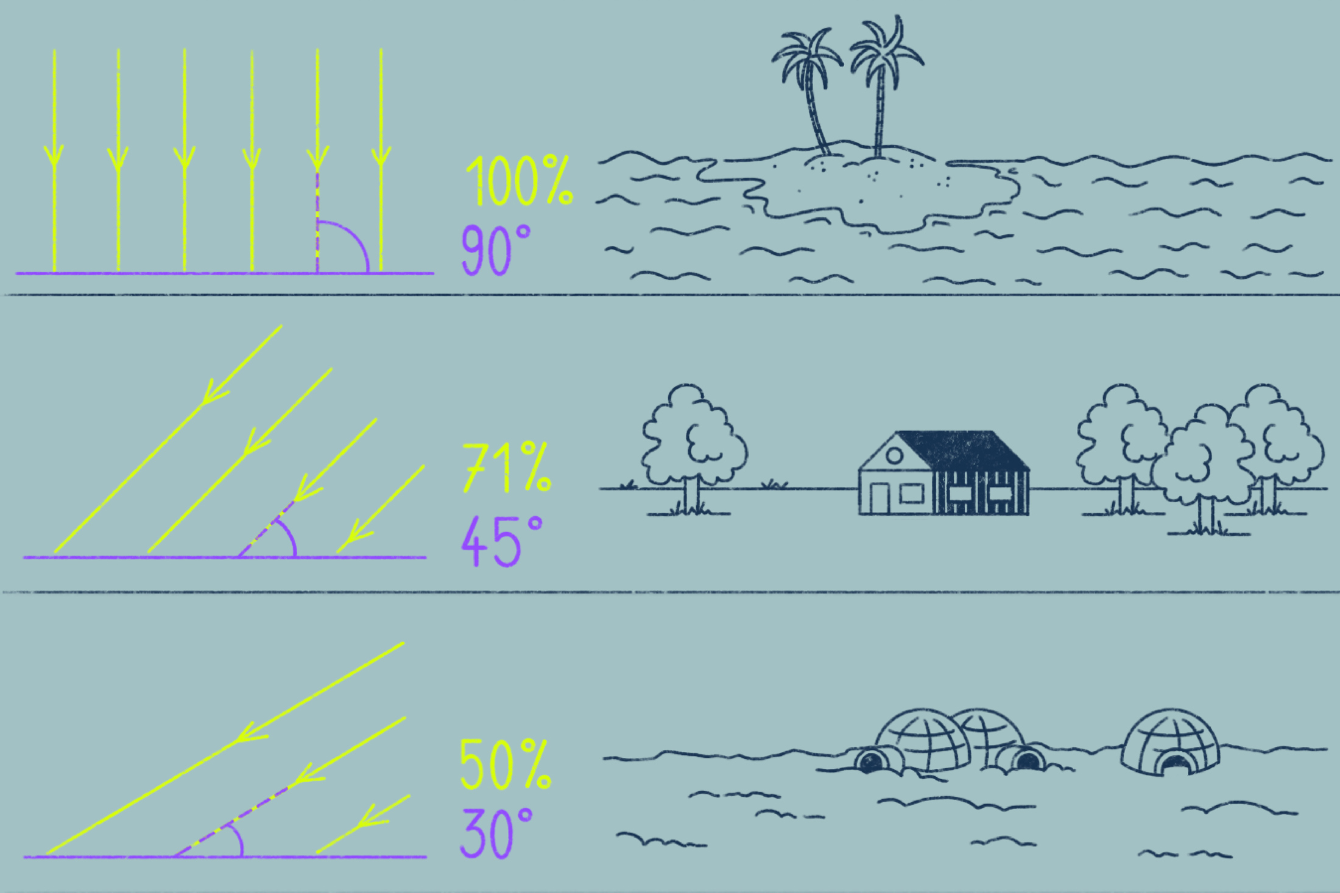
Radiation
Radiation angle
Equator: Sun hits the Earth's surface vertically
Pole: very flat angle of incidence
Notes:
At the equator, solar radiation strikes the Earth's surface more directly than at the poles. As a result, more energy is absorbed, and the ground warms up. At the poles, the angle of incidence is much shallower, and a large portion of the radiation is reflected.

Slide 10
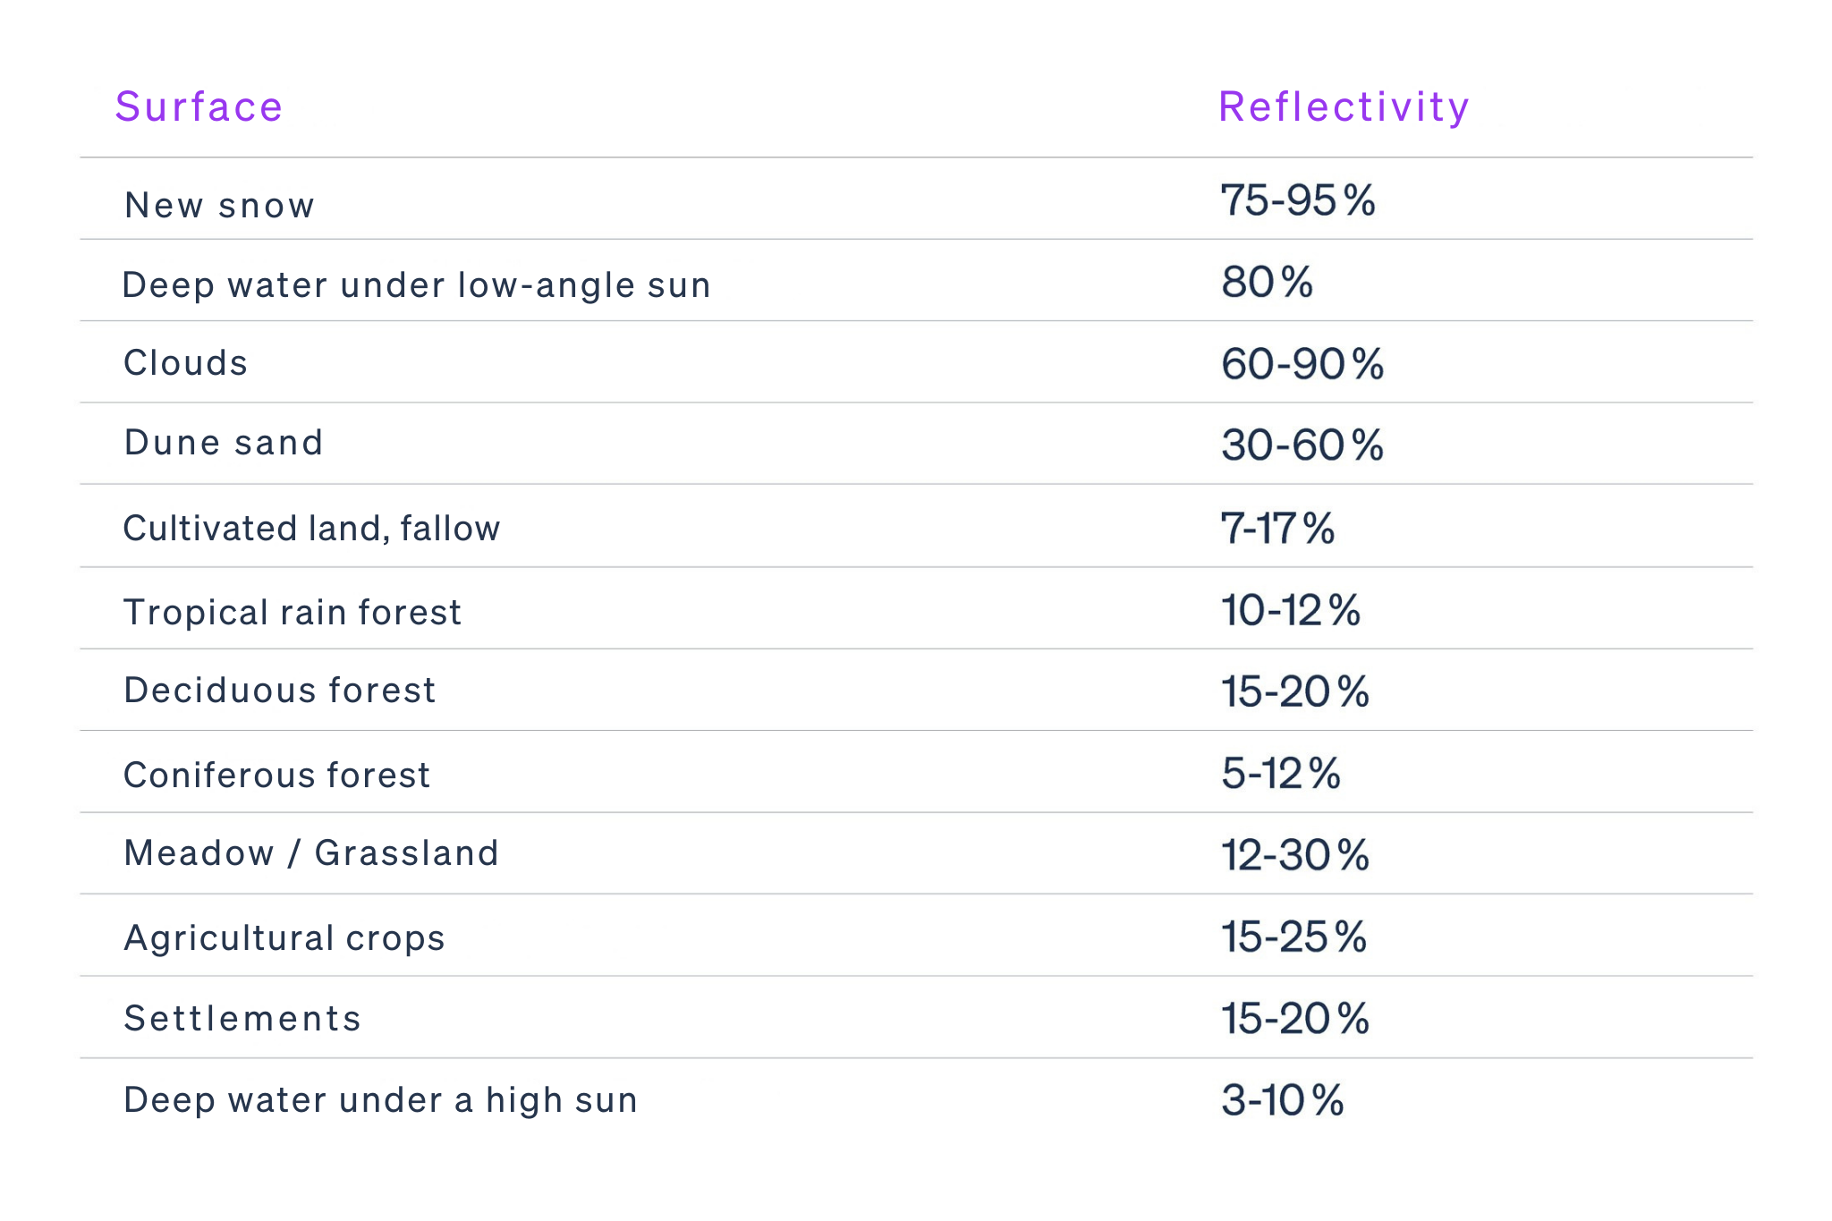
Radiation
Albedo
Reflective capacity of a surface
The darker and rougher the surface, the more radiation is absorbed.
© snow institute
Notes:
Albedo describes the reflectivity of a surface and depends on the type and characteristics of that surface. The brighter and smoother a surface is, the more radiation it reflects. Fresh snow, for example, reflects up to 95% of incoming shortwave radiation, whereas coniferous forest reflects at most 12% by comparison.

Slide 11
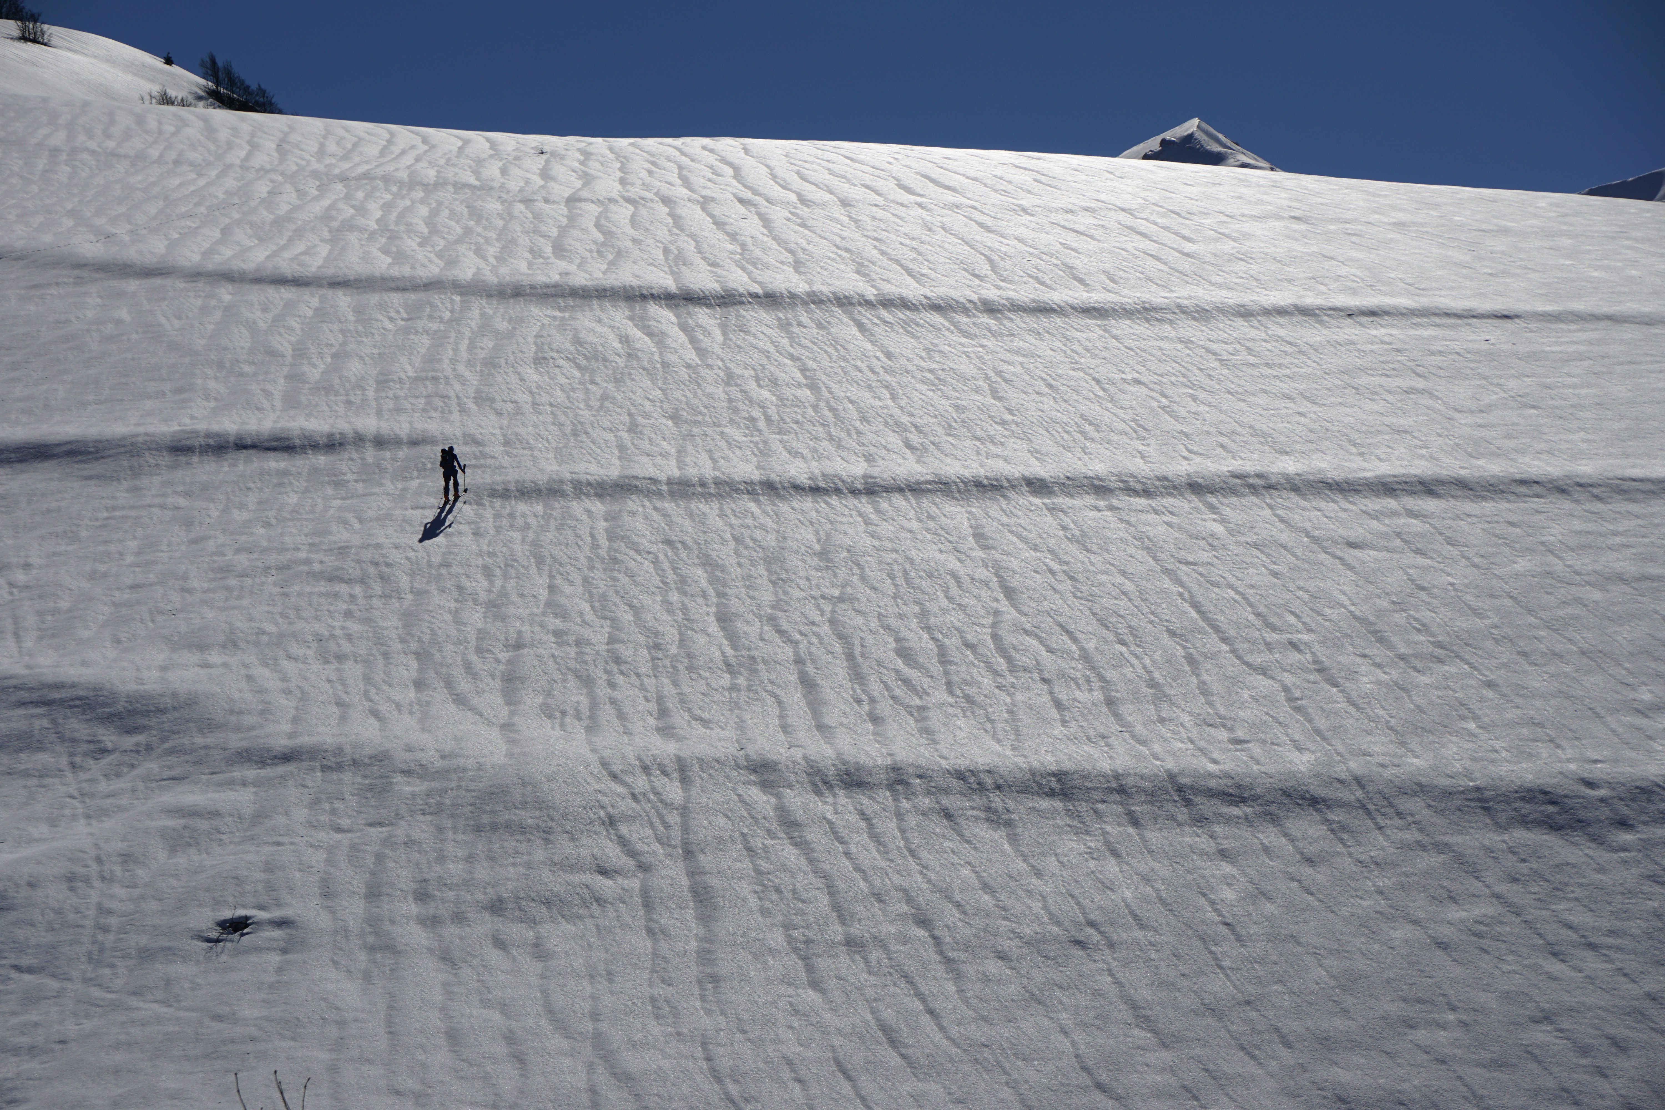
Radiation
What does this mean for the snow cover?
Reflection up to 95%
Low energy intake
Nevertheless, a lot of energy is released
i.e. heat balance = negative
© snow institute / argonaut.pro
Notes:
Due to its high albedo, incoming sunlight is almost entirely reflected back into the atmosphere by snow, resulting in very low absorption. The snowpack absorbs little energy but continuously emits a large amount of energy. As a result, the heat balance remains slightly negative, which is why snow — especially in midwinter — can remain powdery even when the sun is shining and air temperatures are above 0 °C.

Slide 12
01 The meaning of ‘weather’
02 Radiation
03 Temperature
04 Air pressure
05 Wind
06 Air humidity
07 Precipitation

Slide 13
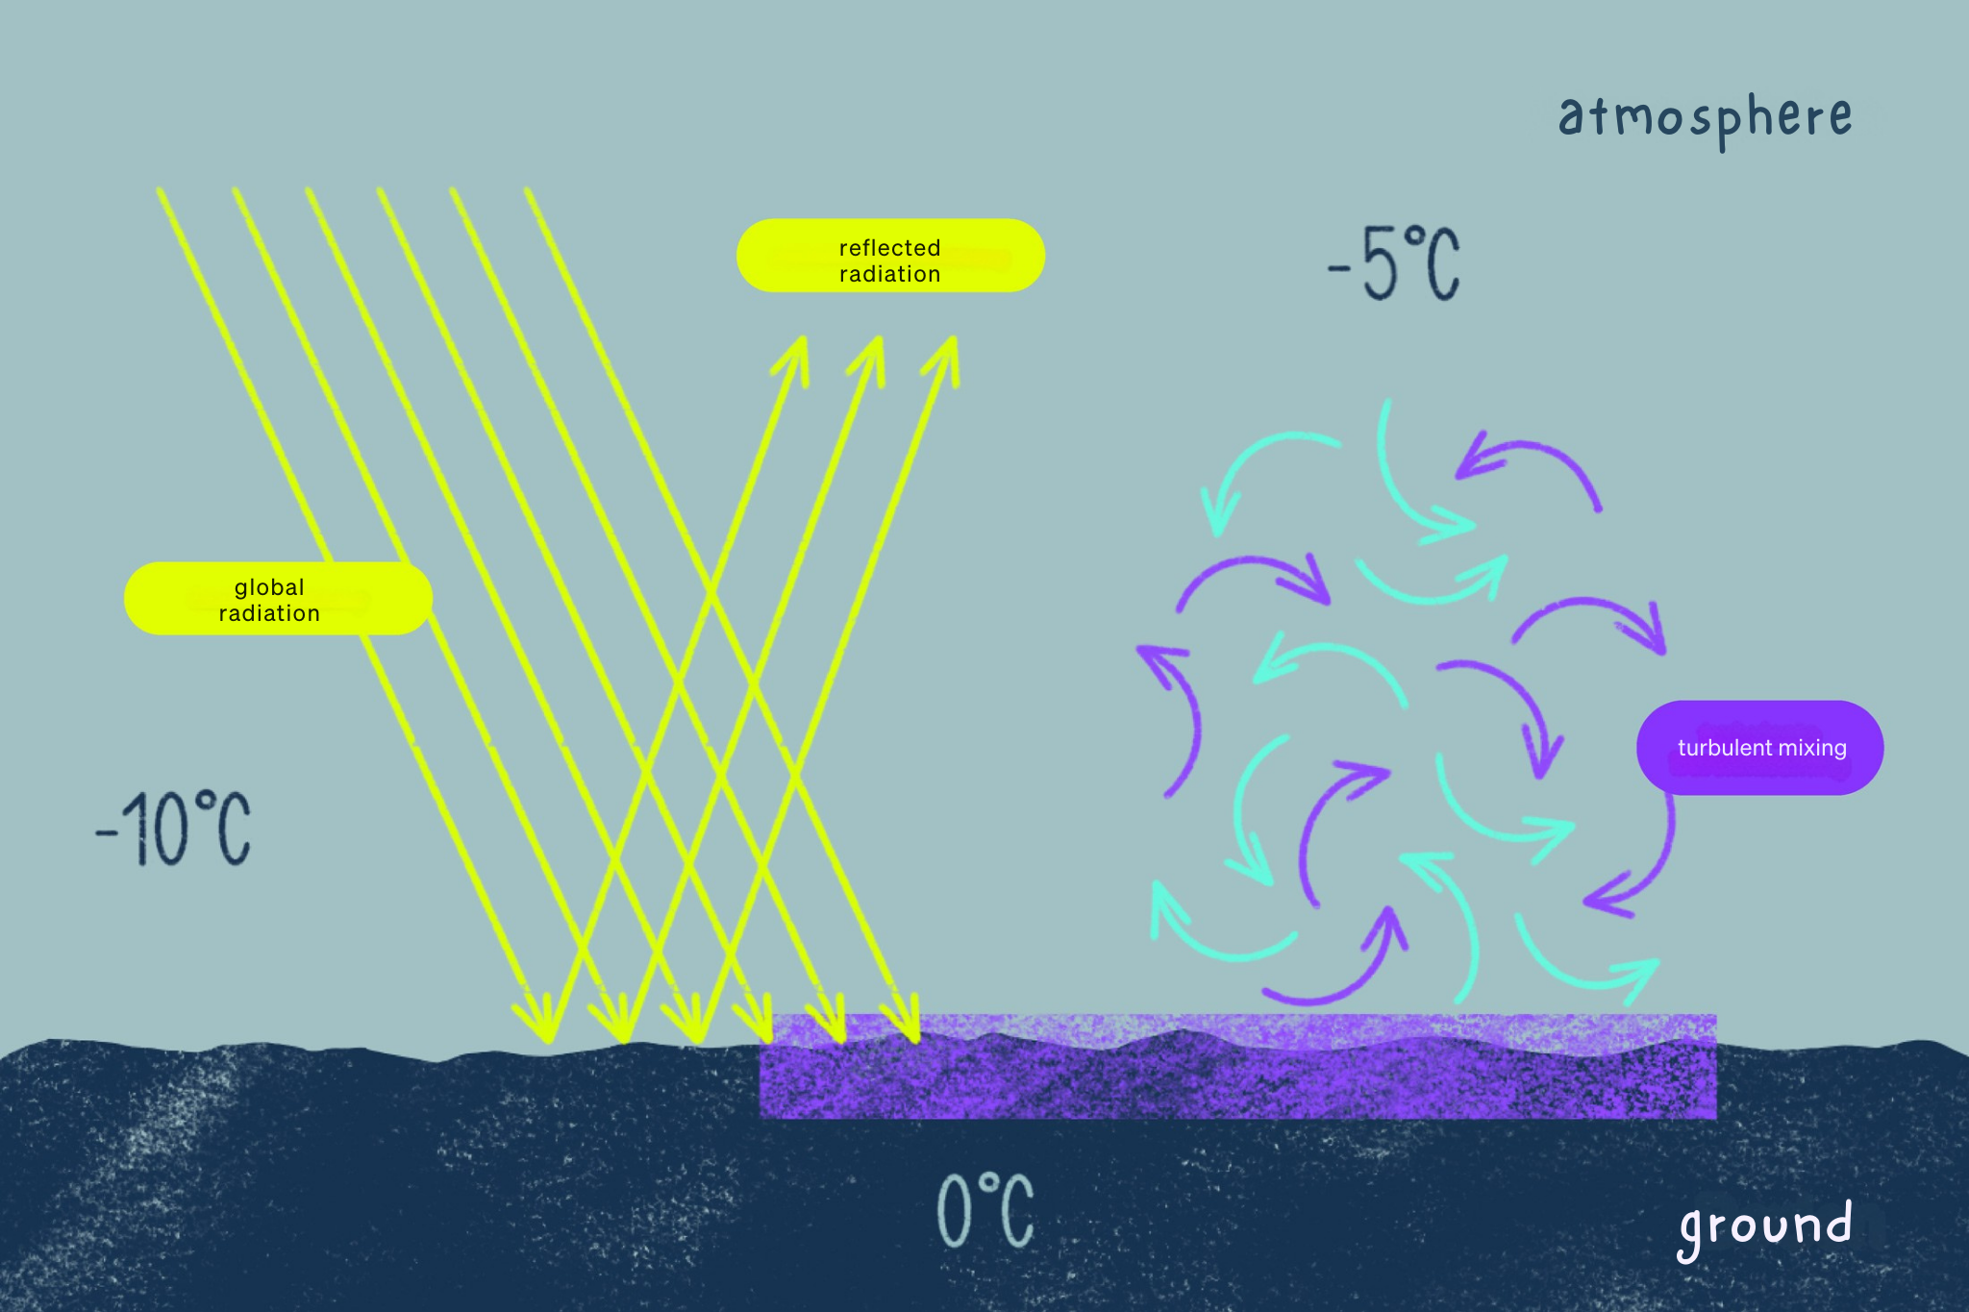
Temperature
Measure of the heat content of air, expressed in °C (K, F)
Indirect heating via the ground: turbulent mixing
Highest sun position ≠ highest temperature
© snow institute
Notes:
Air temperature is a measure of the heat content of the air. The air is not directly heated by solar radiation, but indirectly by longwave radiation emitted from the ground and through the process of turbulent mixing.
This means that when solar radiation hits the ground — such as grass, forest, or rock — the surface warms up. The lowest layer of air (just a few millimeters thick) is then heated through conduction. Small-scale turbulent eddies then mix this warm air with the layers above.
Because this process takes time, the highest air temperature is not recorded at the time of the sun’s highest position in the sky, but rather two to three hours later.

Slide 14
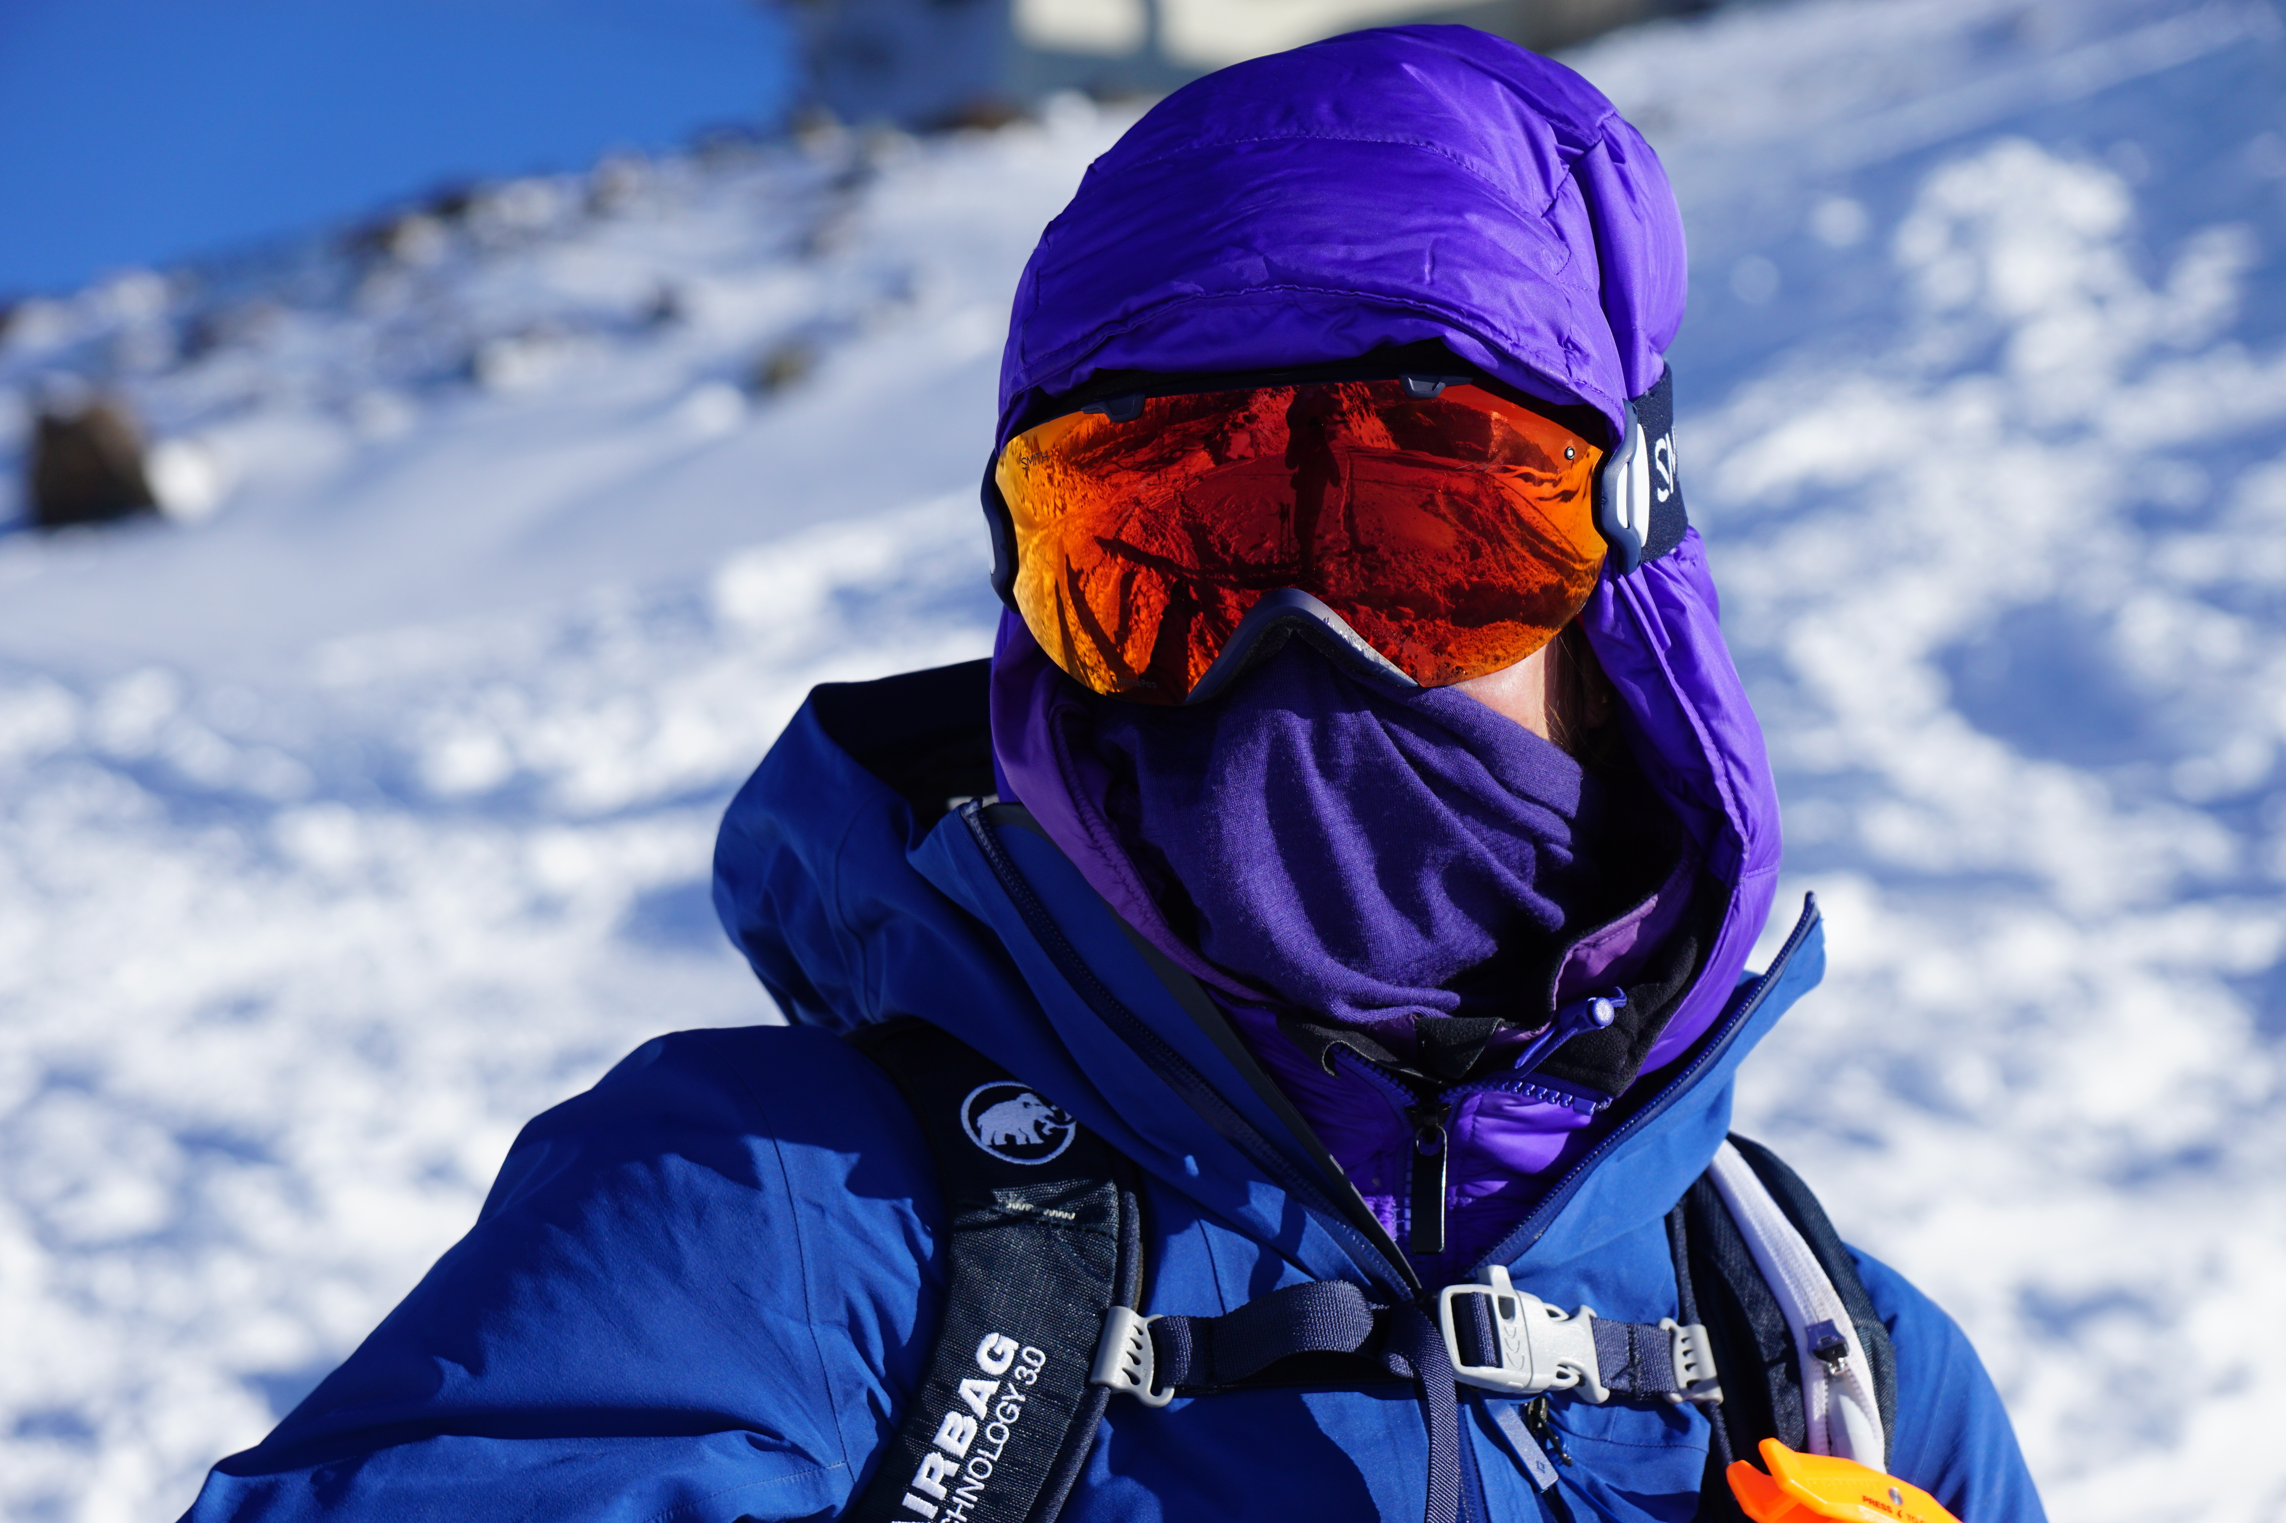
Temperature
Temperature decrease with altitude
~ 0.65 °C per 100 metres of altitude
In extremely dry air: up to 1 °C per 100 metres of altitude
© snow institute / argonaut.pro
Notes:
In general, the higher the air pressure, the higher the temperature. Since air pressure is highest at sea level and decreases with altitude, temperature also decreases with elevation — this is known as the vertical temperature gradient.
On average, the temperature drops by about 0.65 °C for every 100 meters of altitude. In very dry air, the decrease can be as much as 1 °C per 100 meters.

Slide 15
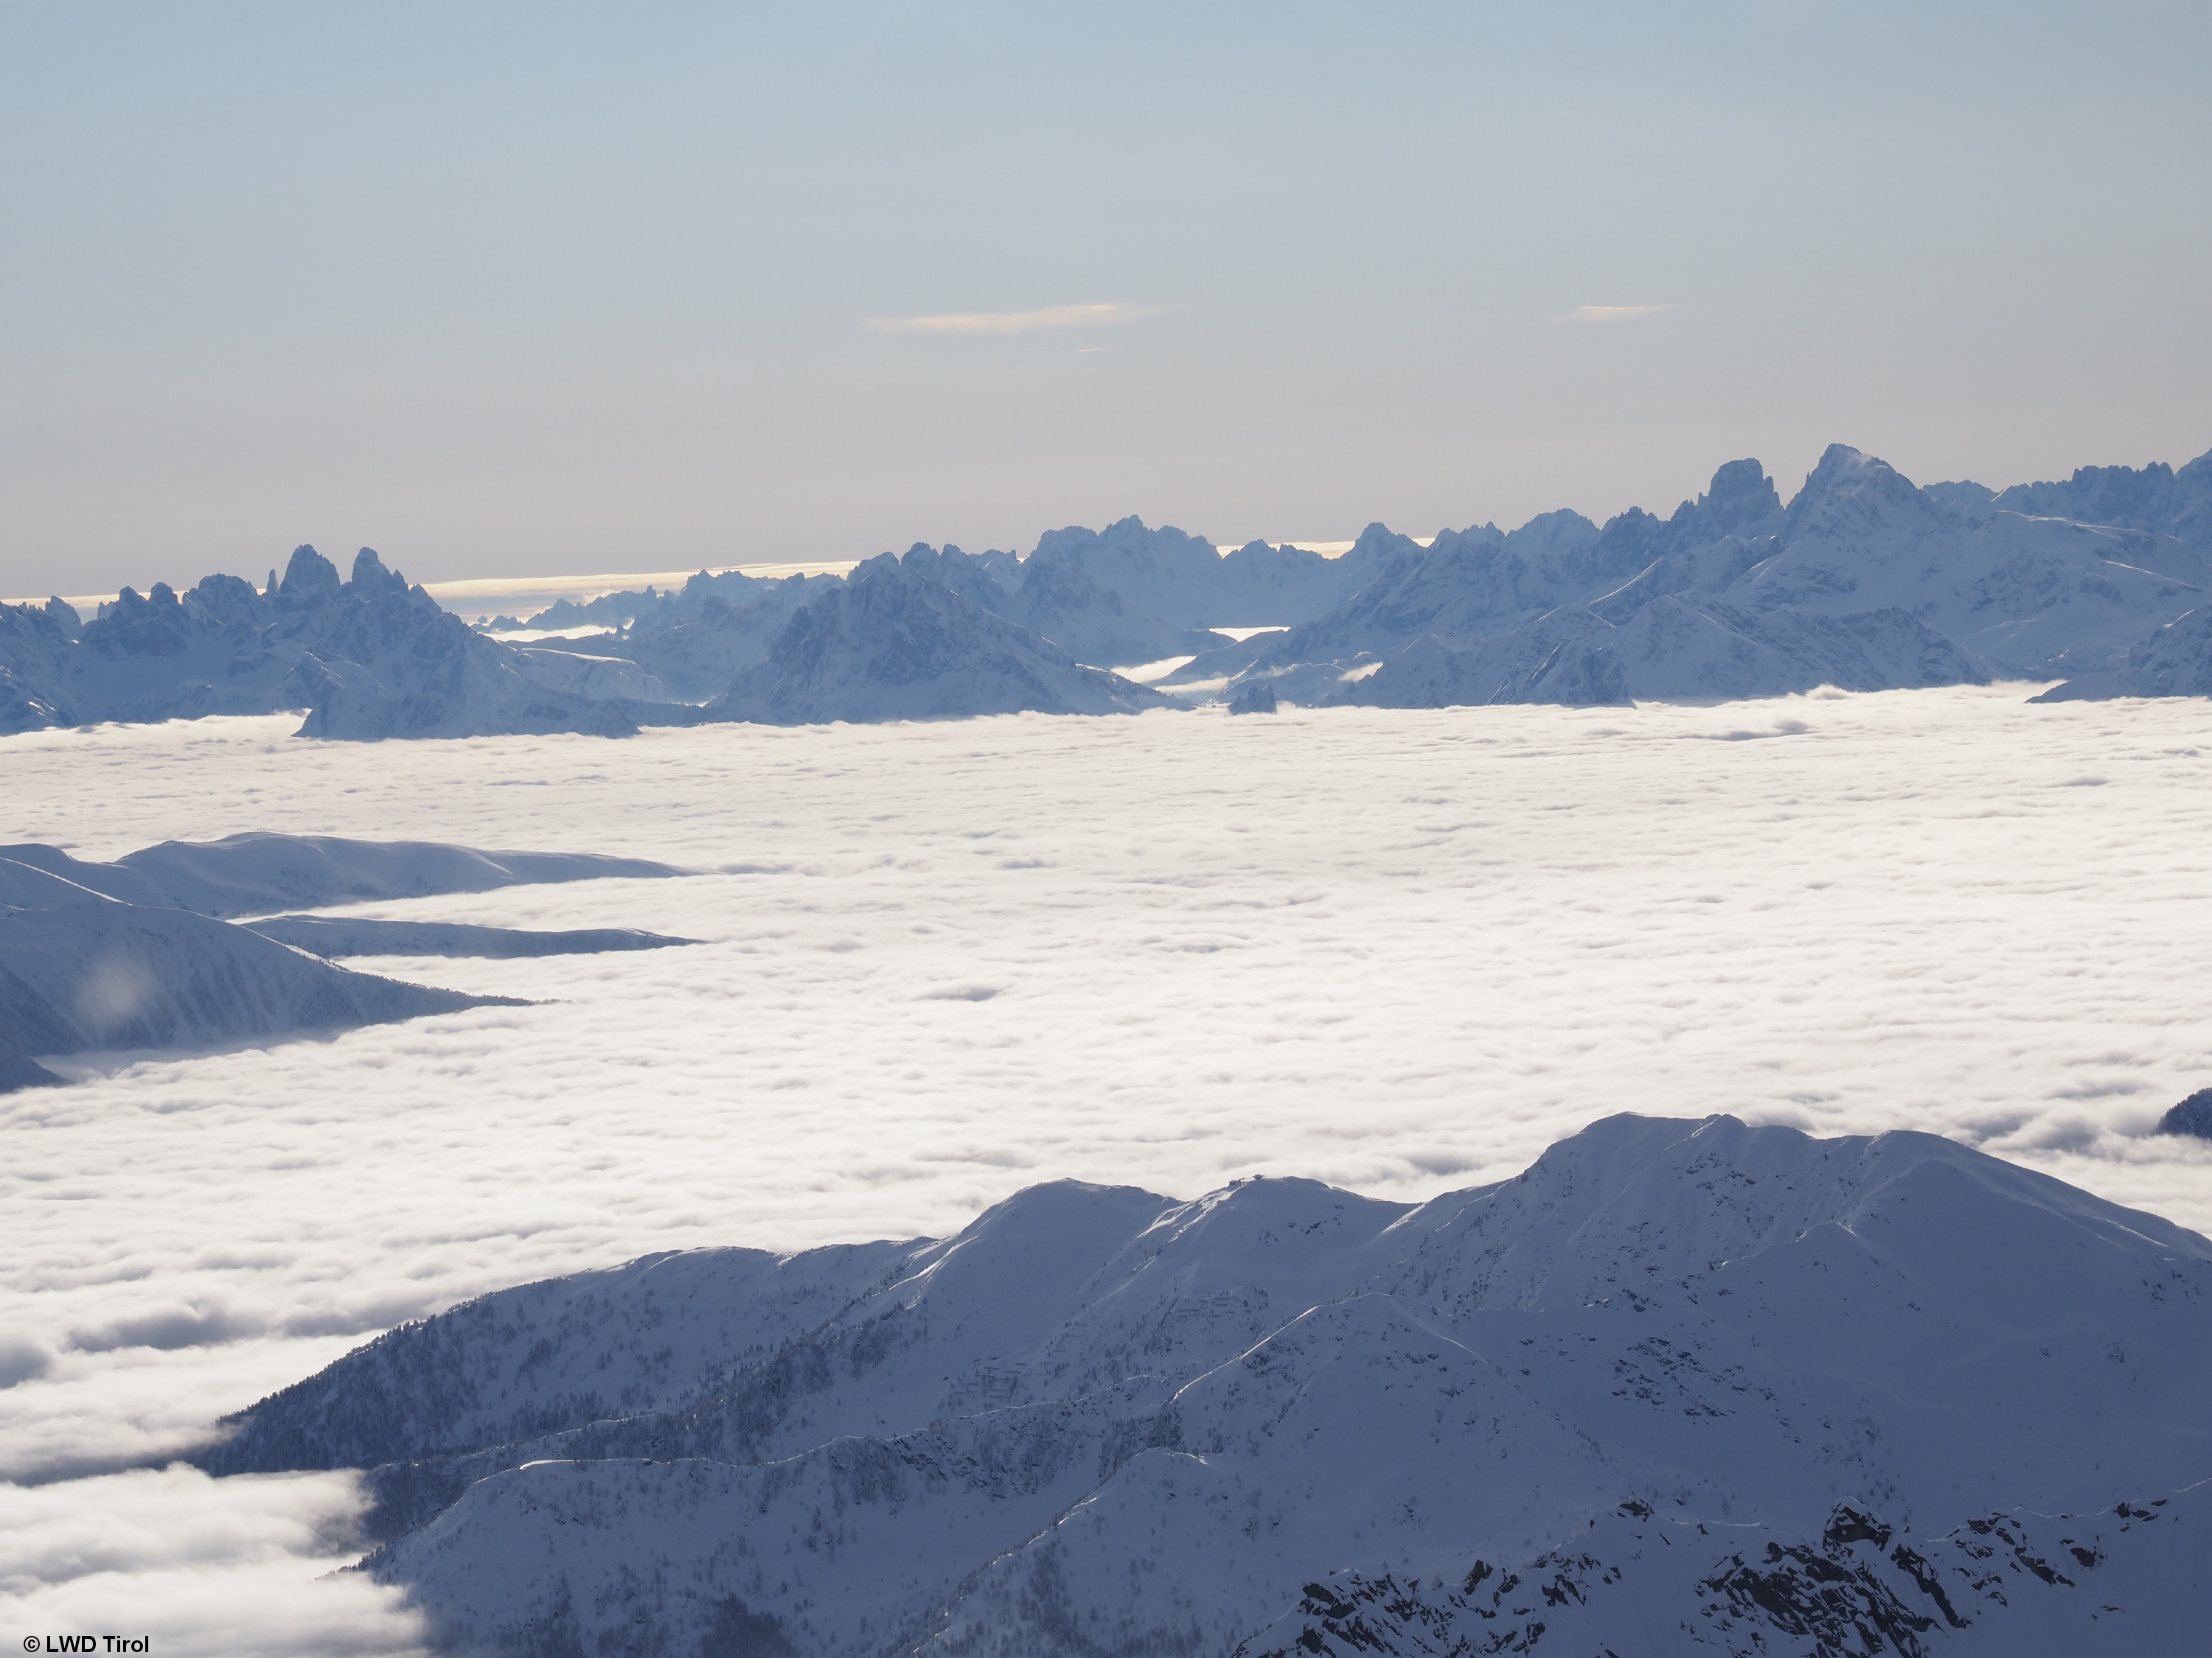
Temperature
Inversion weather conditions
Reverse weather situation
Higher layers of air warmer than lower ones
Cold air collects in valleys/lowlands
© snow institute / LWD Tirol
Notes:
A special case in the distribution of air temperature occurs during a temperature inversion. In this situation, the upper layers of air are warmer than the lower ones. This reversed weather pattern often develops in the autumn and winter months, when cold air collects in valleys and low-lying areas. As a result, it is cloudy and cold in the valleys, while conditions on the mountains are sunny and mild.
During winter high-pressure systems, an inversion can persist for several days.
In such cases, checking a webcam is a good way to better assess the conditions in the mountains.

Slide 16
01 The meaning of ‘weather’
02 Radiation
03 Temperature
04 Air pressure
05 Wind
06 Air humidity
07 Precipitation

Slide 17
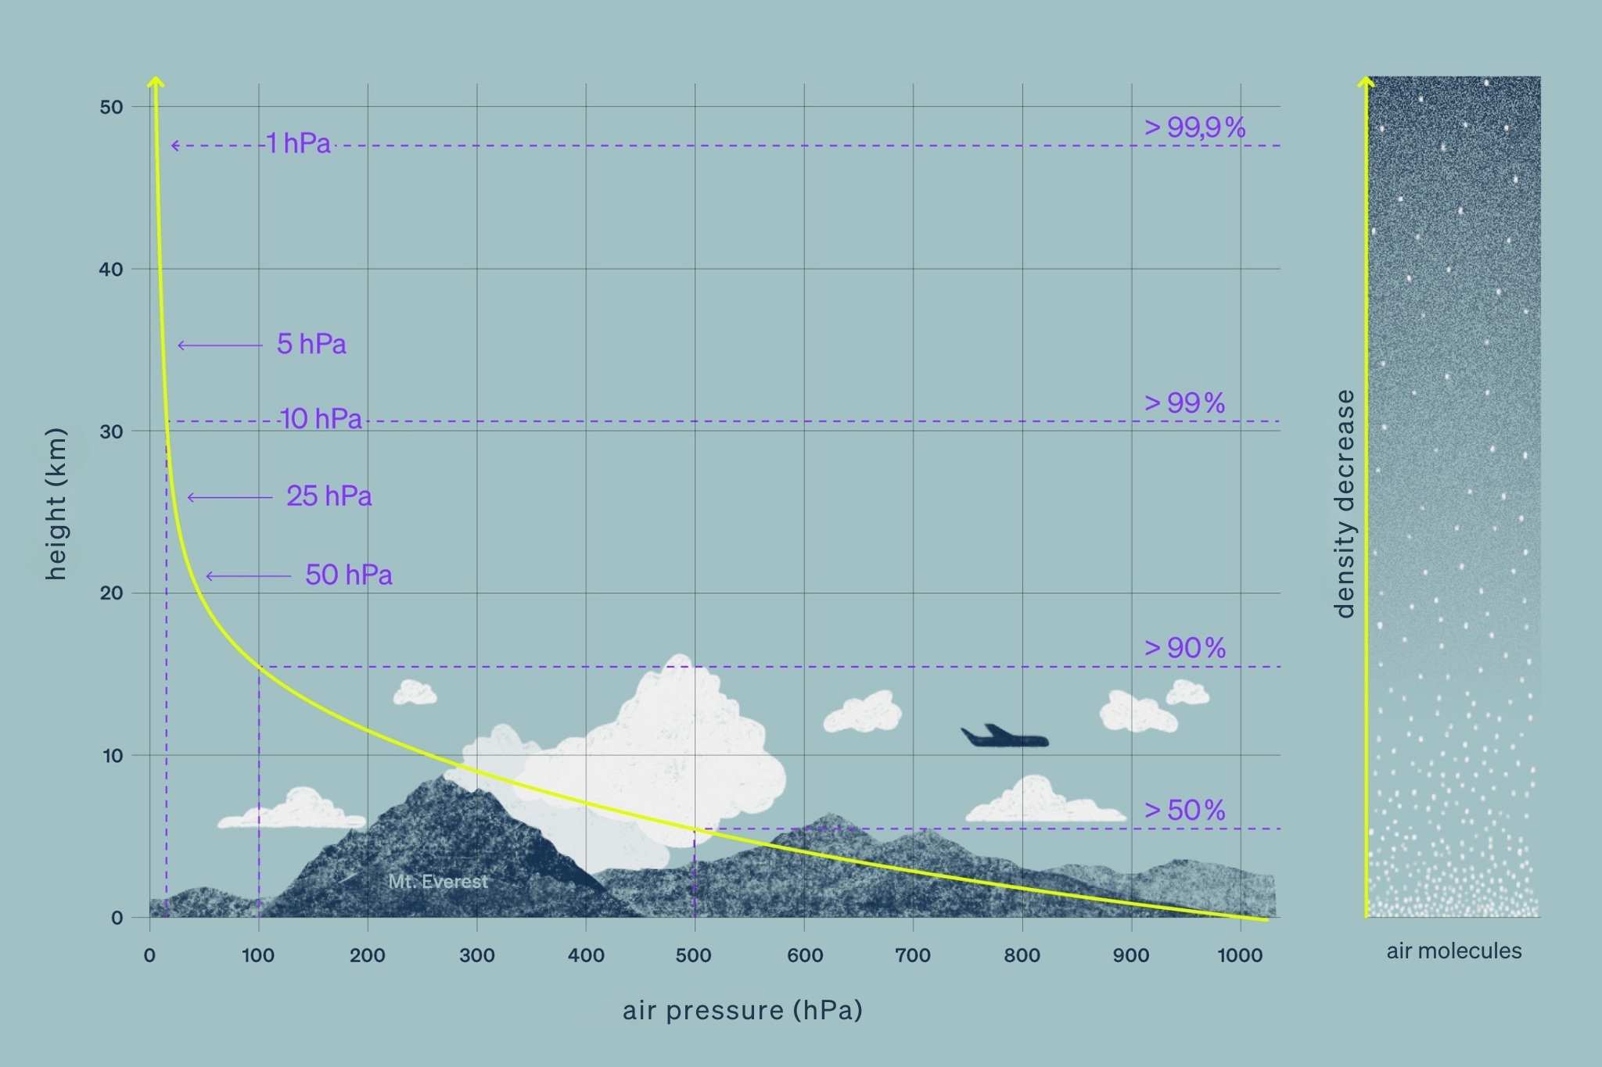
Air pressure
Weight of air on a specific surface area
Indicated in hPa or mbar (1 hPa = 1 mbar)
© snow institute

Slide 18
Air pressure
Air pressure decrease with altitude
The same volume of air contains fewer air particles
Air pressure at sea level:
1013 hPa
For weather forecasts: air pressure at 1500 m of 850 hPa
Horizontal air pressure change
© snow institute
Notes:
The average air pressure at sea level is 1013 hPa, which corresponds to the pressure exerted by a 10-meter-high column of water. Meteorologists usually use the altitude where the air pressure is 850 hPa for forecasts and analyses, which is approximately at 1,500 meters above sea level.
Air pressure is not only dependent on altitude but also changes horizontally. The large-scale distribution of air pressure determines the current weather situation, which is why changes in weather are often associated with changes in air pressure.
At high altitudes above 2,500 meters, air pressure decreases exponentially. This means that in the same amount of air we breathe, fewer air molecules are present. As a result, our body has to work harder (e.g., faster and deeper breathing) to take in the required amount of oxygen.

Slide 19
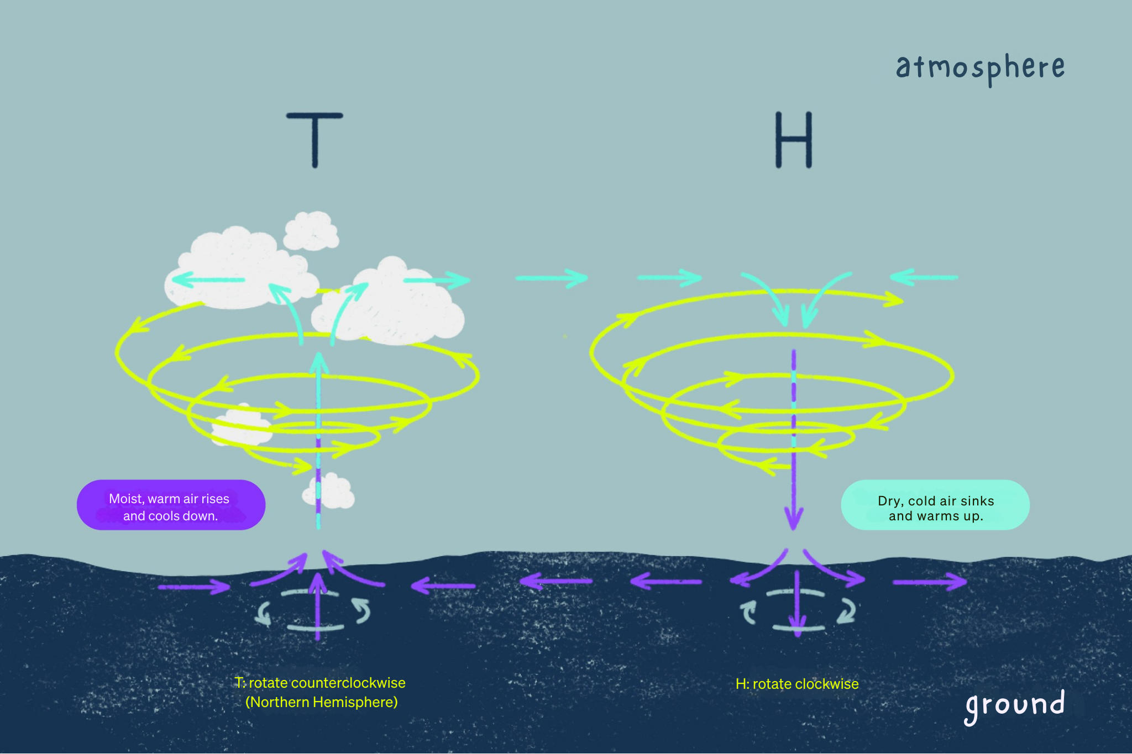
Air pressure : High and low pressure areas
Air pressure distribution
Has a significant influence on weather conditions
Position of high and low pressure areas
© snow institute
Notes:
Low-pressure systems form when incoming solar radiation heats the air. Warm air expands, becomes less dense compared to the surrounding air, and rises. As the air masses warm up, they can hold more water vapor, which is carried upward. When this moist air cools down, clouds form.
For this reason, low-pressure systems are often associated with cloudy and rainy weather.
High-pressure systems form when cold air masses sink due to their higher density. High-pressure areas are often associated with fair weather because the sinking air warms and dries, causing clouds to dissipate.
The positions of high- and low-pressure systems shape the overall weather conditions.

Slide 20
01 The meaning of ‘weather’
02 Radiation
03 Temperature
04 Air pressure
05 Wind
06 Air humidity
07 Precipitation

Slide 21
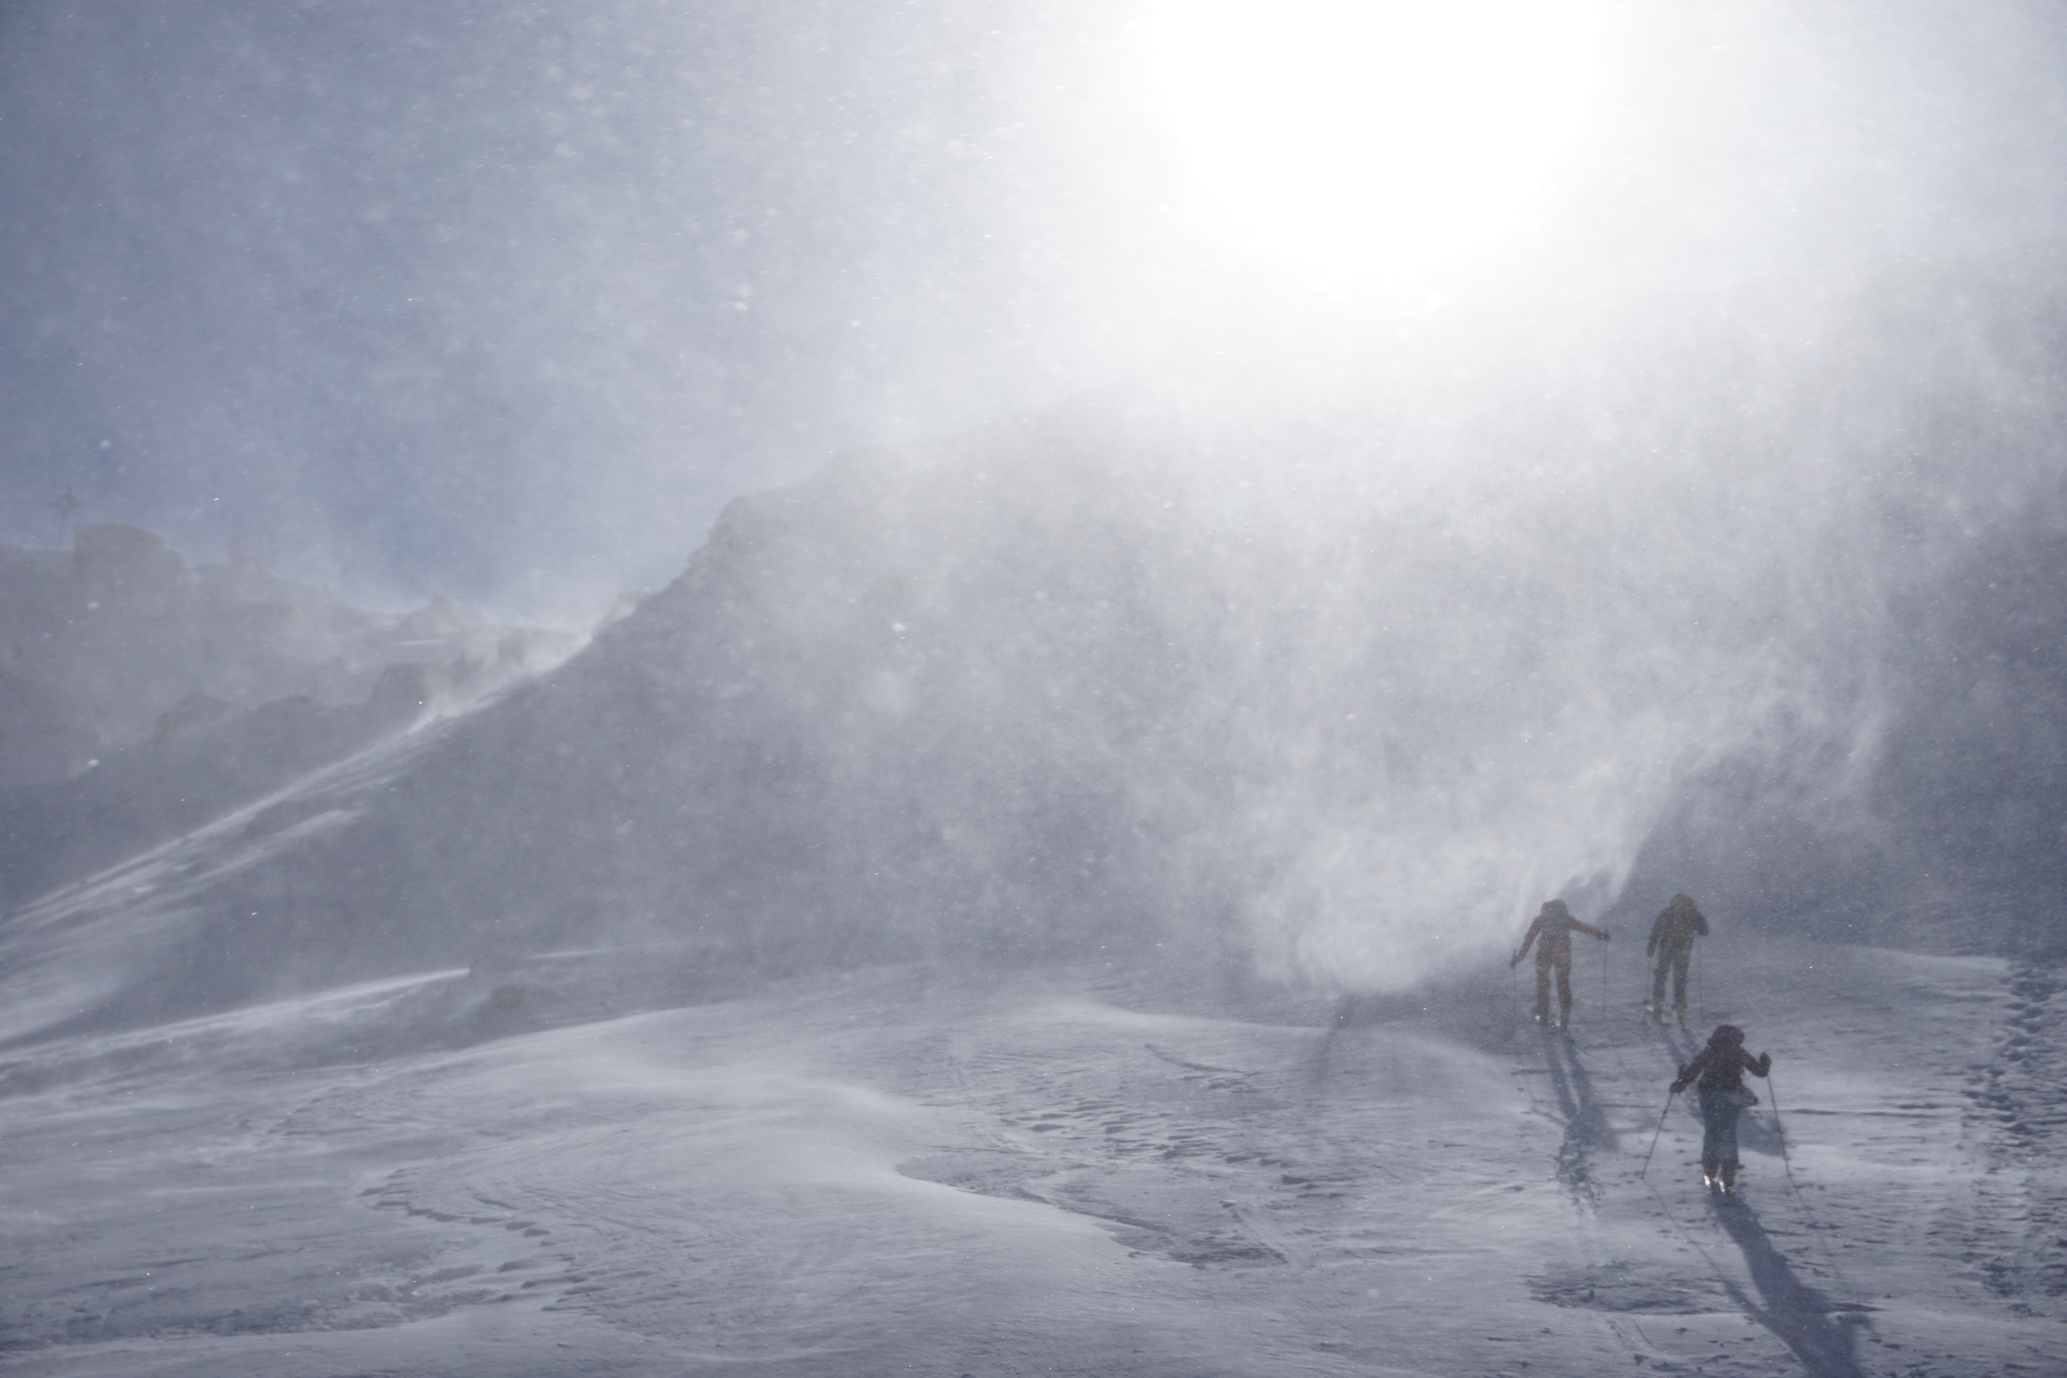
Wind
How is wind created?
Warming of the Earth's surface and the surrounding air
Rising and sinking air masses
Different air pressures
© snow institute / argonaut.pro
Notes:
A key factor in the formation of wind is the warming of the Earth's surface and the surrounding air by the sun. Warm air rises and cools down. In colder areas, cold, dry air masses sink. This creates differences in air pressure. To balance these pressure differences, air flows from areas of high pressure to areas of lower pressure. This movement of air layers results in wind. Colder air flows toward places where warm air is rising.

Slide 22
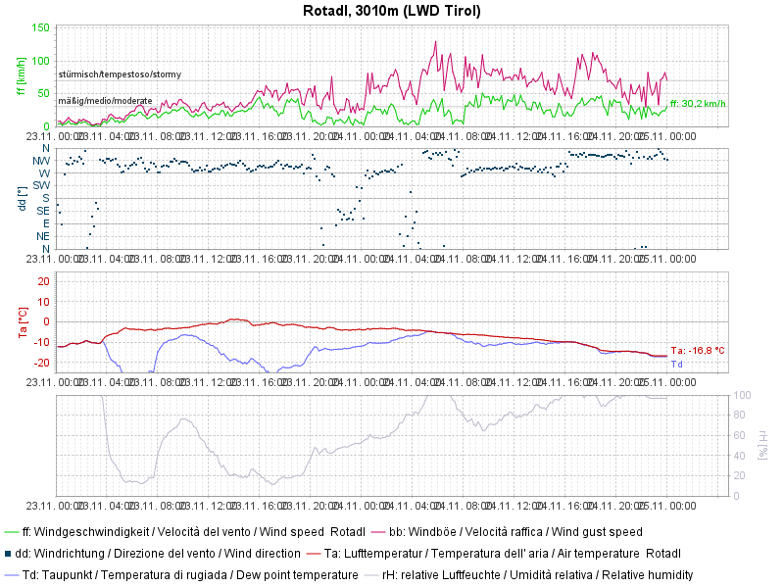
Wind
Influence of relief on winds
Increase in wind speed with altitude
Exception: Passes and gaps → jet effect
Wind direction in the valley ≠ wind direction in the mountains
© LWD Tirol
Notes:
Wind speed increases with height due to surface friction, which is why it is generally windier on mountains than in valleys. An exception to this are certain passes and saddles, where the so-called “venturi effect” can cause it to be windier there than on the peaks. This happens because the wind tries to flow around obstacles like mountains and looks for lower passages (passes, saddles).
The mountain terrain can have various effects on the wind due to its relief and exposure. It can accelerate the wind, redirect it, or disrupt its laminar flow, causing turbulence. Therefore, the main wind directions at higher altitudes in the mountains can differ from the winds forecasted in the valley systems.
At higher altitudes above the ground, airflow is usually laminar, meaning smooth and steady. However, the airflow can become turbulent due to the uneven surfaces of mountains. When winds hit obstacles like mountains, the wind speed decreases on the lee side (the side sheltered from the wind). Repeated vortices form at this location in the airflow. These vortices can be noticed as sudden gusts of wind. Although the wind speed on the lee side is lower than on the windward side (the side facing the wind), gustiness is increased there.
Graphic: The arrow points to the measurement at the Rotadl weather station on the Stubai Glacier. The green line shows wind speed, and the pink line shows wind gusts, which are significantly stronger but not constant. Weather station measurements are publicly available and are the most important source of information about the wind when planning a day in the mountains.
For Tirol available at: Lawinen.report Austria and South Tyrol: LAWIS

Slide 23
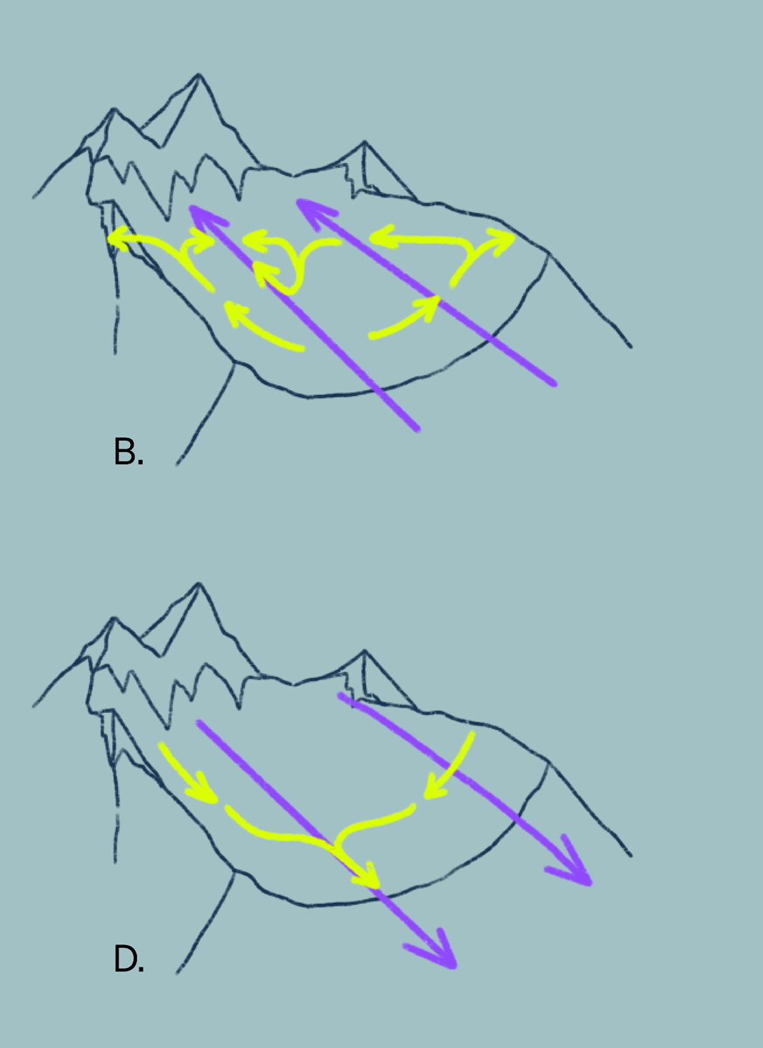
Wind
Mountain and valley wind system
Sunrise: warming of the air near the slope → upwind
During the morning: compensatory currents → valley wind
Sunset: Upwind and downwind come to a standstill.
After a brief standstill → reversal of the wind system → downslope breeze and mountain wind
© snow institute
Notes:
Mountain and valley wind circulation are thermally driven wind systems that occur in mountainous areas due to horizontal temperature differences.
-After sunrise, the ground warms up strongly, causing the air near the slopes to warm more than the air farther away. This leads to upslope winds in the morning.
-To replace these rising air masses, compensating air flows from the plains into the valleys occur — the valley wind.
-Around sunset (or shortly before), the upslope and valley winds die down. After a short pause, the wind system reverses.
-The mountain slopes radiate heat and cool down faster than the air over the valley. The cool, denser air sinks and flows down the slopes — the downslope wind.
-The cool air from the surrounding slopes gathers in the valley bottom and then gradually starts to flow down the valley — the mountain wind. This wind again comes to a stop at sunrise.
Wind direction describes where the wind comes from, for example: Valley wind = wind coming into the valley West wind = wind coming from the west

Slide 24
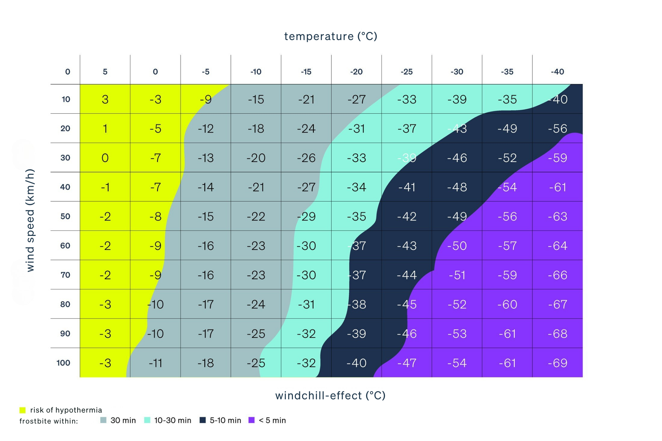
Wind
Windchill-effect
The perceived temperature decreases as the wind increases.
© snow institute
Notes:
The wind chill factor shows how temperature and wind affect our skin and body. Everyone knows the feeling that wind cools us down. While this can be pleasant on hot days, it becomes very uncomfortable and even dangerous in cold weather.

Slide 25
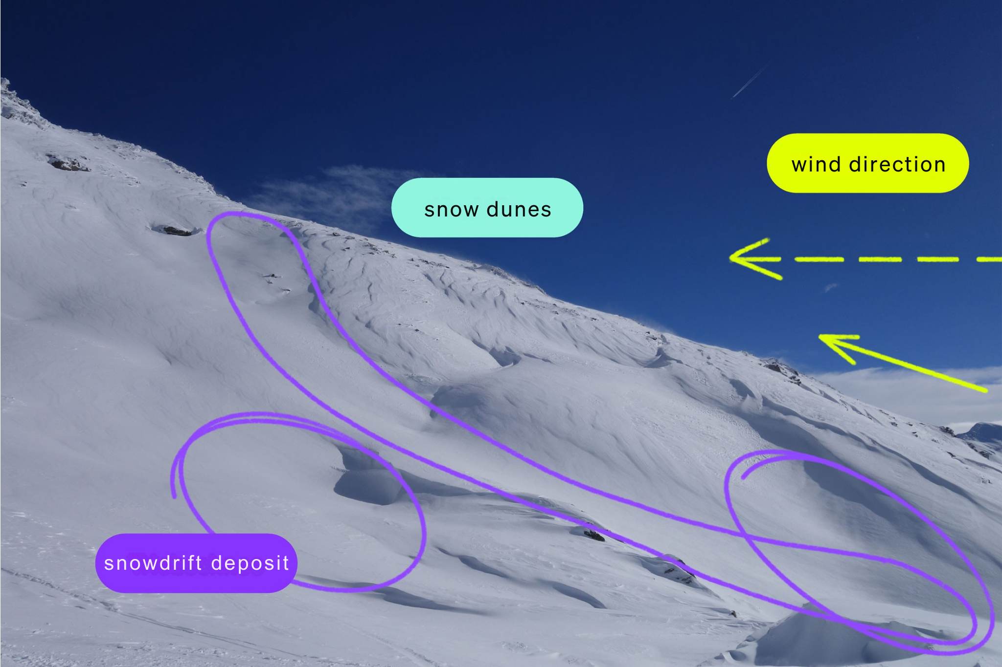
Wind
Wind signs in the snow
Wind also has a strong influence on the snow cover in high mountains
Transportation of loose snow
LUV – windward side
LEE – leeward side
© snow institute / argpmait.pro
Notes:
The snow cover is a true master of transformation. Sometimes you sink hip-deep into it, other times you stand on it without breaking through. Impressive, imposing snow cornices show how strongly the wind shapes the snow cover in high mountain areas. Due to the influence of the wind, not only does the amount of snow on a given area change, but also the layering and density of the snow layers. Usually, these constant changes remain hidden from the outside. Not only the already deposited snow, but also the falling snow is shaped by the wind. Especially with loose, dry snow, the wind always causes drifting. Wind slabs form on the windward side (luv), and wind-drifted snow deposits form on the leeward side (lee). Snow is also blown off ridges and crests and then deposited again in gullies and hollows.

Slide 26
01 The meaning of ‘weather’
02 Radiation
03 Temperature
04 Air pressure
05 Wind
06 Air humidity
07 Precipitation

Slide 27
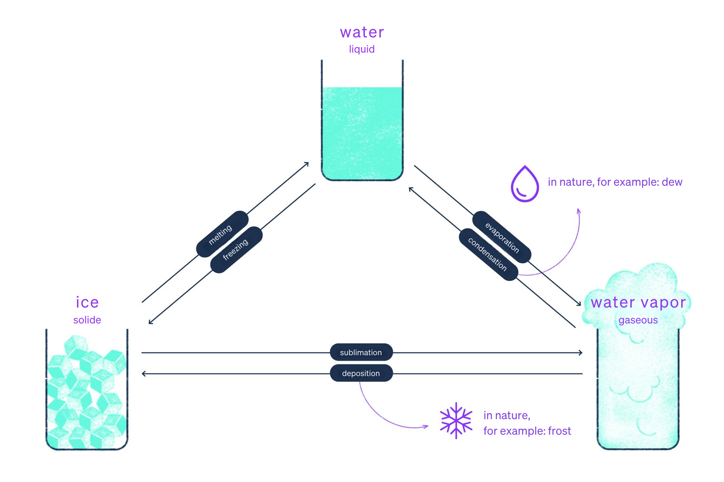
Air humidity
Water in the atmosphere
3 physical states
Water vapour content in the air = temperature-dependent
© snow institute
Notes:
Water occurs in the atmosphere in three different forms (states of matter): gaseous (water vapor), liquid, and solid. The amount of water vapor that air can hold is highly dependent on temperature—cold air cannot hold as much water vapor as warm air. Knowing the level of humidity and whether and when saturation and condensation occur is particularly interesting for winter sports enthusiasts. There are two ways to express humidity.

Slide 28
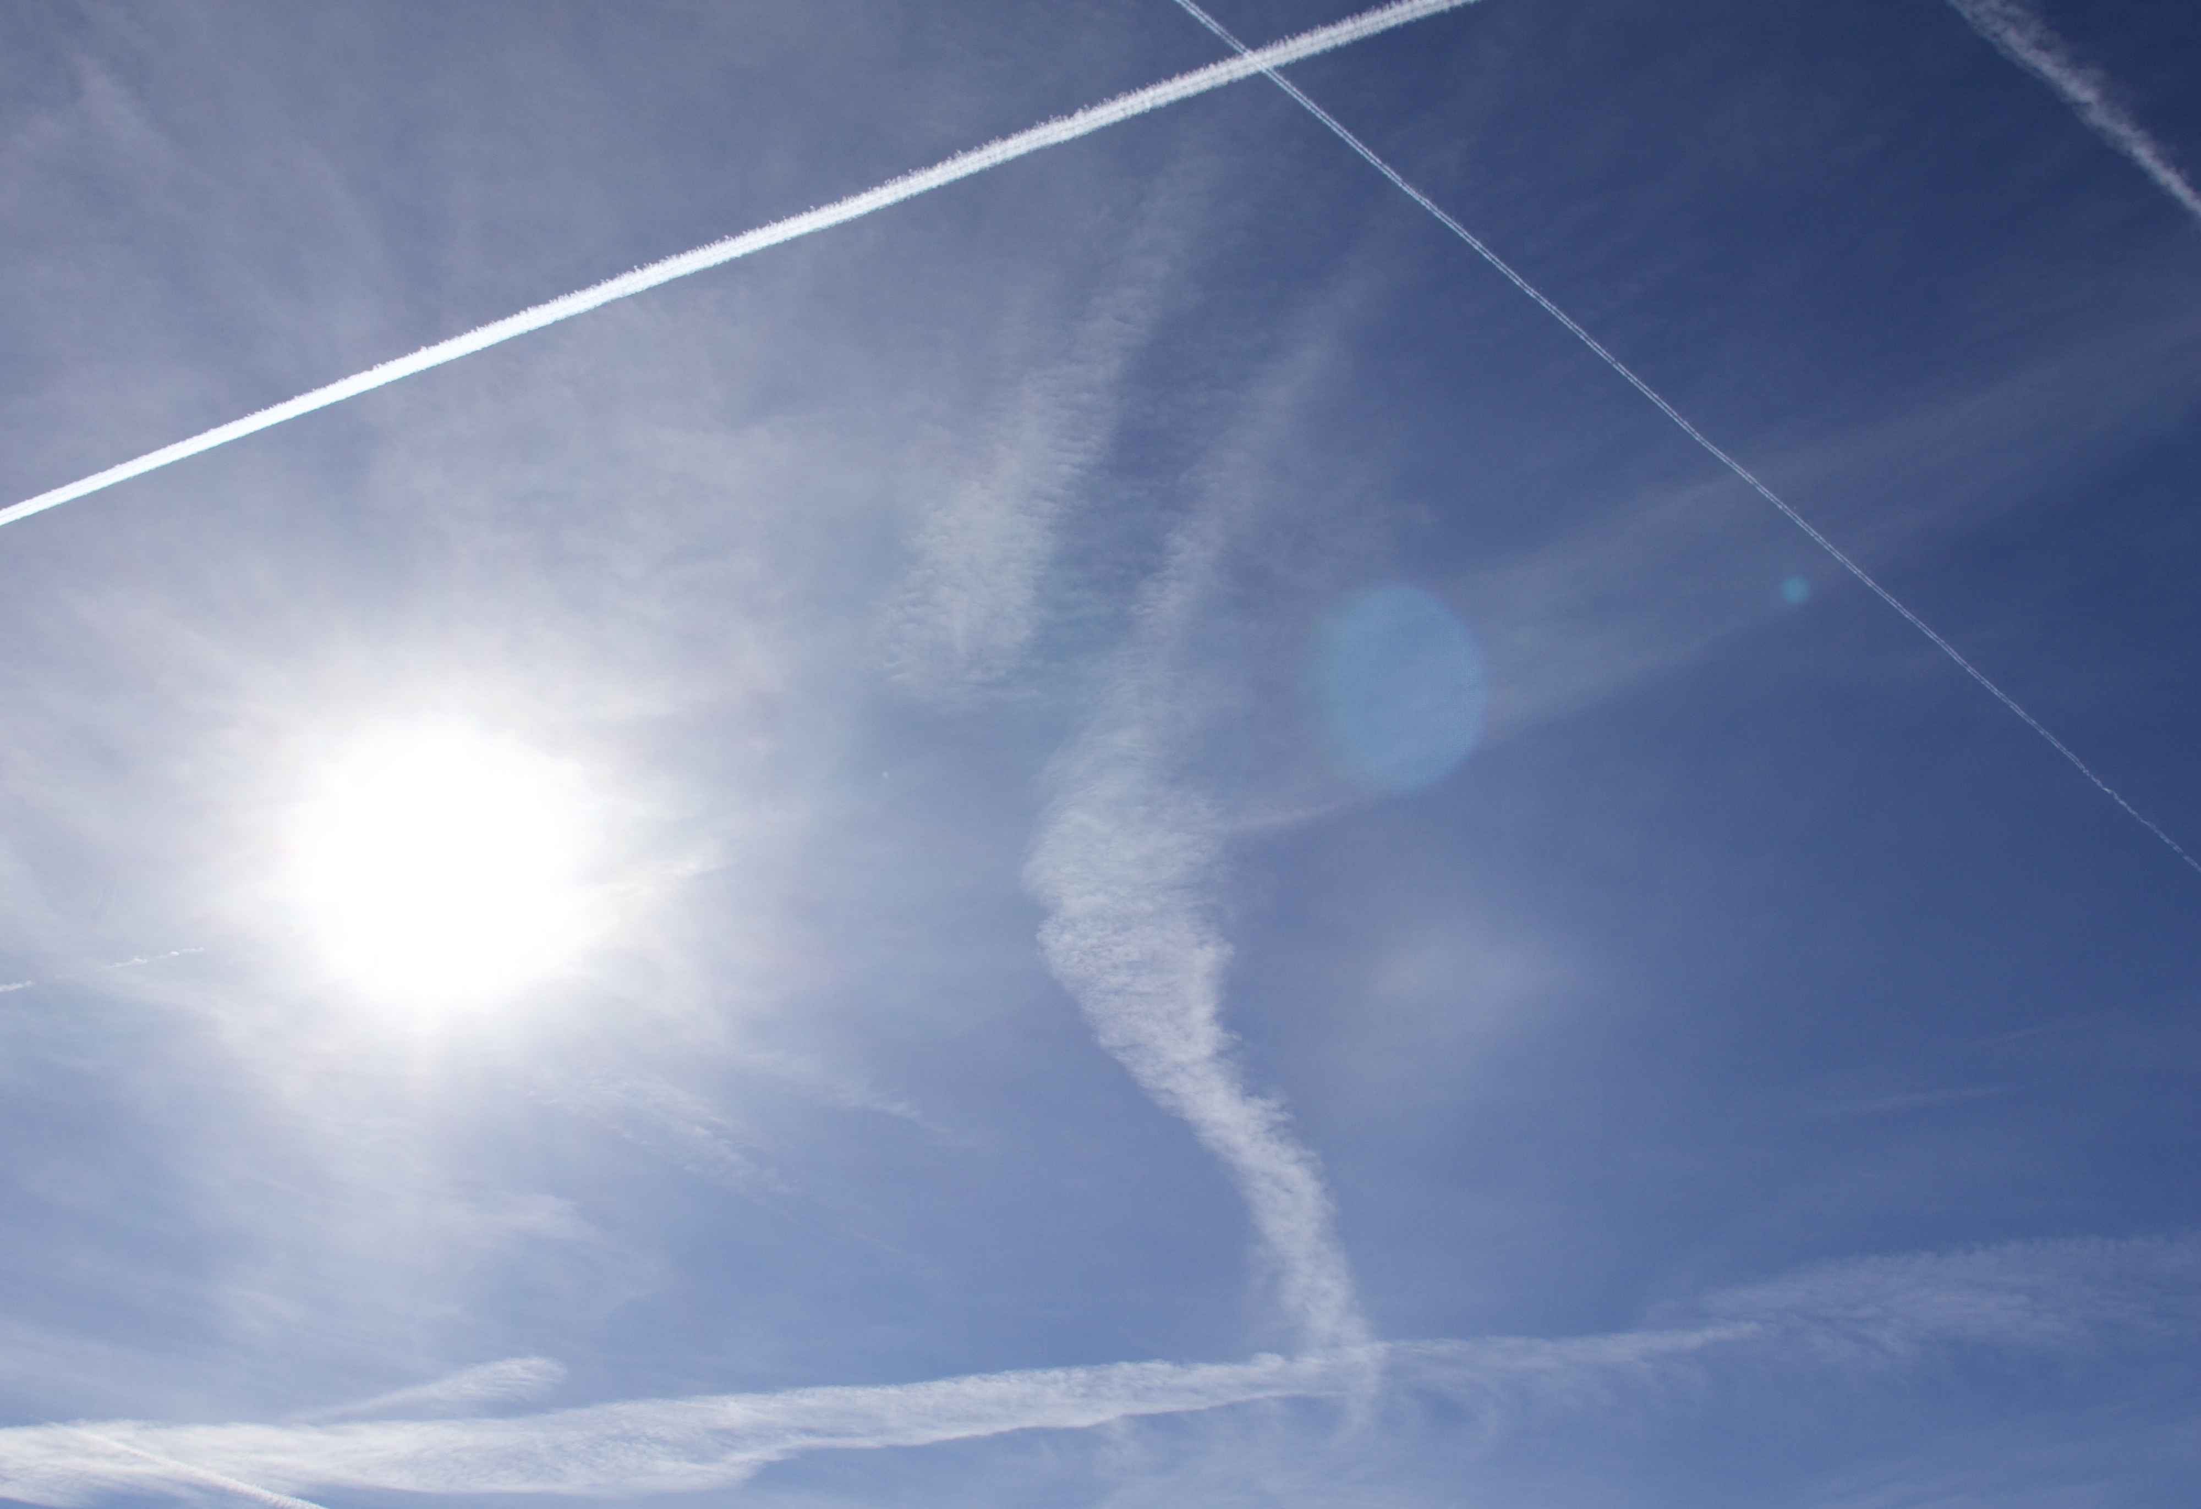
Air humidity
Describe air humidity
Relative humidity:
Percentage of the maximum capacity of water vapour in the air
Air is saturated = 100% relative humidity
© snow institute / argonaut.pro
Notes:
Relative humidity indicates what percentage of the air's absorption capacity has been reached – if we talk about 100 percent relative humidity, the air is saturated and cannot absorb any more. At 50 percent relative humidity, the reservoir is half full, so to speak, and can be increased either by adding water vapor (e.g., through evaporation) or by cooling the air.

Slide 29
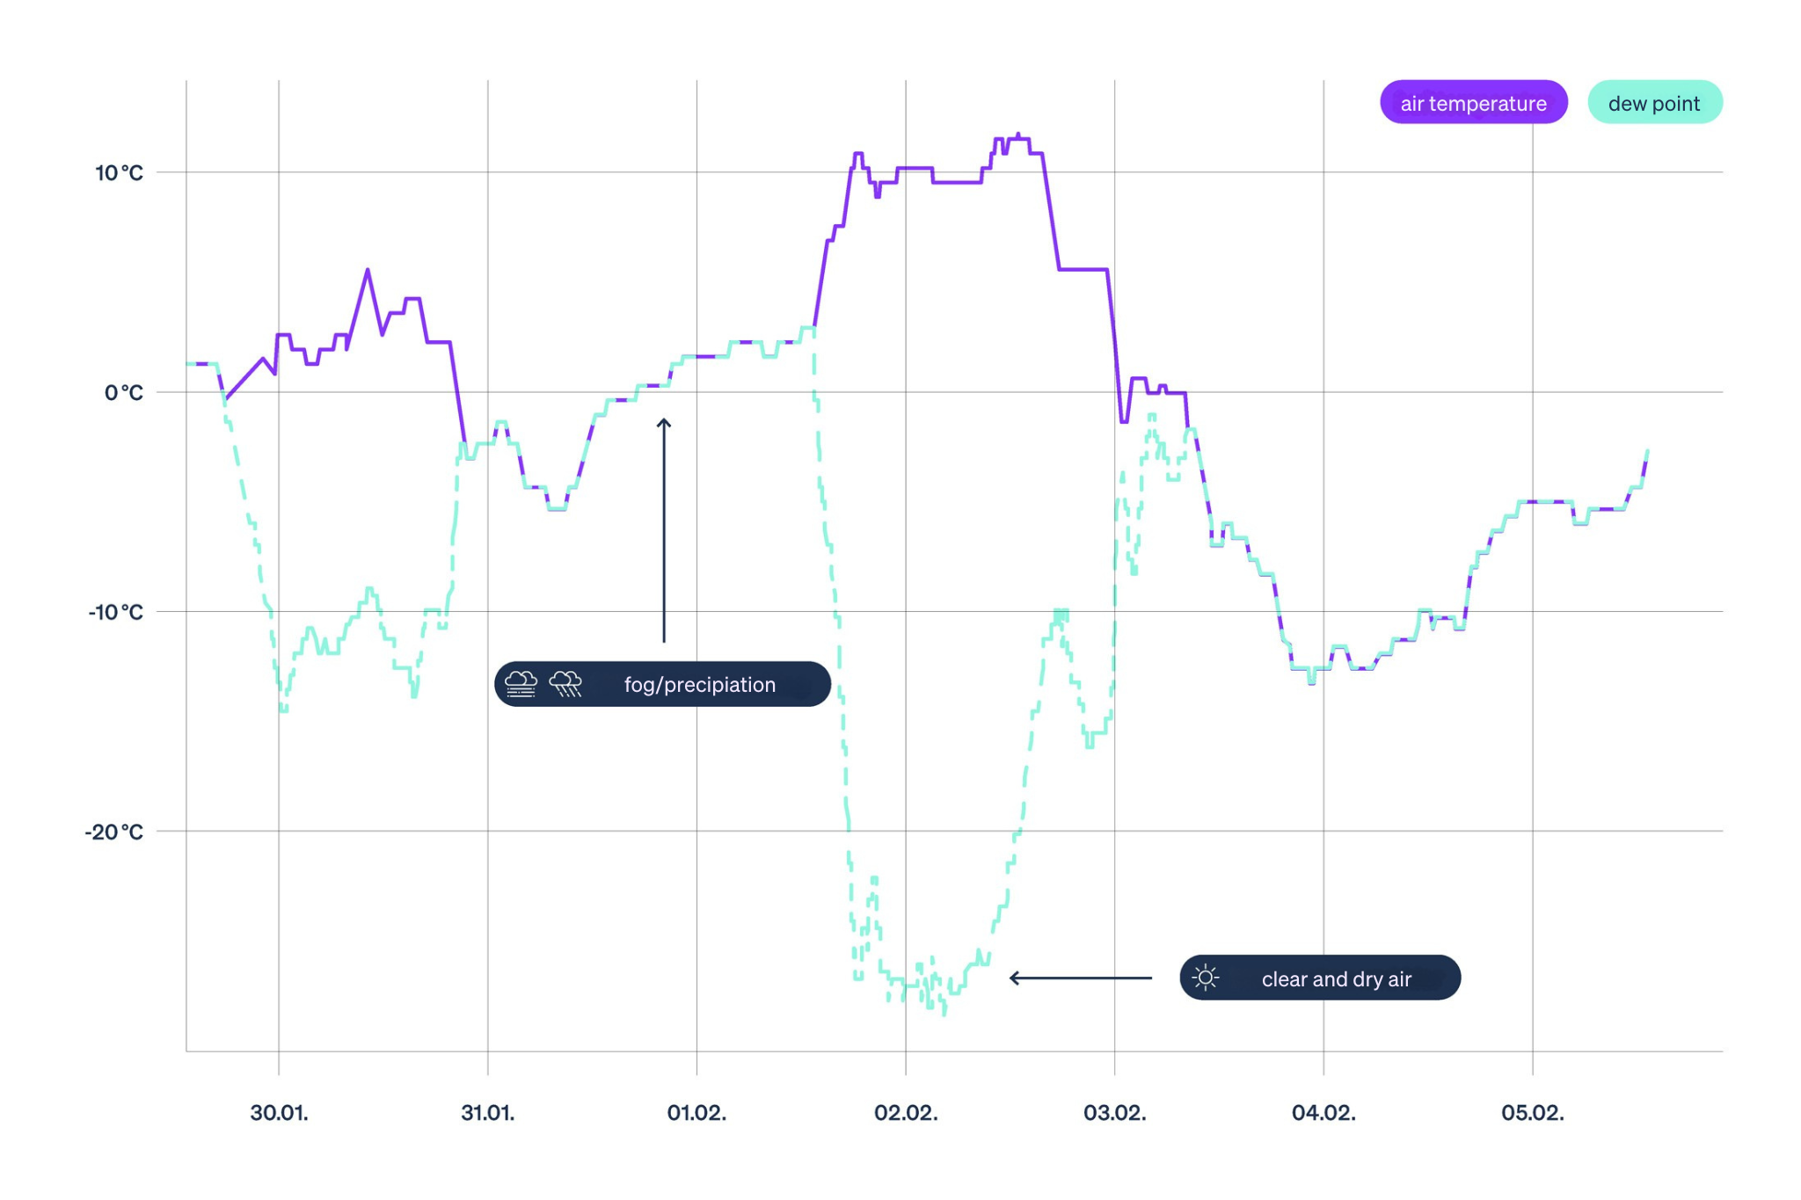
Air humidity
Describe air humidity
Dew point:
Temperature to which an air parcel must be cooled in order for saturation to occur
© snow institute
Notes:
Every air parcel contains water vapor and can be cooled down until the water vapor can no longer be held or saturation occurs. If an air parcel has already absorbed the maximum possible amount of water vapor and continues to cool, condensation takes place. This results in dew or, at air temperatures below 0 °C, frost. Tiny droplets can also form in the air, which we perceive as fog. The temperature at which condensation occurs is called the dew point.
If the dew point is low (below –10 °C), meaning there is little water vapor in the air, the snowpack can radiate strongly (release a lot of energy). For winter sports enthusiasts, this is noticeable as hard slopes or frozen snow surfaces. A high dew point (higher than –5 °C), close to the air temperature, means that the air is (almost) saturated and fog, snow, or rain may occur.

Slide 30
01 The meaning of ‘weather’
02 Radiation
03 Temperature
04 Air pressure
05 Wind
06 Air humidity
07 Precipitation

Slide 31
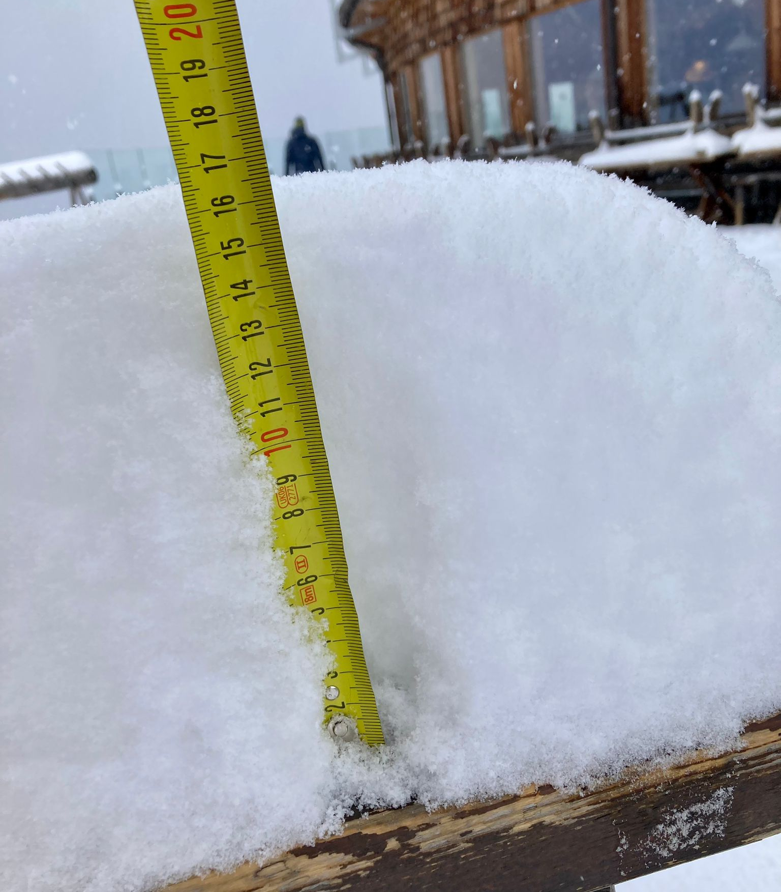
Precipitation
Amount of precipitation
Specified in mm or l
Liquid precipitation per square metre
Time period decisive
© snow institute / LWD Tirol
Notes:
When planning a tour, we closely monitor the precipitation. While in summer people usually hope for sunshine and rain is not considered ideal mountain weather, in winter we eagerly anticipate precipitation in the form of snow (followed, of course, by sunshine). The temperature inside the cloud as well as the air temperature are crucial for snowfall. They determine up to which altitude the precipitation falls as snow crystals—that is, whether it snows. The precipitation forecast can be read from the weather report or seen in precipitation animations. The amount of precipitation is usually described or shown in millimeters and refers to precipitation in liquid form (rain)—but not to the amount of new snow.

Slide 32
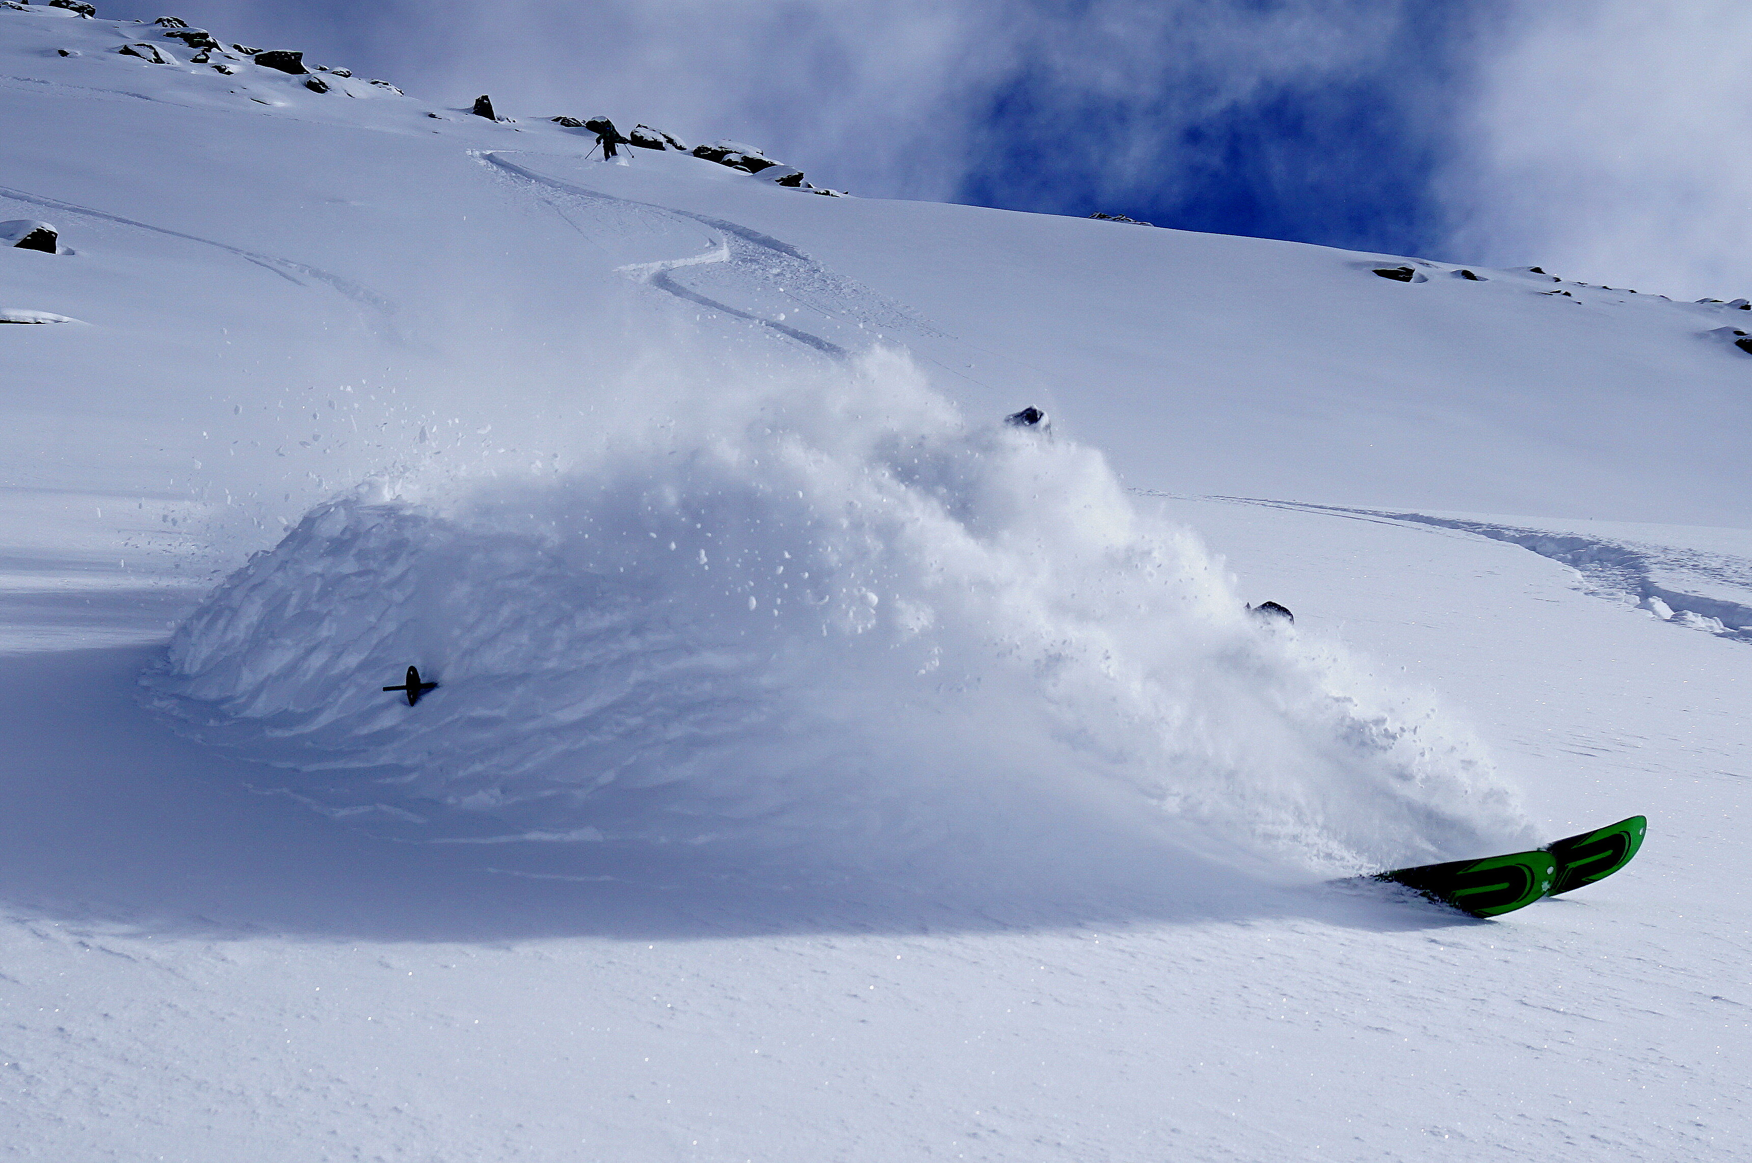
Precipitation
Amount of precipitation
Example:
10 mm precipitation = 10 litres of rain per square metre during the specified period
That would be 10 cm of snow at temperatures around the freezing point
© snow institute / argonaut.pro
Notes:
10 mm of precipitation means that 10 liters of liquid precipitation (rain) fall per square meter. What matters is the time period over which this precipitation is predicted. Does it fall within one hour, or is it spread out over four hours? In winter, it makes a big difference whether new snowfall amounts arrive within a short time or over a longer period.
Snow has a much lower density than liquid water. Therefore, 10 mm of precipitation at around freezing temperature can mean about 10 cm of new snow. If it is very cold and the snow is very powdery (low density), 10 mm of precipitation can correspond to 20 cm of snow or even more at very low densities.

Slide 33
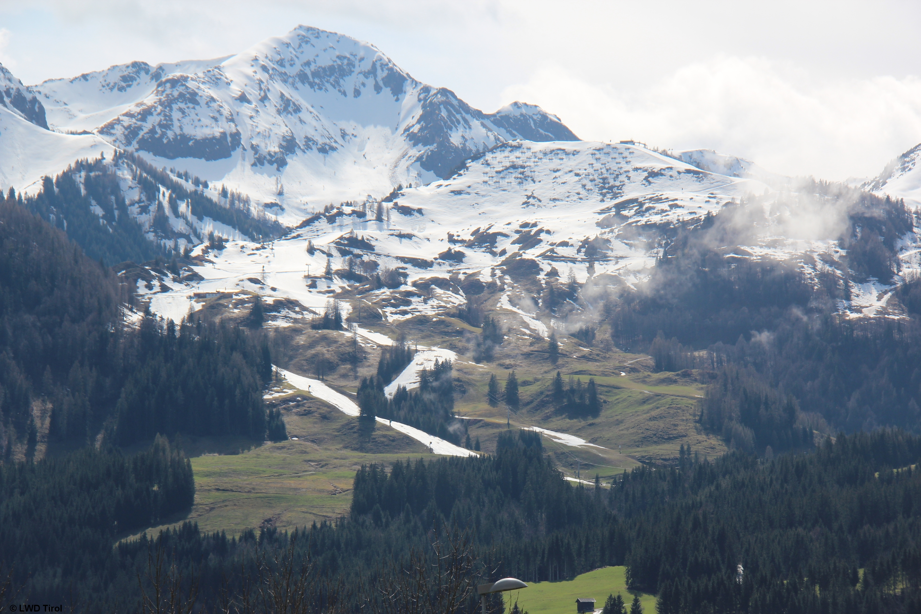
Precipitation
Probability of precipitation
How likely is it that it will actually rain or snow?
Expressed as a percentage
© snow institute / LWD Tirol

Slide 34
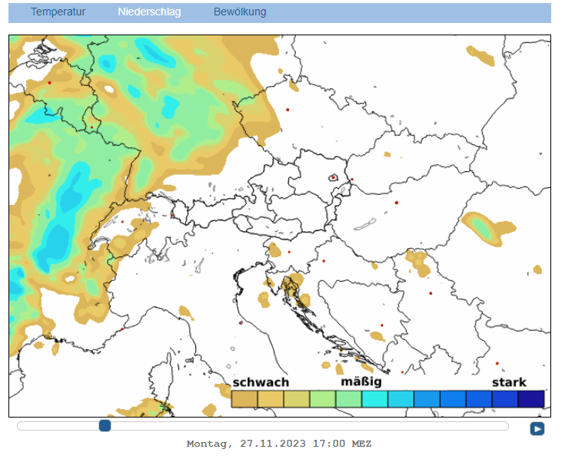
Precipitation
Probability of precipitation
Example:
There is a 20% chance of rain tomorrow.
i.e. in the past, it rained on 2 out of 10 days (=20%) with the same weather conditions.
© snow institute / GeoSphere Austria

Slide 35
Winter is coming!
Notes:
Using weather forecasts is an important part of tour planning. Nowadays, thanks to weather apps, it is very easy to access current weather reports. Of course, there are quality differences between the various products, and different forecast models underlie the respective weather predictions. However, all are more or less reliable. Short-term weather forecasts are generally more accurate than long-term forecasts that extend beyond five days. Therefore, a final weather check should always be done shortly before the tour.

